Slide 1



Notes:
Welcome to Red Ribbon Week 2022 !

Slide 2
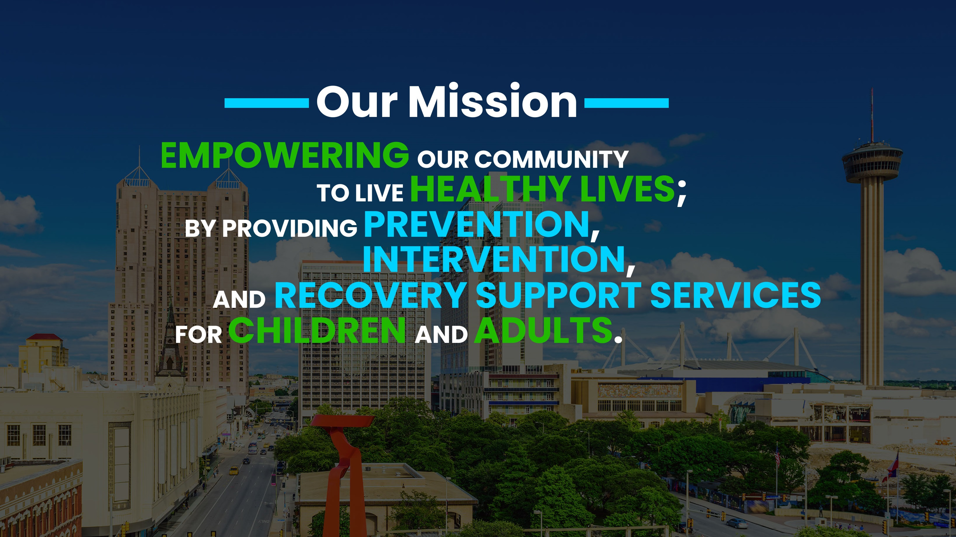
Notes:
My name is ___________________________________, I am a Prevention Specialist with the San Antonio Council on Alcohol and Drug Awareness, known as SACADA.
Our mission at SACADA is: Empowering our community to live healthy lives by providing Prevention, Intervention and Recovery Support Services for Children and Adults.

Slide 3

Being our best selves and making good and healthy decisions!
Notes:
My name is ___________________________________, I am a Prevention Specialist with the San Antonio Council on Alcohol and Drug Awareness
Today we are going to talk about Red Ribbon Week and being our best selves and making good and healthy decisions!

Slide 4
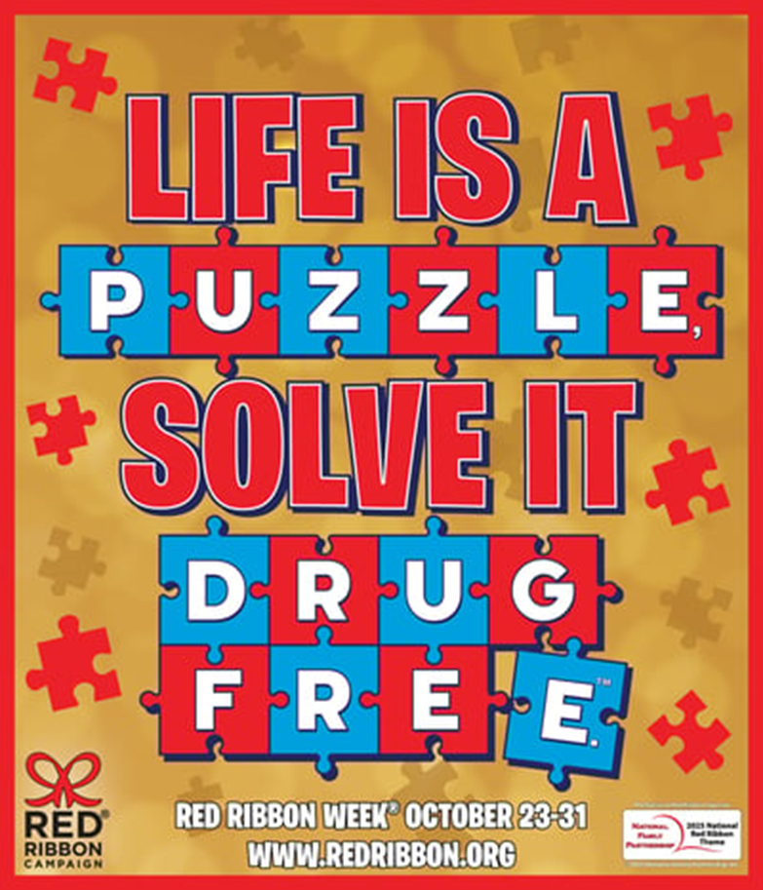

2025 THEME
This year's theme symbolizes how every choice we make fits into the bigger picture—just like a puzzle coming together.
Living drug-free helps build a stronger, brighter future, one piece at a time.
Notes:
Today I’m here to Celebrate Red Ribbon Week 2025! This year’s Red Ribbon Week Theme is LIFE IS A PUZZLE, SOLVE IT FRUG FREE.™
This powerful theme symbolizes how every choice we make fits into the bigger picture—just like a puzzle coming together. Living drug-free helps build a stronger, brighter future, one piece at a time.

Slide 5

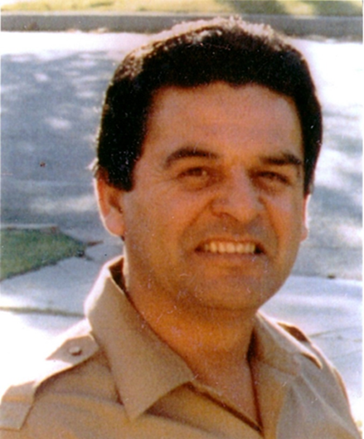
Enrique “Kiki” Camarena 1947-1985
Notes:
Red Ribbon week honors the memory of Enrique “Kiki” Camarena. He was very concerned about the drug problem in this country and wanted to make a difference by helping the people that he cared about.
After his passing, “parents and youth in communities across the country began wearing Red Ribbons as a symbol of their commitment to raise awareness of the destruction caused by drugs in America”

Slide 6

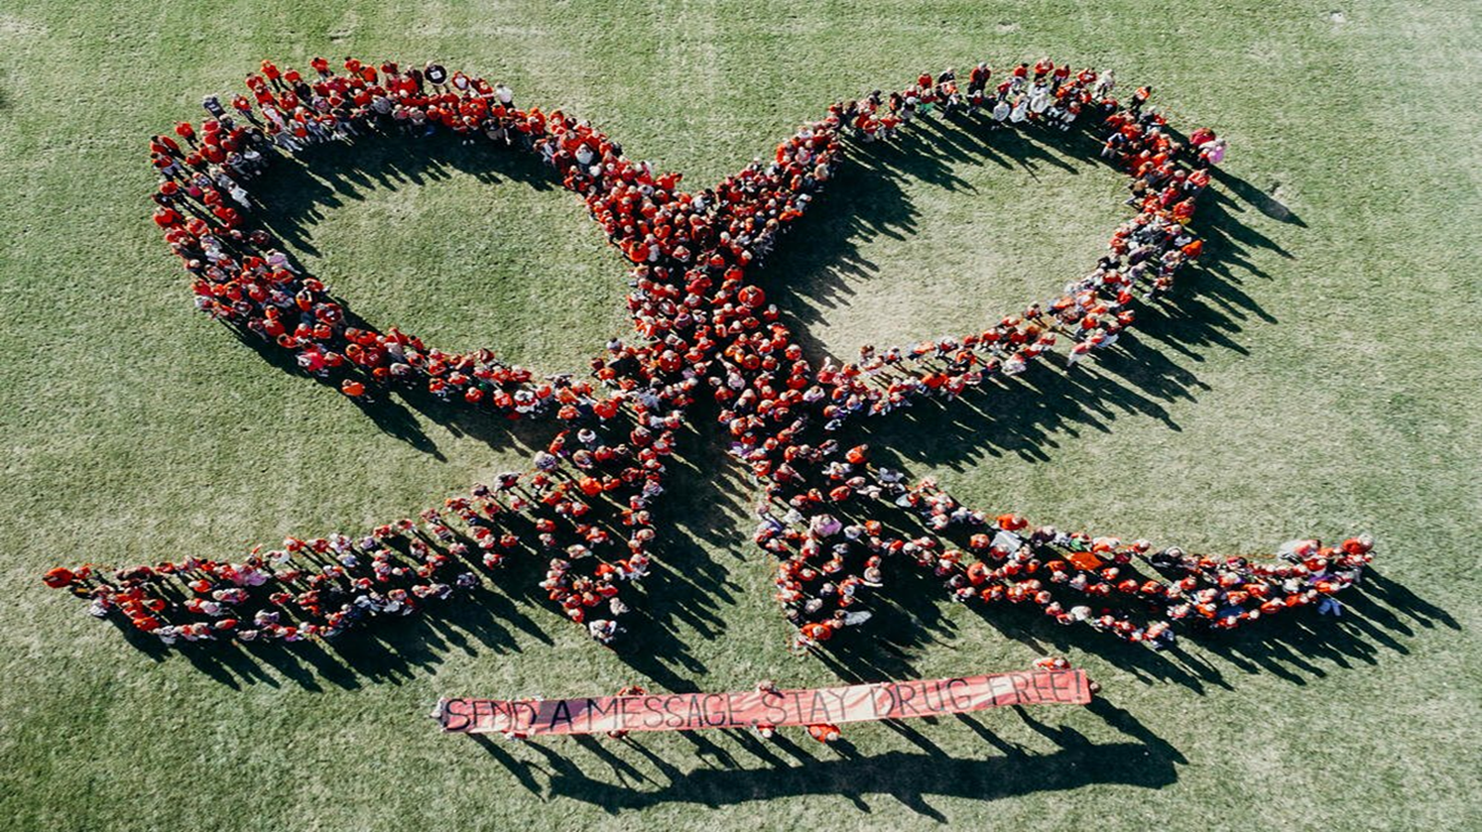
Drug Prevention Awareness Program
Notes:
We honor the memory of Officer Camarena by celebrating Red Ribbon Week
*Click* which is the nation’s oldest and largest Drug Prevention Awareness Program
During Red Ribbon Week we also talk about making good decisions and living a healthy life!

Slide 7
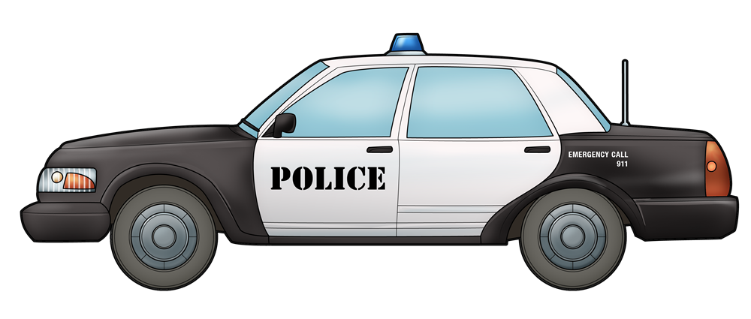
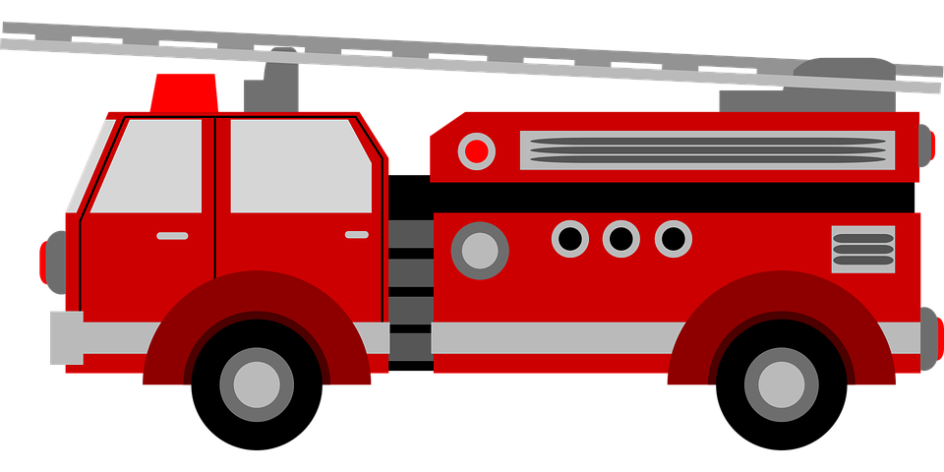
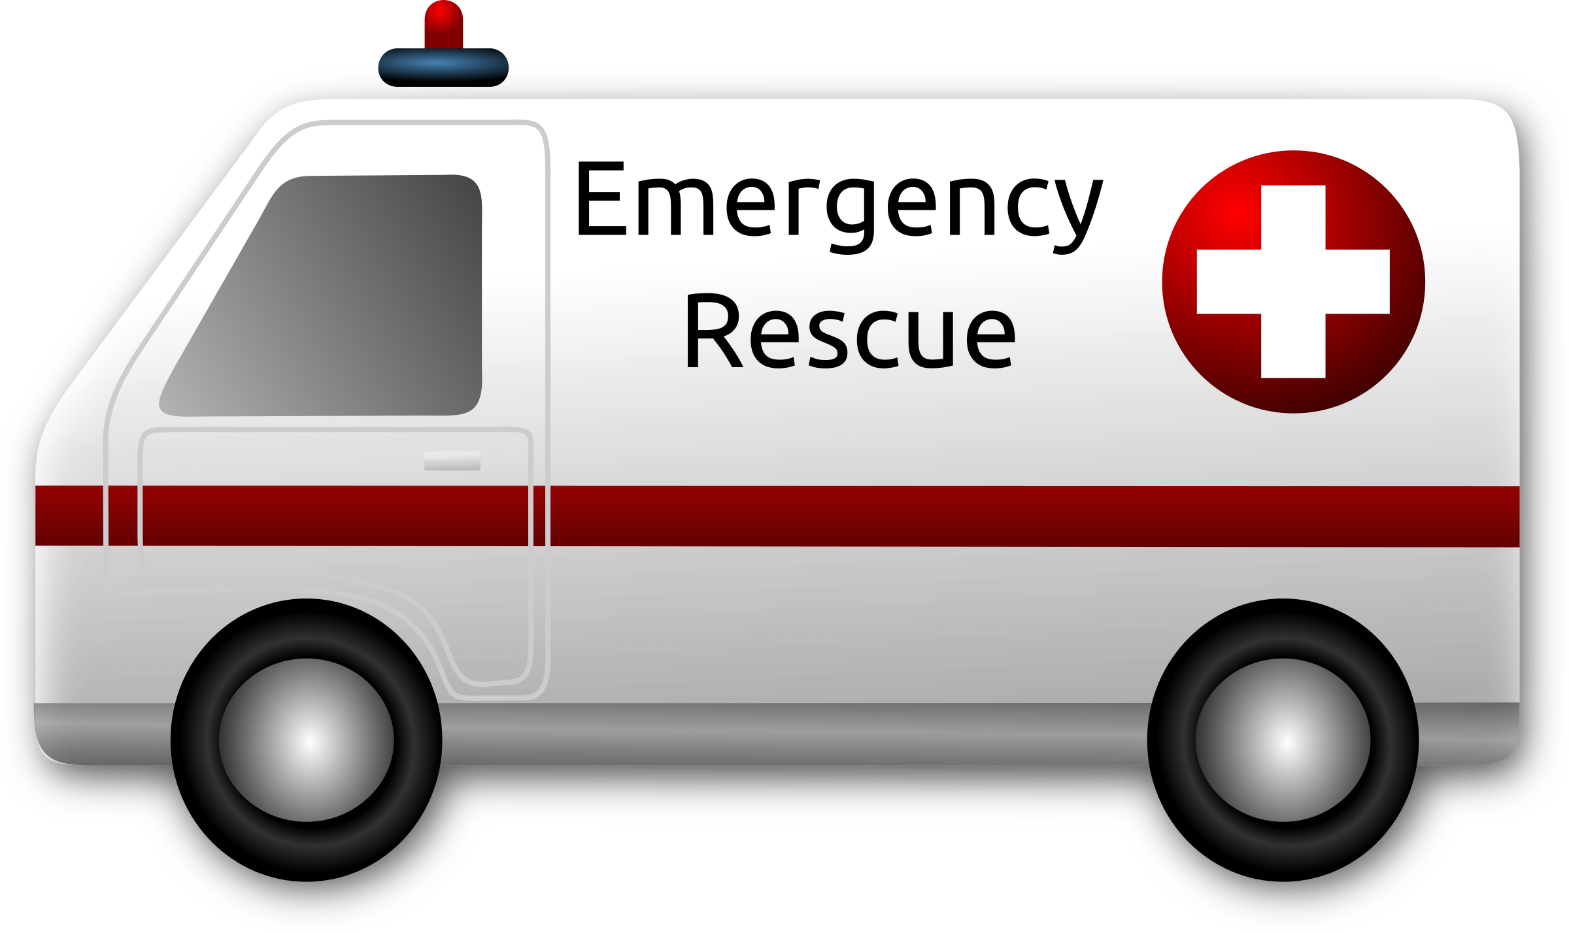
Help us stay safe!
COMMUNITY HELPERS & FIRST RESPONDERS
This Photo by Unknown Author is licensed under CC BY-NC
This Photo by Unknown Author islicensed under CC BY-NC
Notes:
Red Ribbon Week is also a time to honor members of Law Enforcement like
*Click* Policemen
*Click* firefighters
*Click* EMTs and other First Responders who keep us safe!

Slide 8
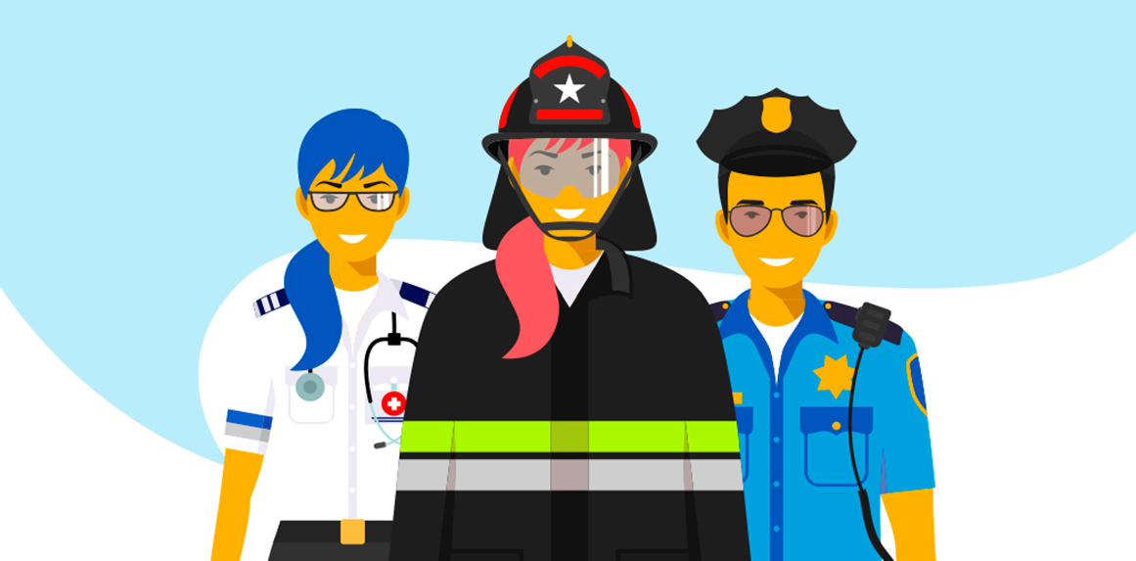
What do you do when you need a first responder?
Notes:
What do you do when you need a first responder? Take a minute and think about the first steps you take.

Slide 9

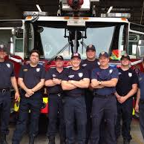
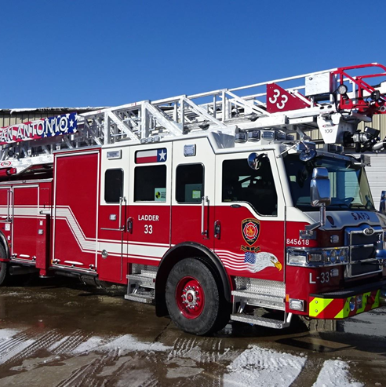
Call 911
Notes:
When there is a fire, or other emergency, we call * “911” and Trained first responders will come and help with the situation.

Slide 10
Before you call 9-1-1 what is the very first thing you should do?
Look for a trusted adult!
Notes:
If there is an emergency, before you pick up a phone to call 9-1-1, what is the very first thing you do?
*Click* Look for a trusted adult!
Try to tell a parent or any grown–up, babysitter or whoever is staying with you.
If you can’t tell a trusted adult, then call 9-1-1 in case of an emergency!

Slide 11

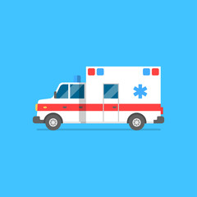
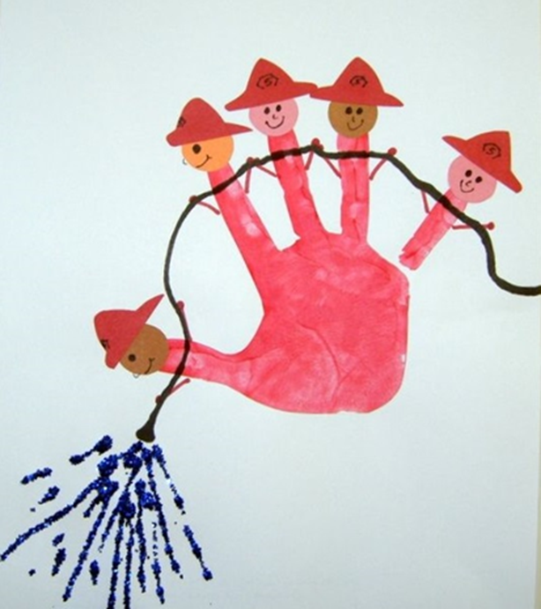
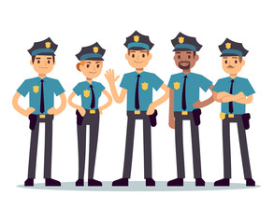
9-1-1
Let’s take a minute to talk about it!
www.teachthelittlepeople.com
Notes:
Do you know when it’s O.K to call 9-1-1-?
First, if you think it is an emergency, try to tell a parent or any grown–up, babysitter or whoever is staying with you. If they are hurt or not available, then you can call 9-1-1
www.teachthelittlepeople.com

Slide 12
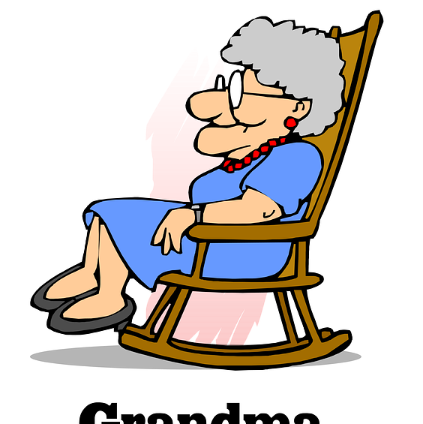
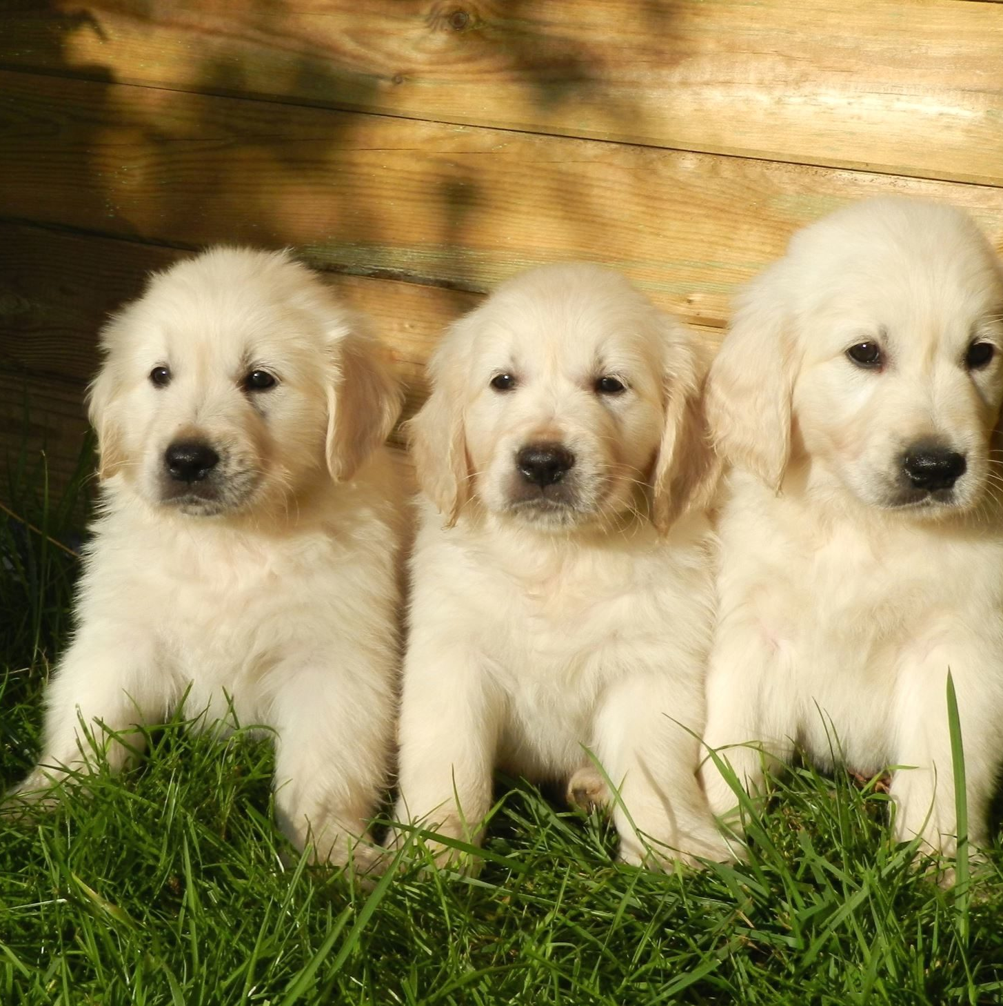
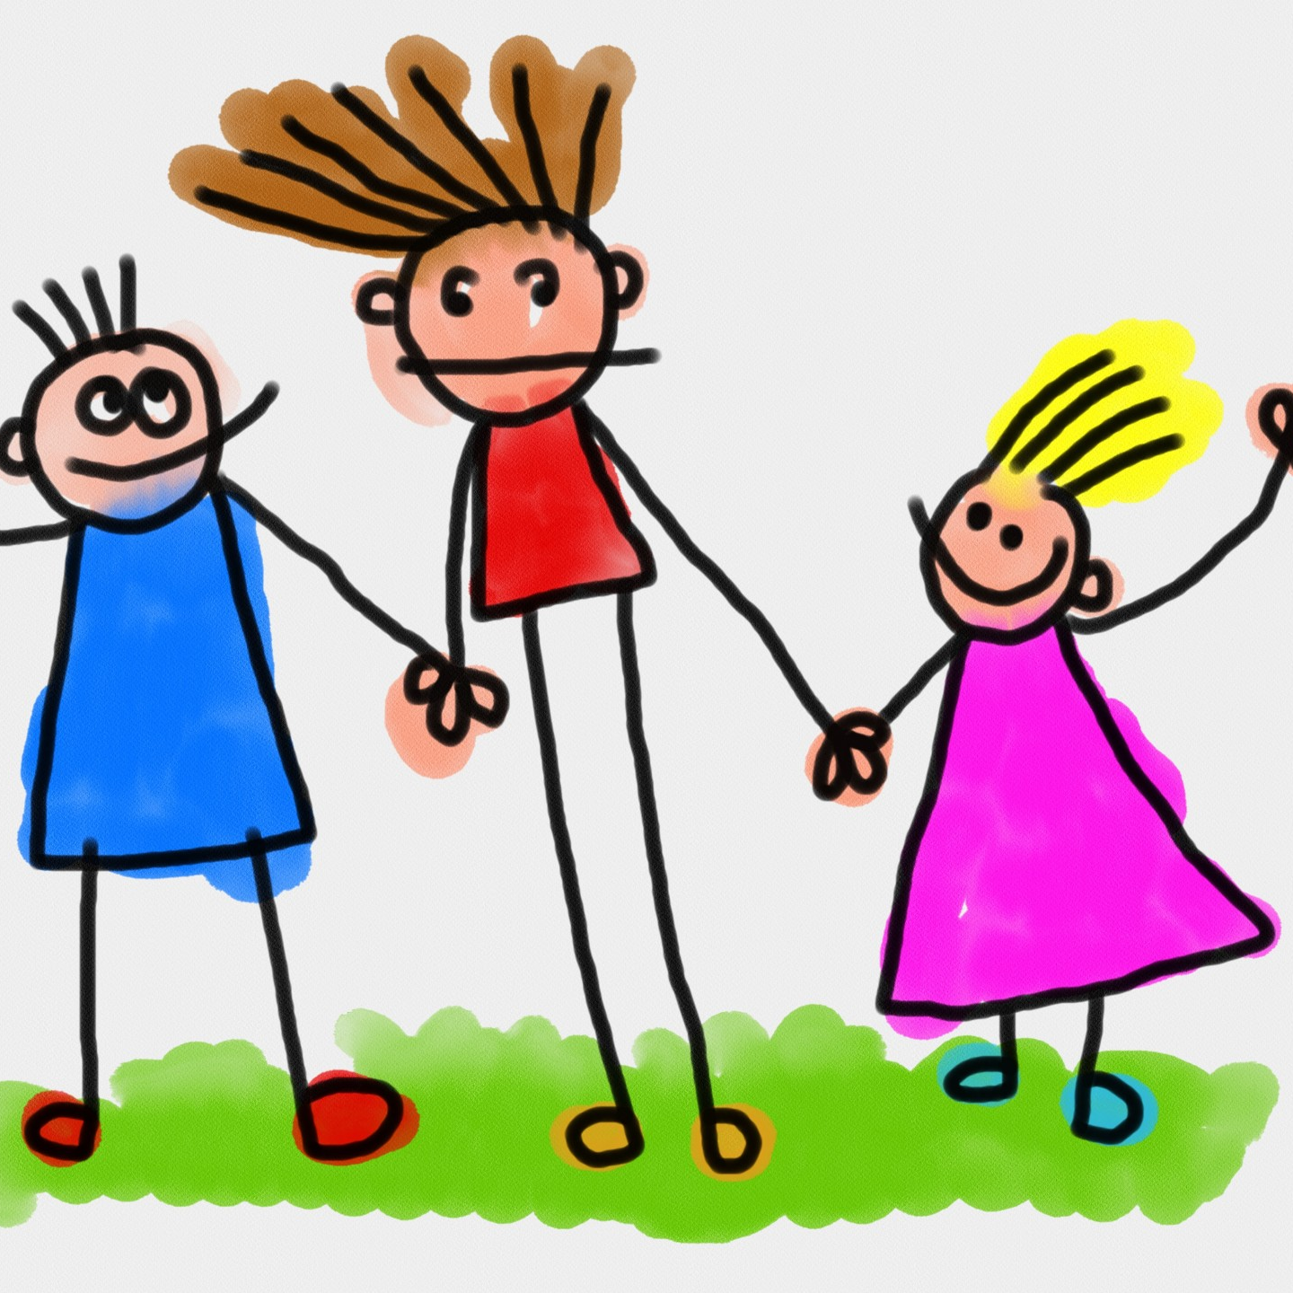
YES!
No
No
What is an emergency?
Notes:
Now let’s see if you know what is a real emergency.
Is it an emergency if you can’t find your puppy?
*Click* No, that is troublesome, but it is not an emergency for which you would call 9-1-1.
How about if your sister won’t play with you, or is being mean? \
*Click* Nope, you can’t call 9-1-1 for that either.
How about if your mother or grandmother has fallen and is hurt, or you can’t wake up your grandparent?
*Click* Yes, those are true emergencies, and you could call 9-1-1 if there isn’t another adult around to help.

Slide 13

9-1-1 SONG sung to “Three Blind Mice”
Help's on the way. Help's on the way.
If I need help, I know what to do.
I can call police and firefighters, too
It makes me feel safe to know what to do.
Dial 9-1-1, Dial 9-1-1
Notes:
To help you remember to call 9-1-1 for help I found this song, sung to the tune of “Three Blind Mice”
Helps on the way. Helps on the way.
If I need help, I know what to do.
I can call police and the firefighters, too,
It makes me feel safe to know what to do.
I can call police and firefighters, too
Dial 9-1-1, Dial 9-1-1
www.123learncurriculum.info

Slide 14
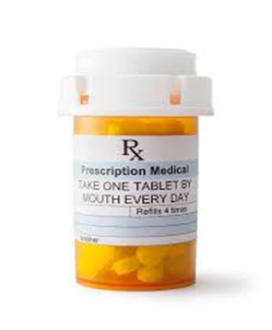
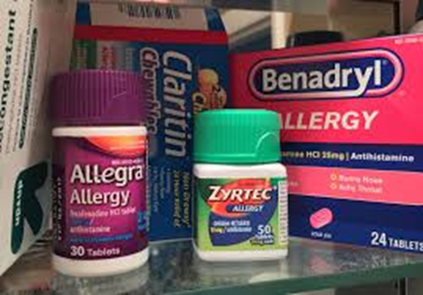
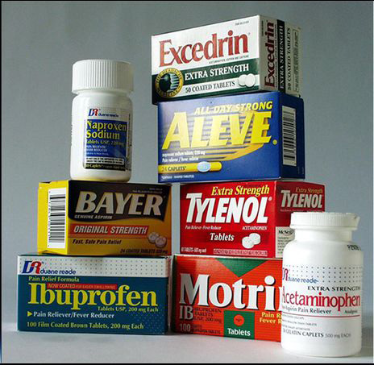
Medicine
Antibiotics
Medicines
Over the Counter Allergy Medicine
Over the Counter
Pain Relievers
Notes:
Did you know a drug is anything that changes the way your mind or body work.
Today we are going to talk about Medicine, which is a helpful drug, and when used correctly can make people feel better.
Medicines, should always be given to you by a trusted adult, and they can be very helpful.
Examples of some medicines are
*Click* Antibiotics - which are prescribed by a doctor, and can help your body fight an infection
*Click* Allergy medications – which a trusted adult can give you if you are experiencing allergies
*Click* Pain relievers – which a trusted adult can give you to help you if you are hurt
These are all examples of Medicine - which are helpful drugs.
Medicines like these are NOT things you should take without permission.
Only take medicine from a trusted adult, like a parent, grandparent, doctor or nurse.
These things you don't share with anyone. You should always tell a trusted adult if you find something, laying around, that looks like a pill or other medicine.

Slide 15

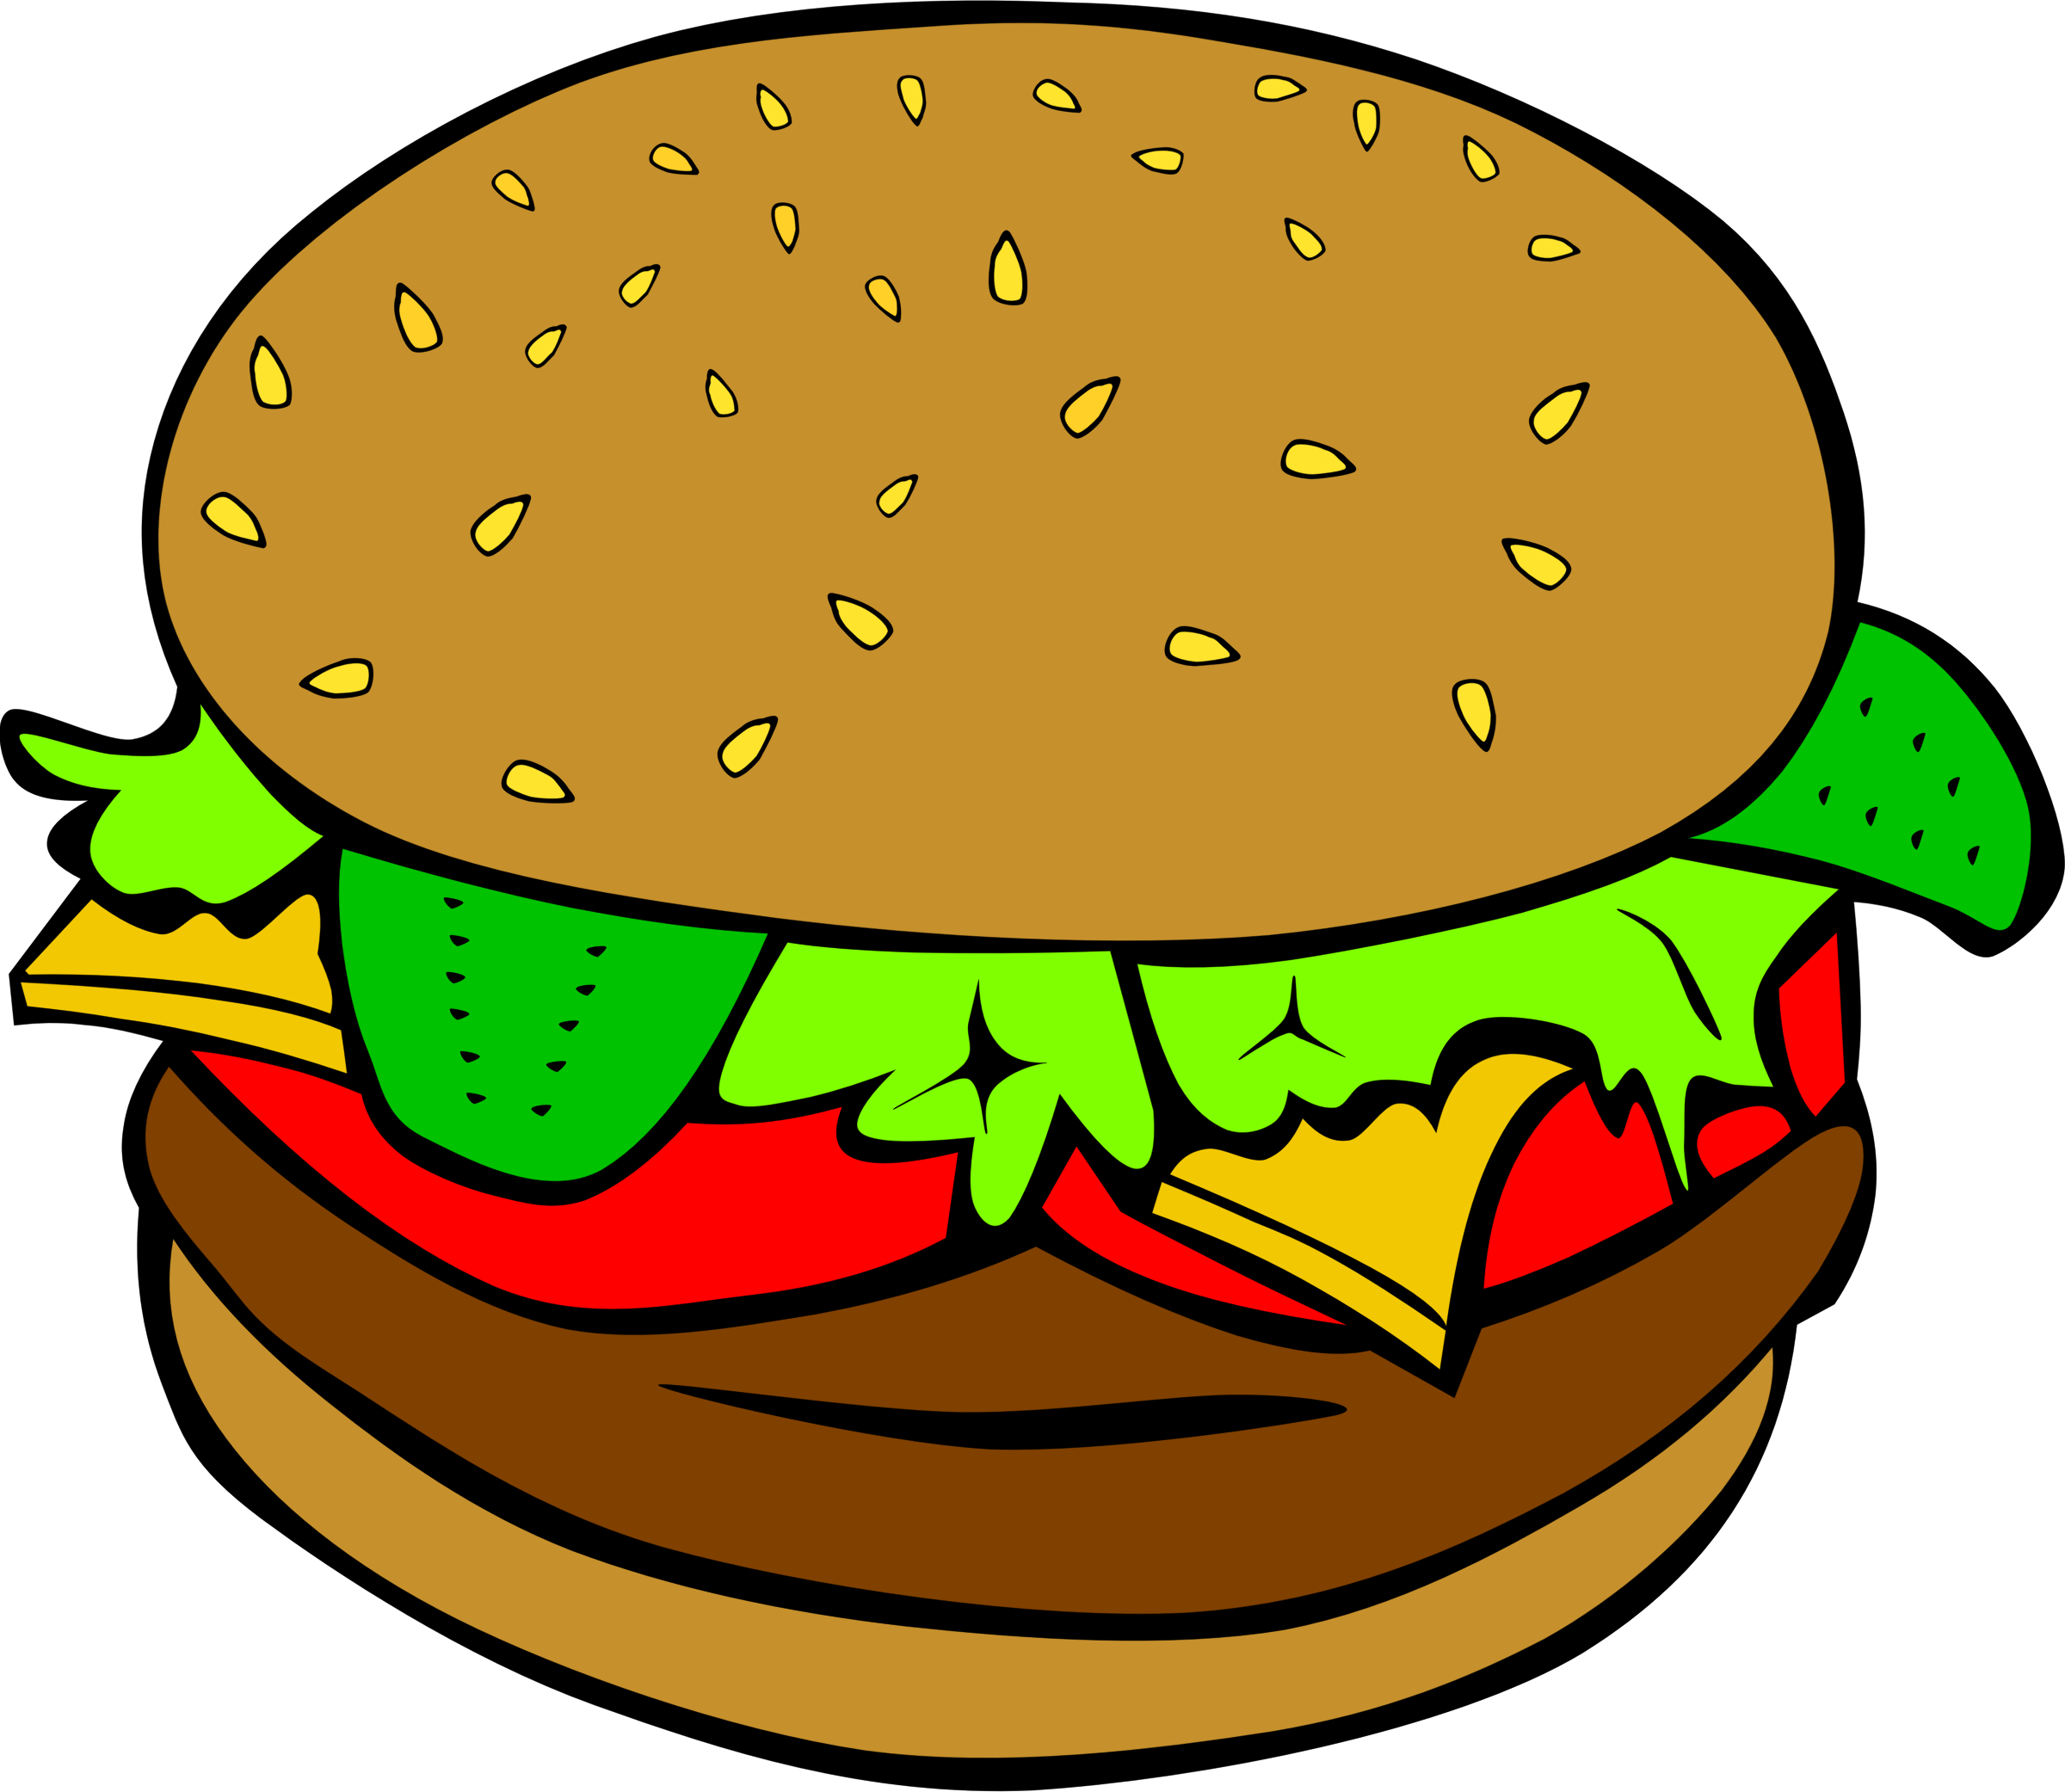







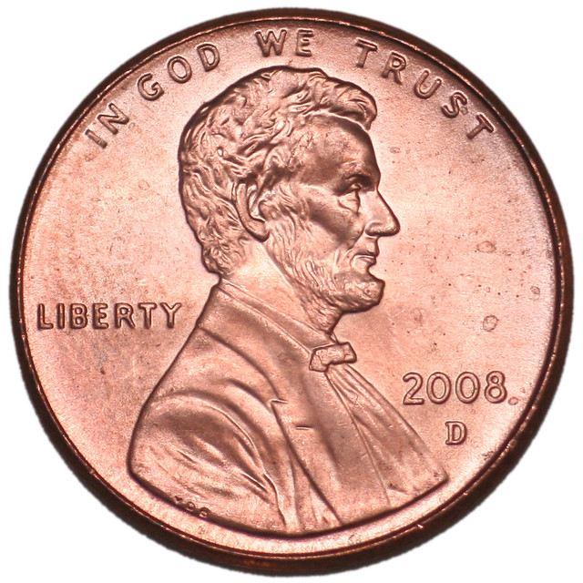
SAFE OR NOT SAFE?
(To Put in Your Mouth)
Notes:
Let’s look at some things, including medicines, that might be Safe, or Not Safe.
Think for a minute, of these things, think, “What is safe to put in my mouth….”
I see some things that are safe to put in your mouth and some things that are NOT safe to put in your mouth…
** Start from top left and go to the right, then go to the bottom line and go left from right… the clips move based on if they are safe or unsafe to put in your mouth.

Slide 16
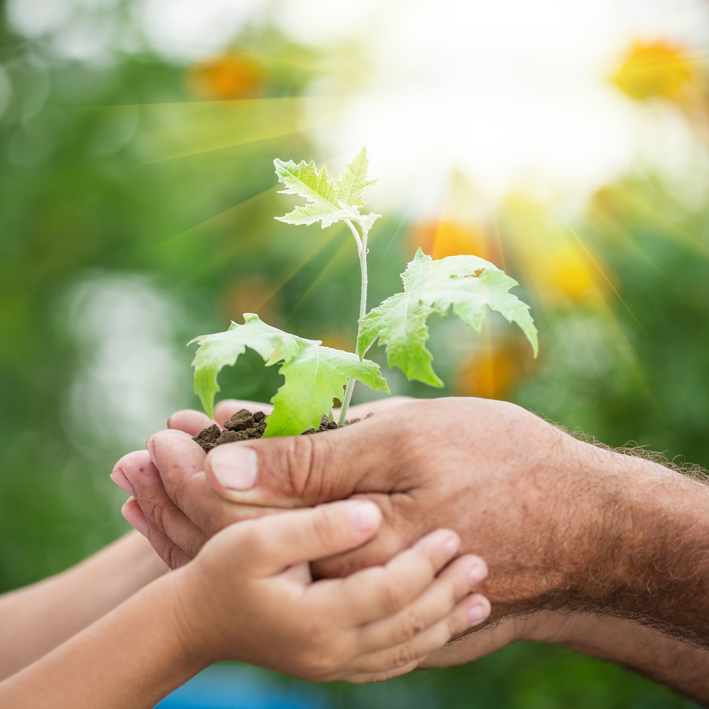

During Red Ribbon Week we want to:
STAY HEALTHY!
Notes:
During Red Ribbon Week we talk about living healthy lives and making healthy choices.
Let’s go over some things that you can do to stay healthy…

Slide 17


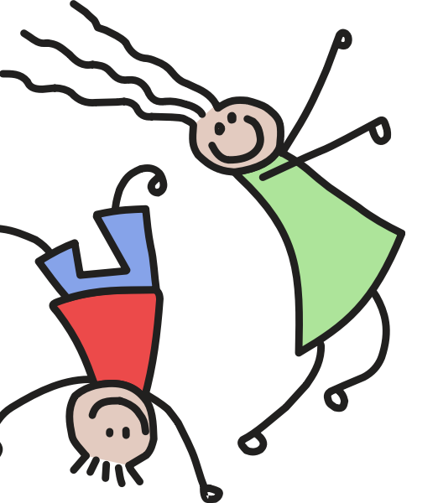
What are some ways we can stay healthy?
This Photo by Unknown Author is licensed under CC BY-NC-ND
This Photo by Unknown Author is licensed under CC BY-NC
Notes:
Let’s take a moment and think about some way to stay healthy!
What are some ways you stay healthy?

Slide 18
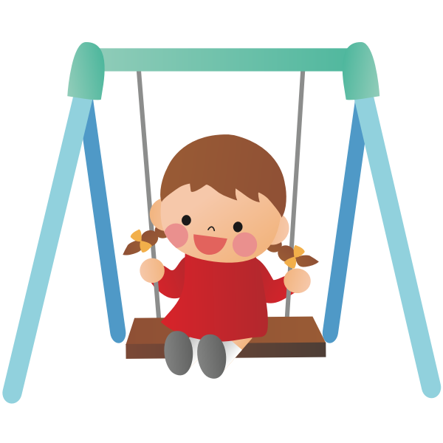
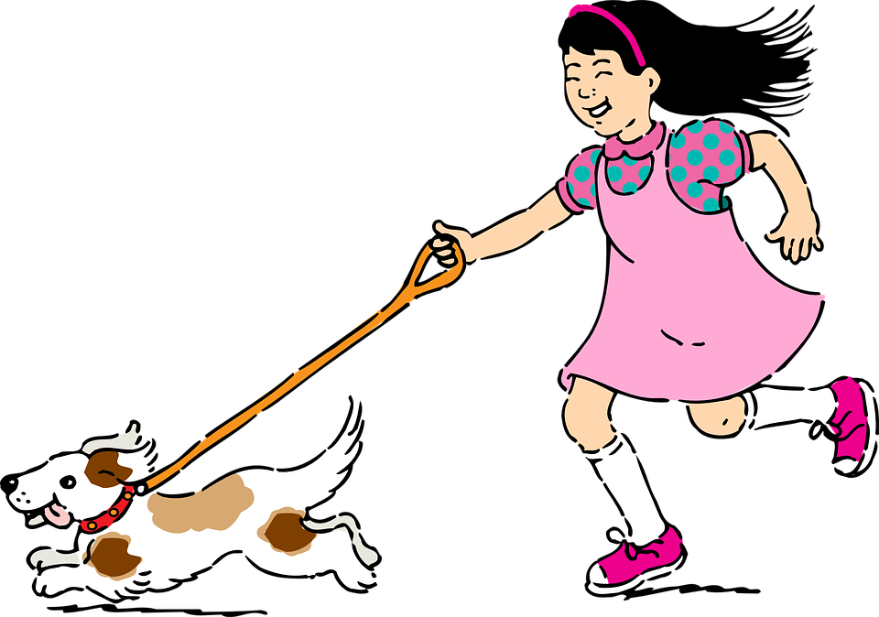
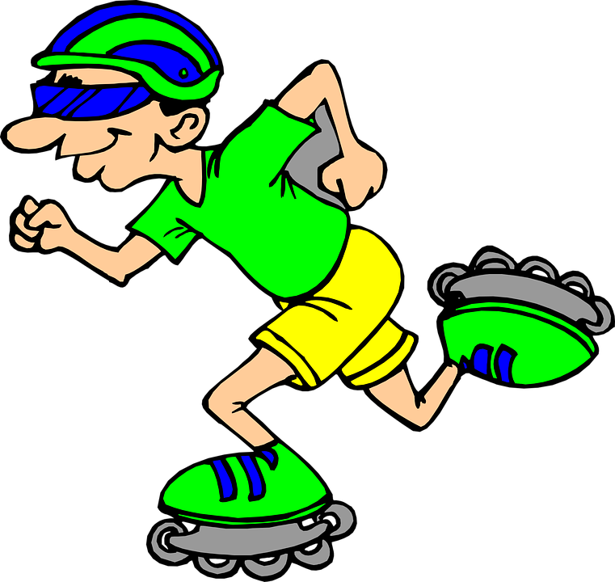

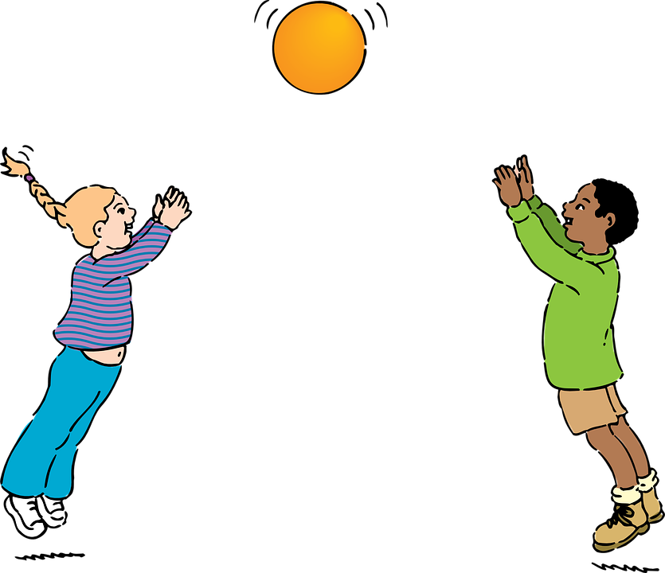
EXERCISE!
Notes:
One way we can stay healthy is to exercise every day!
Get outside in the fresh air, play and run around, these are all great ways to get exercise!

Slide 19

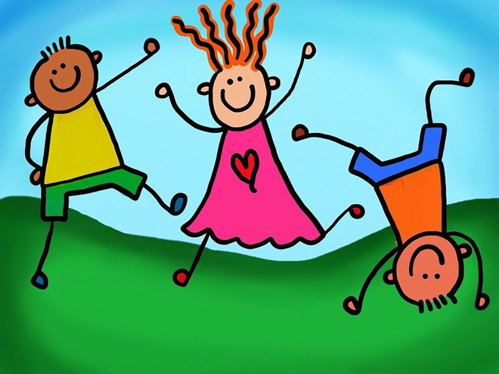
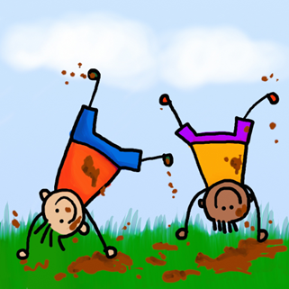
How do YOU exercise?
Notes:
What are some ways you exercise?

Slide 20
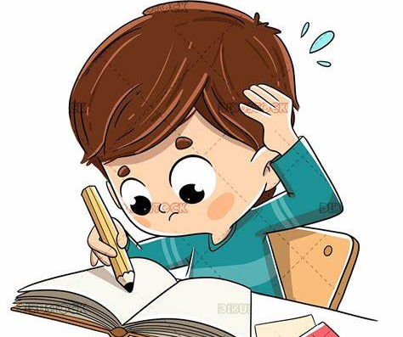
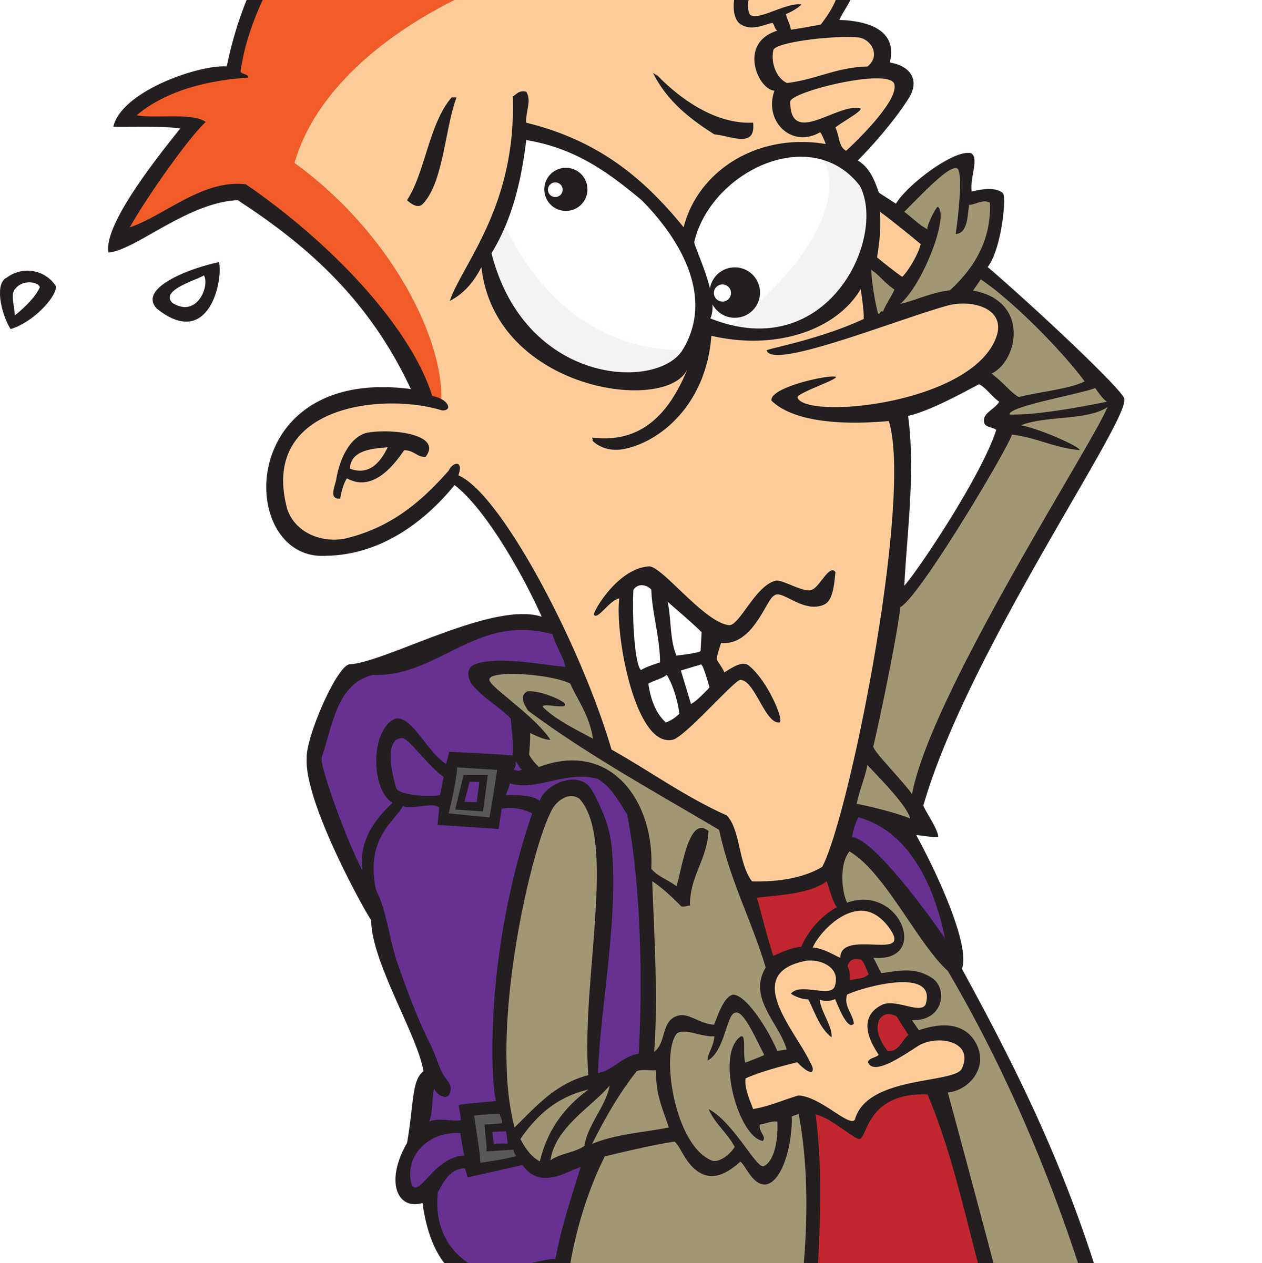
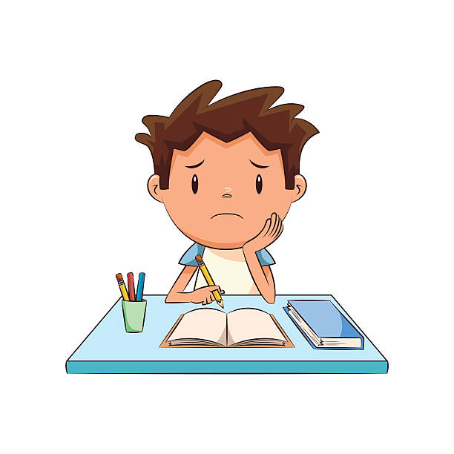
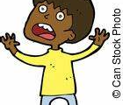
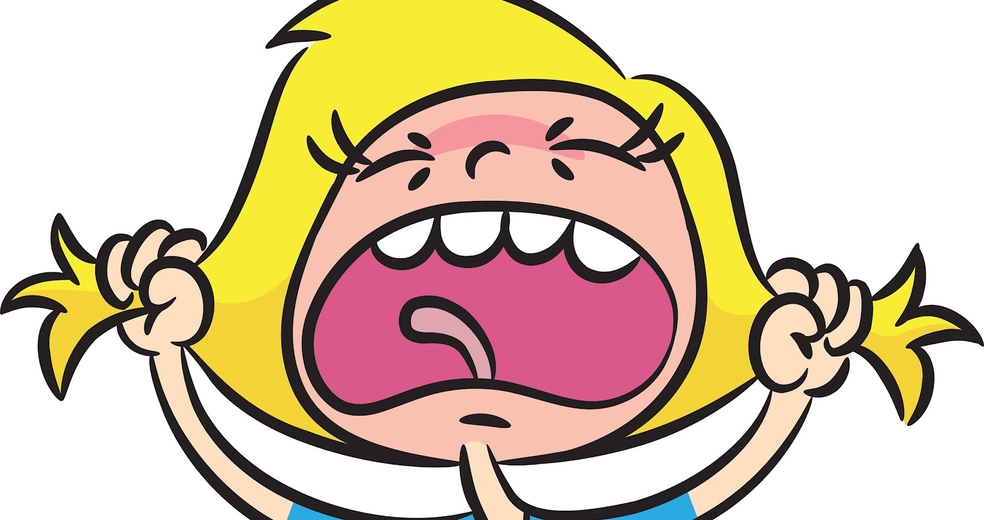
Who Has Felt Stress Before?
Notes:
Who here has felt stress before?
Most likely everyone has felt some sort of stress before.

Slide 21
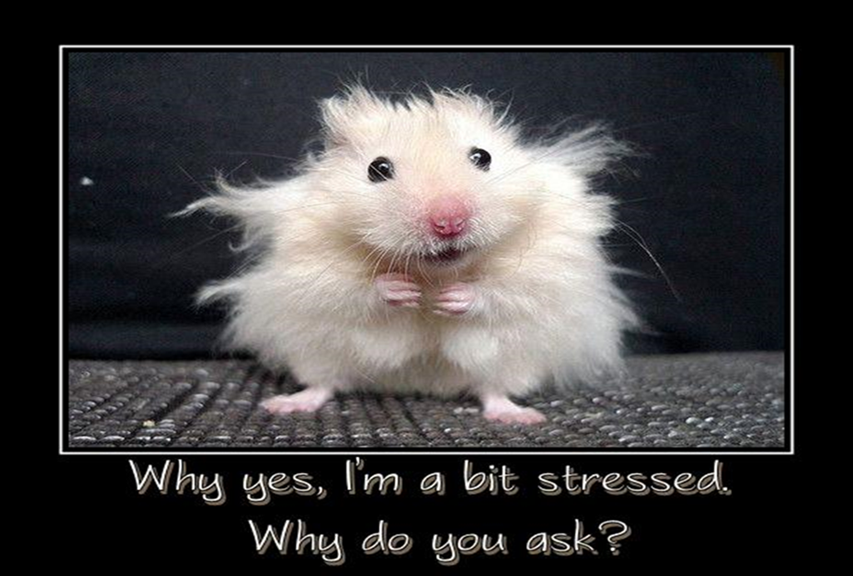
Stress is…
Notes:
Incase you don’t know, stress is “that nervous, uptight, uneasy, feeling that we all experience from time to time.
Some example someone your age my feel stressed about are….
Learning how to read and write. That can be very stressful, but you must remember there are lots of people who are around to help you. You teachers, your family, other people in the school. If you are feeling stressed about school and education find someone to help you.
You might feel stressed if your pet goes missing. That is super scary and something that would make anyone feel uneasy. When we are going through something like that we are feeling stressed because we don’t know what is going to happen. Now, when we lose our pet do we call 911? Remember we went over this earlier…..
No, we don’t call 911, but we find a trusted adult to help us look. That trusted adult can also help you manage the stressed out feelings you are experiencing.

Slide 22
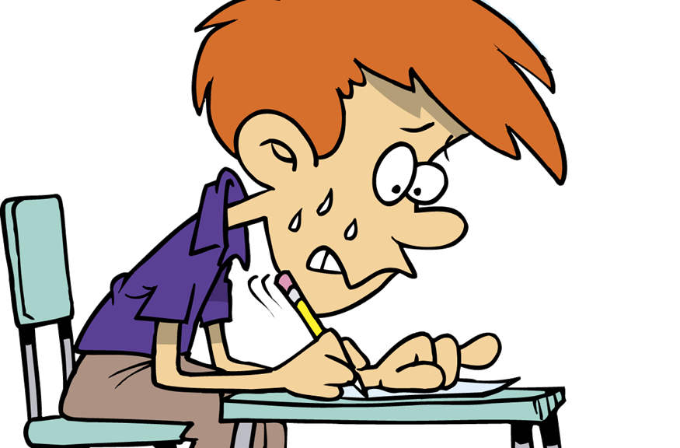
Physical Signs of Stress (Signs that your body gives you to alert you to Stress)
Racing Heart
Shaking Hands
Shaky Legs
Clenched Fists
Red Face
Headaches
Tense
Tight Muscles

Slide 23

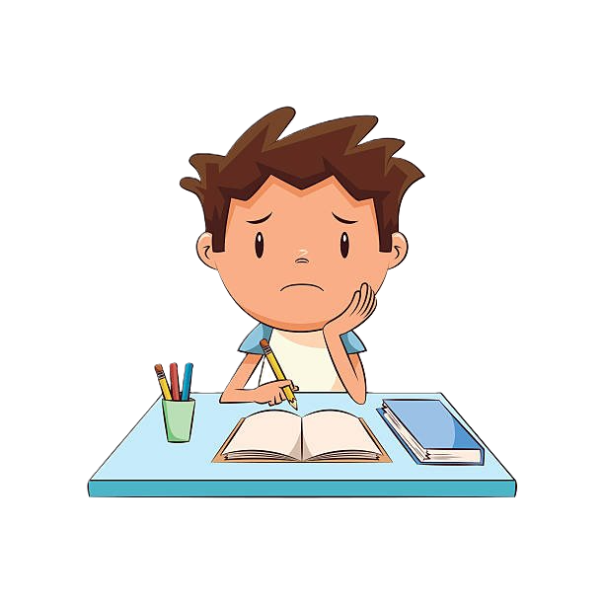
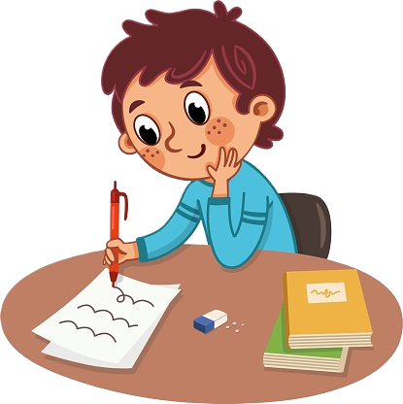
Some amount of stress can be good for you
Notes:
I want to point out that Stress is not always bad;
Stress may motivate you to study for a test, or practice before a “try-out”
We all have to try and learn new things, which can cause stress, because sometimes change is scary and stressful, but if we never try these new things because we are worried about stress, we will never learn anything new or get to have new experiences.
So some stress is good, but we need to learn to how handle any stress that we may face….

Slide 24
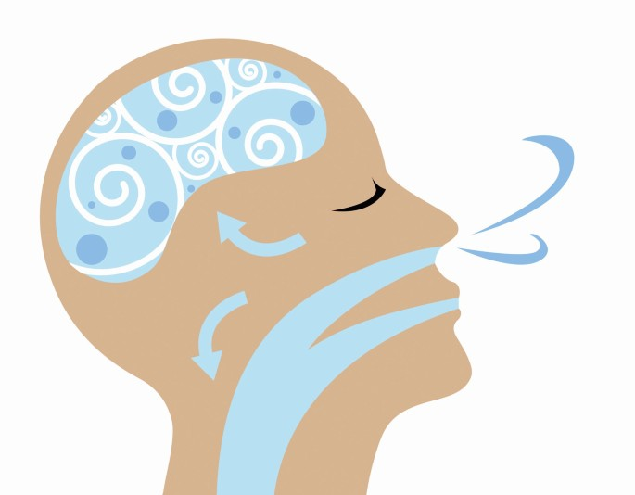
1… 2… 3… 4…
Breathing
Notes:
One great way to handle stress is to take some deep breaths in and out
*Click*
Counting in you head or having someone count for you while taking deep breaths is very helpful

Slide 25
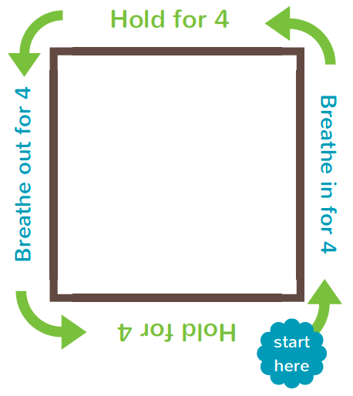
Breathing Square
Notes:
We are going to take some deep breaths, following the path of this breath square!
We are going to start where the arrow is pointing, and I will count out loud for you.
Take a deep breath in for 1… 2… 3… 4… hold it for 1… 2… 3… 4… and breath out for 1… 2… 3… 4… hold it for 1… 2… 3… 4…

Slide 26


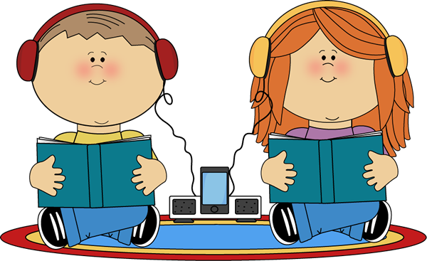

RELAX!
Notes:
Relax, meditate, daydream, beathing and sleep are all great ways to stay healthy.

Slide 27
10 hours
REST
Notes:
Getting enough sleep is super important for children your age to stay healthy.
*Click* It is recommended for you all to sleep at least 10 hour each night!
When we get enough sleep, we are prepared and energized for the day ahead.

Slide 28
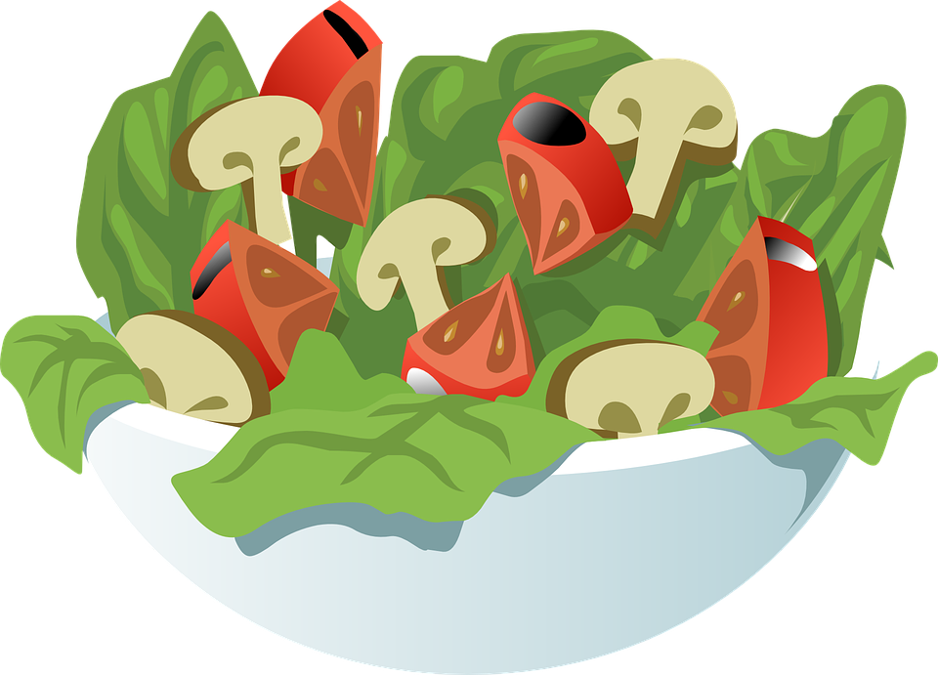
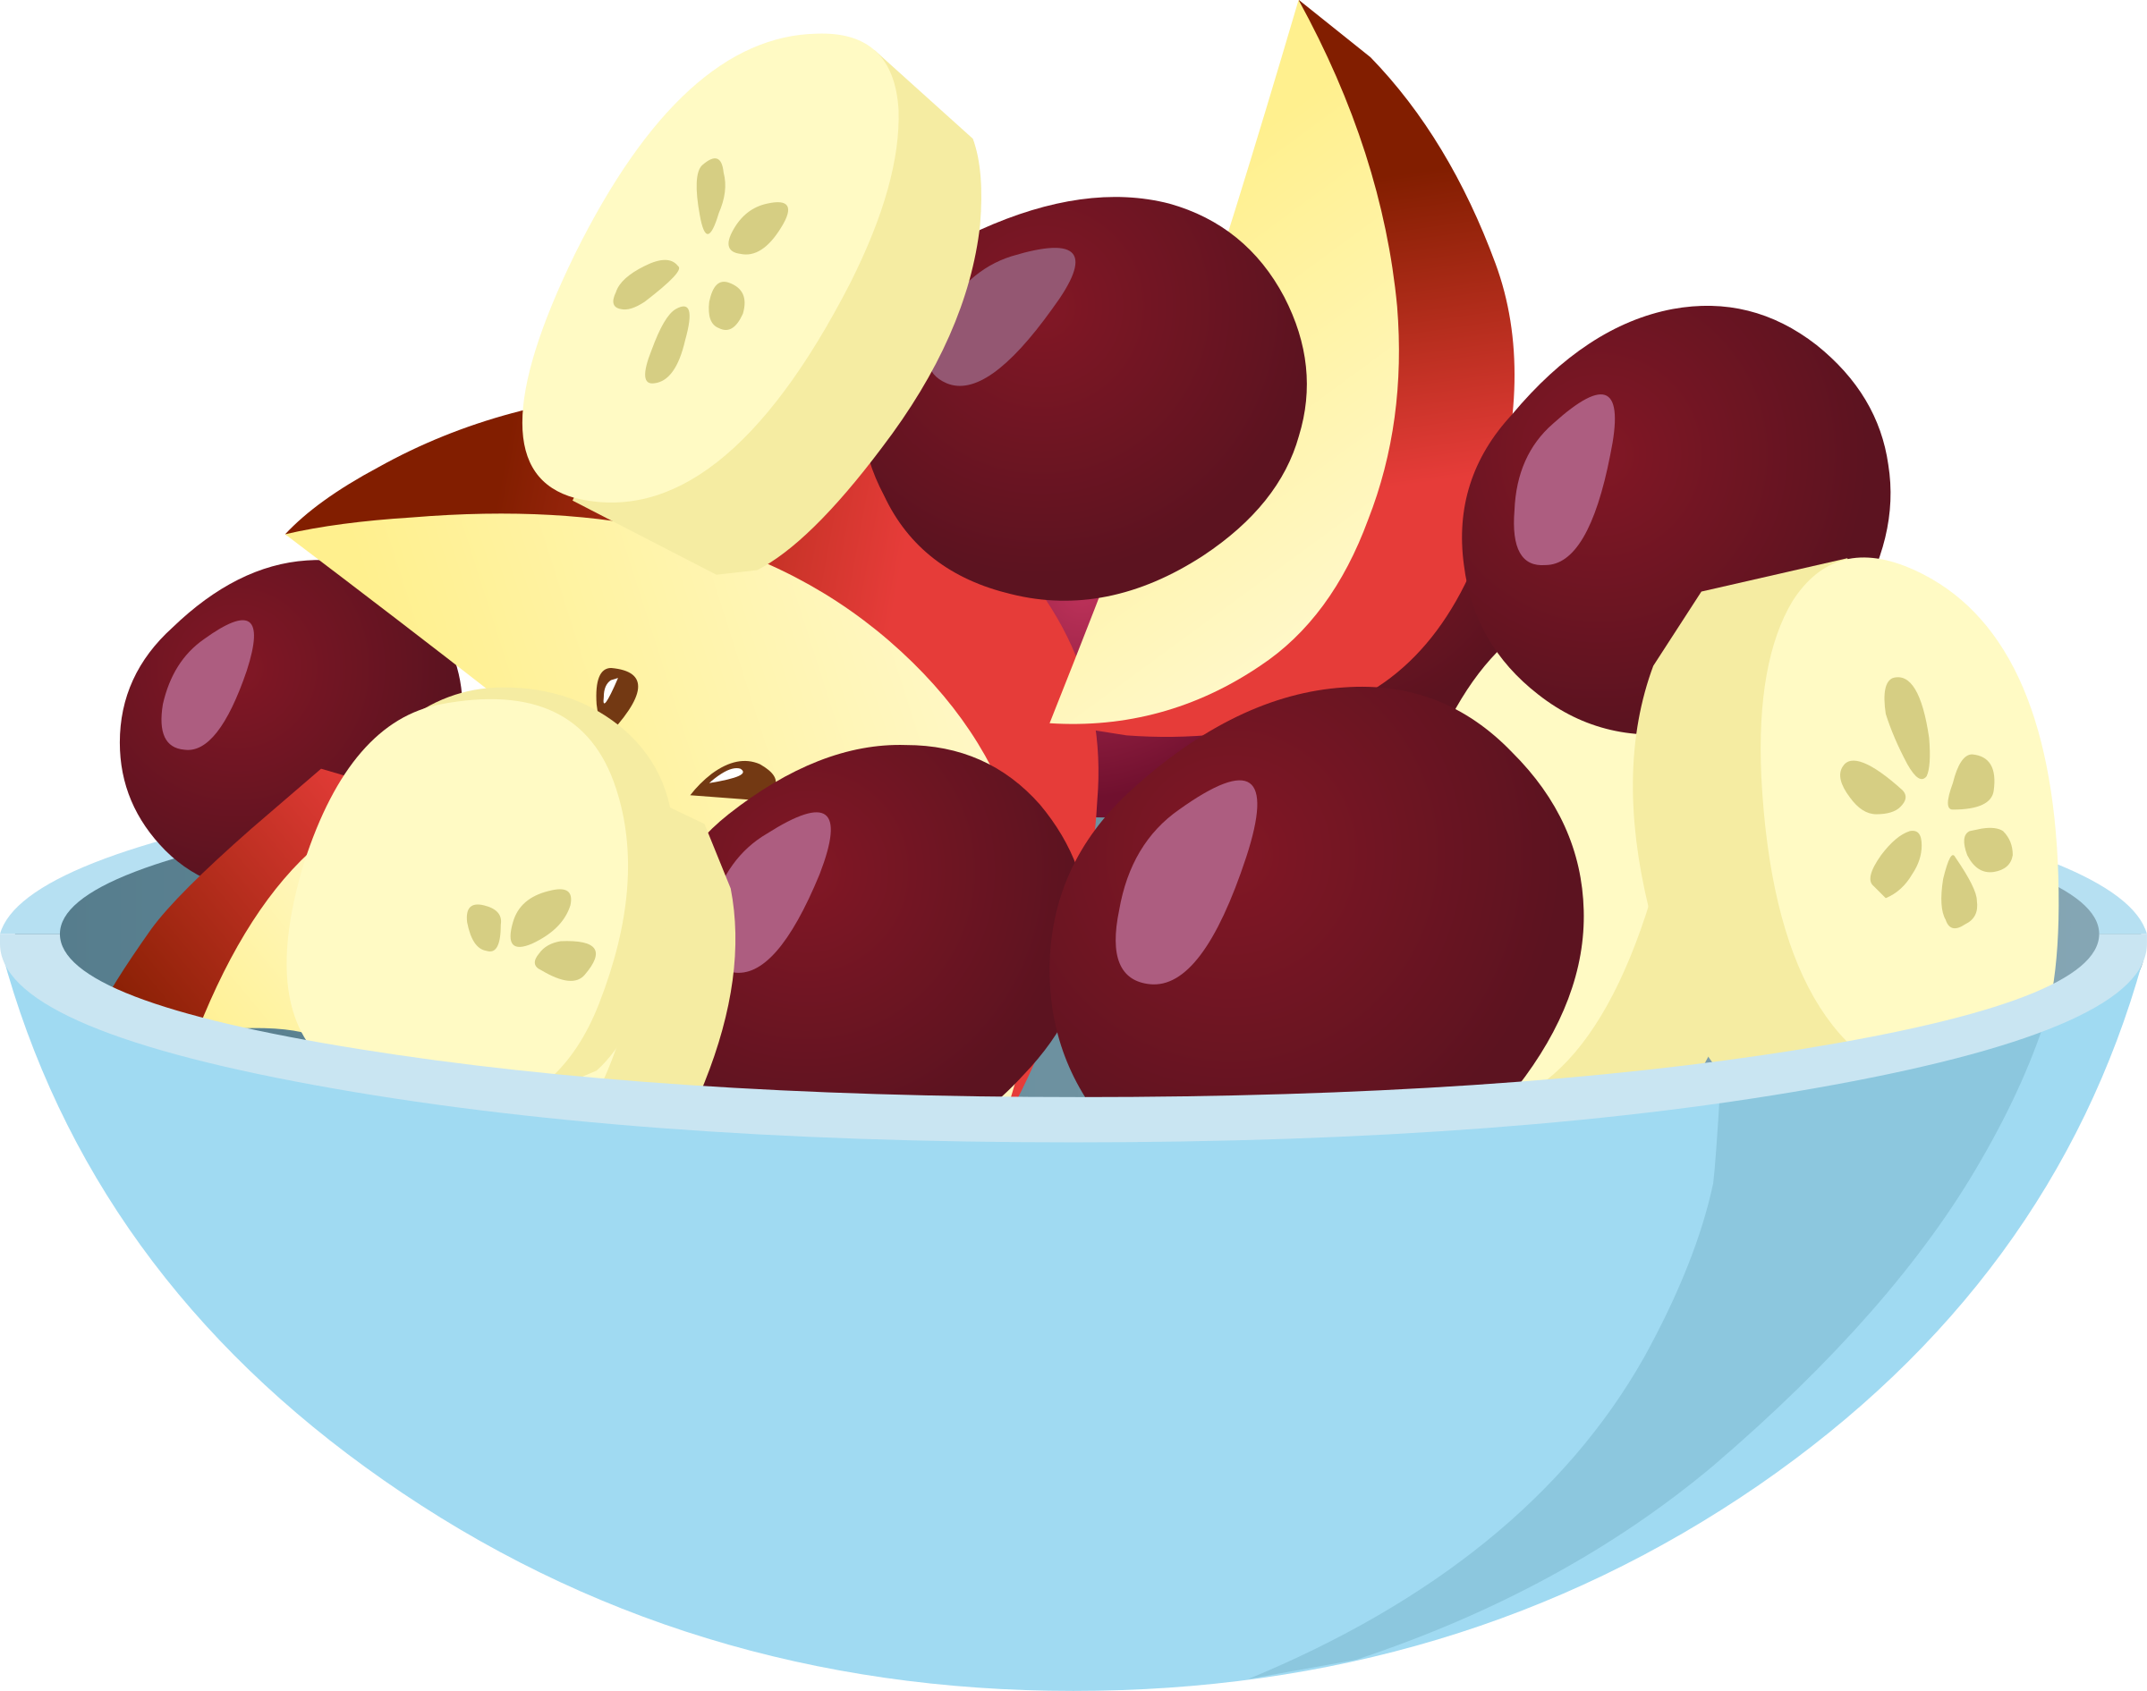



HEALTHY FOODS!
Notes:
Having a balanced diet is a great way to stay healthy!

Slide 29
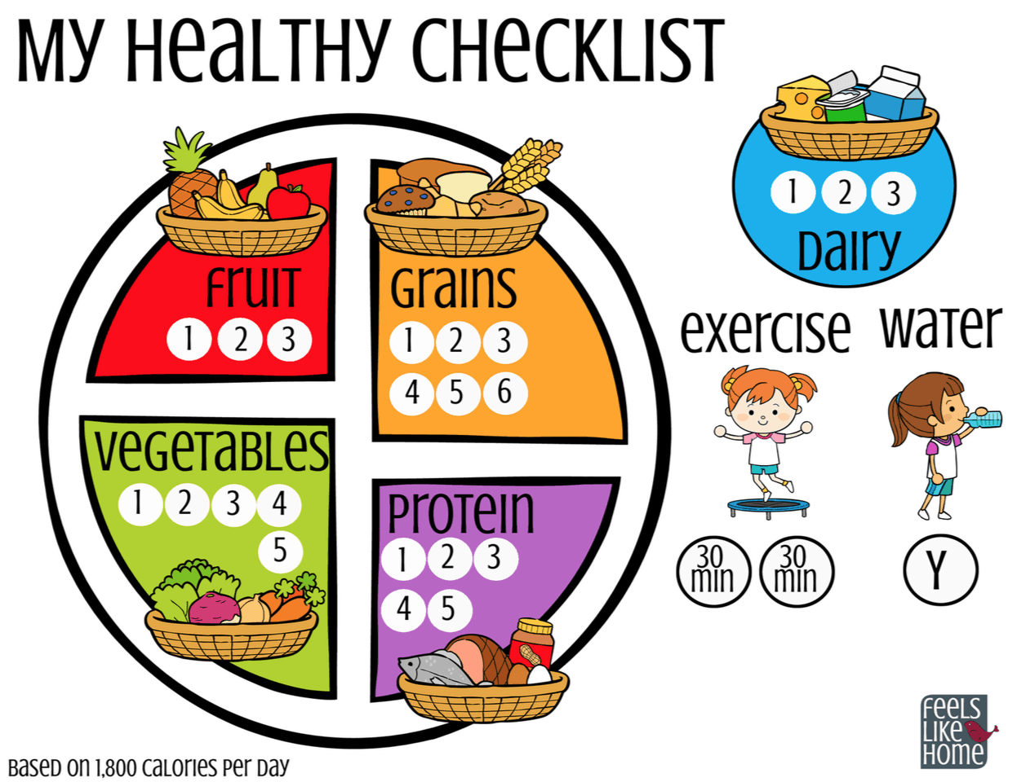
What is a balanced diet?
Notes:
A balanced diet is being sure to eat a variety of healthy foods and making sure you are getting your fruits & vegetable, grains, like bread and protein which is found in meat. You should try to avoid lots of sweets and processed foods.
Raise your hand if you think you know what a processed food is. It’s ok if you don’t know cause it’s a tricky word.
A processed food is anything that has been changed from its original form and has other stuff added to it, like more sugar and salt. An example would be an apple versus an apple breakfast bar. Although the apple breakfast bar has apple in it, they added other stuff to make it into a bar and sometimes that stuff can be unhealthy for you, like adding too much sugar. Most of the time it is better to just have an apple.
You also want to be sure to drink lots of water.

Slide 30
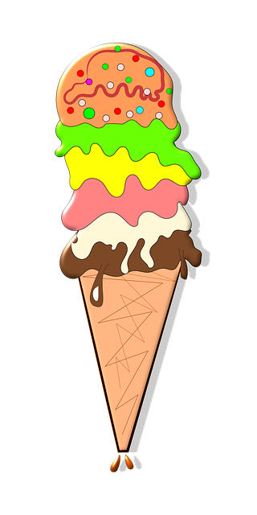





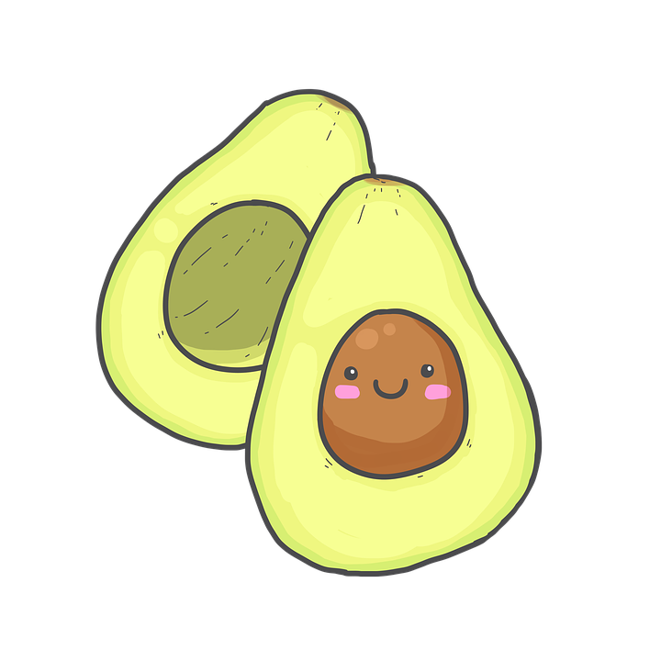
Healthy or Un-Healthy?
Notes:
Let’s look at some food items.
Some of these are healthy for you and some are not. Take a minute to think what up here is healthy and what is unhealthy.
** Start from top left and go to the right, then go to the bottom line and go left from right… the clips move based on if they are Healthy or Unhealthy.

Slide 31
Un-Healthy
Notes:
So just because these things are unhealthy does that mean we can never have them?
Every now and then they are ok, but we should be sure to balance them with other healthy foods!

Slide 32

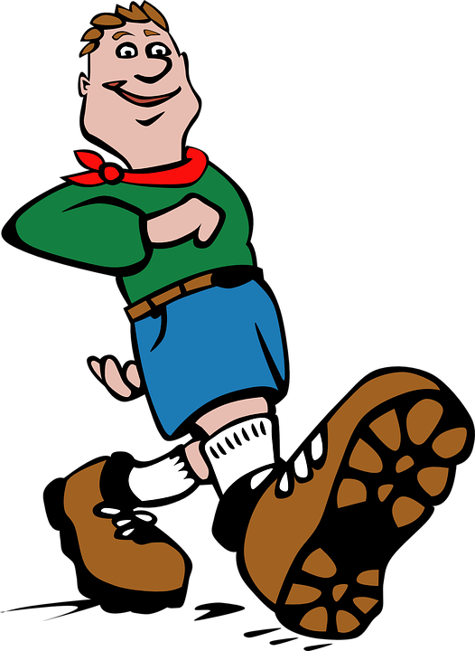
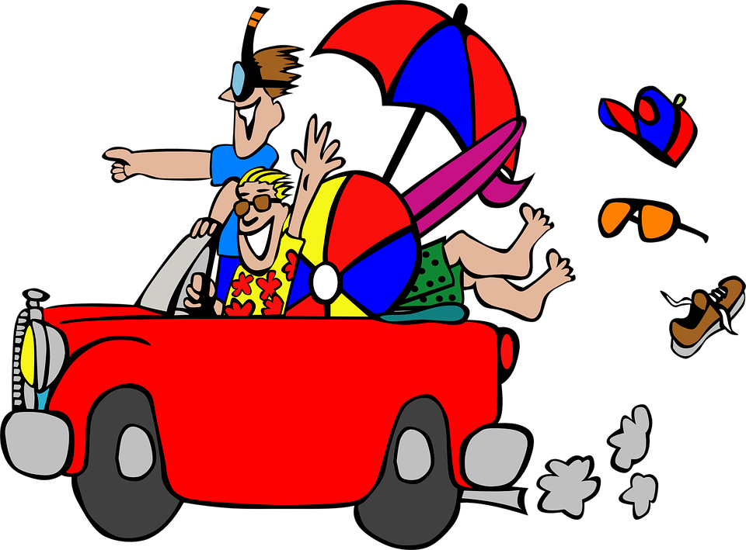


GET
OUTSIDE!
Notes:
It is important to get outside everyday. Our bodies soak up vitamins like vitamin D from the sun. It is important to breath in fresh air and when we are outside, we can run around and do things we might not be able to do inside.
But whenever you go outside you always need to be sure to tell a trusted adult! This helps you stay safe by making someone always knows where you are!

Slide 33
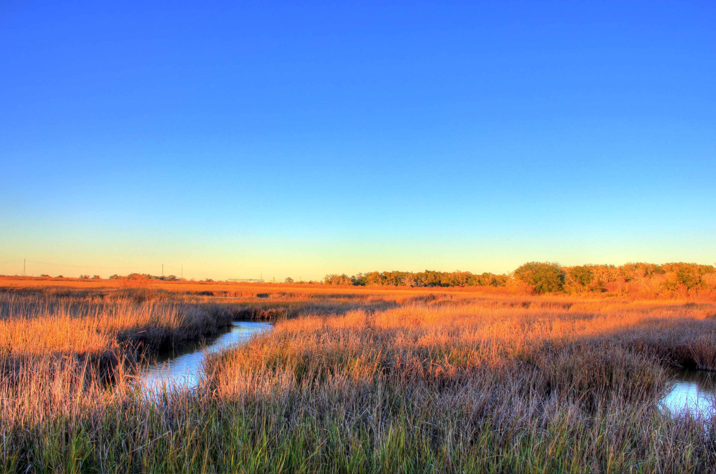
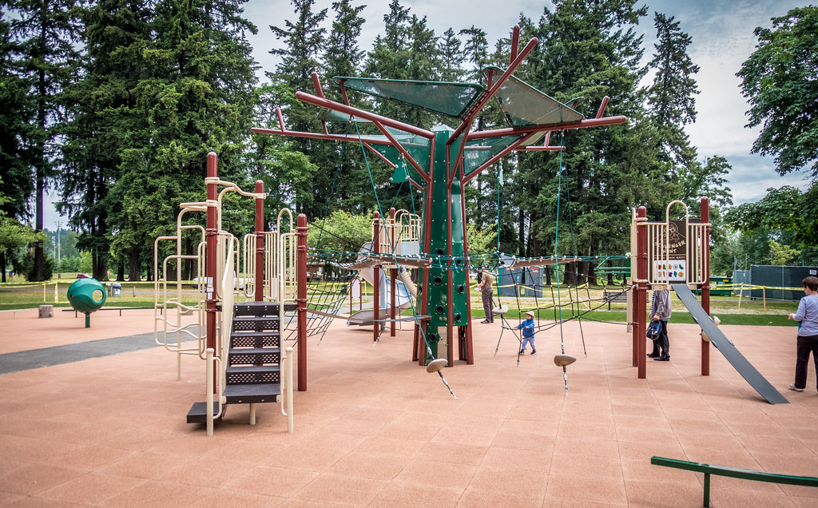
What do you like to do outside?
Notes:
What do you like to do when you are outside?
I like to walk my dog, go walk around, and I love sitting outside and taking some deep breaths!
If you are going to be in the sun what should you always remember?
Sunscreen, a hat, sunglasses, etc.

Slide 34





ALWAYS BE SAFE!
Notes:
Being safe is very important to living a healthy life!
*Click* You should always remember to wash your hands to help prevent you getting sick or passing germs to someone else.
When washing your hands, try to count to 20 or sing the happy birthday song twice
*Click* Look both ways before you cross the street, and if there is a crossing guard be sure to wait until they say you can cross.
*Click* Always follow safety signs and follow the safety rules your parents, teachers, and other trusted adults have given you.
*Click* & *Click* Be sure you wear a helmet and always wear your seatbelt while you are in a moving vehicle.

Slide 35
LAST BUT NOT LEAST…

Slide 36





HAVE LOTS OF FUN!!
This Photo by Unknown Author is licensed under CC BY-NC
Notes:
Have lots of fun!!
Living a healthy life is fun, you should laugh, sing, play and do all sorts of things that make you happy!
You should always be trying to make new friends to do these fun things with!
And Remember: A good friend will help others make healthy choices!

Slide 37

MAKE HEALTHY CHOICES
Notes:
Don’t let anything get in the way of you achieving your goals.
>Say “YES” to being healthy. There are many healthy choices out there, and so many more than we talked about today, the list is endless!
We are all empowered with shaping our communities through positivity, bravery and strength.
And don’t forget to Celebrate Life, Live Drug Free because*Click* you are all worth it!
Thank you!

Slide 38


South Texas Centre – Dave Coy Building
7500 U.S. Highway 90 West, Suite 201
San Antonio, Texas 78227
Phone: (210) 225-4741  Fax: (210) 225-4768
www.sacada.org
Mrs. Abigail Garza Moore, Chief Executive Officer

