Slide 1



2025
Notes:
Image resource: shuttersctock.com 1823618789
https://www.shutterstock.com/image-vector/national-red-ribbon-week-october-260nw-1823618789.jpg

Slide 2
Drug Facts 101
Prevention Specialist:
Adriana Jaramillo

Slide 3
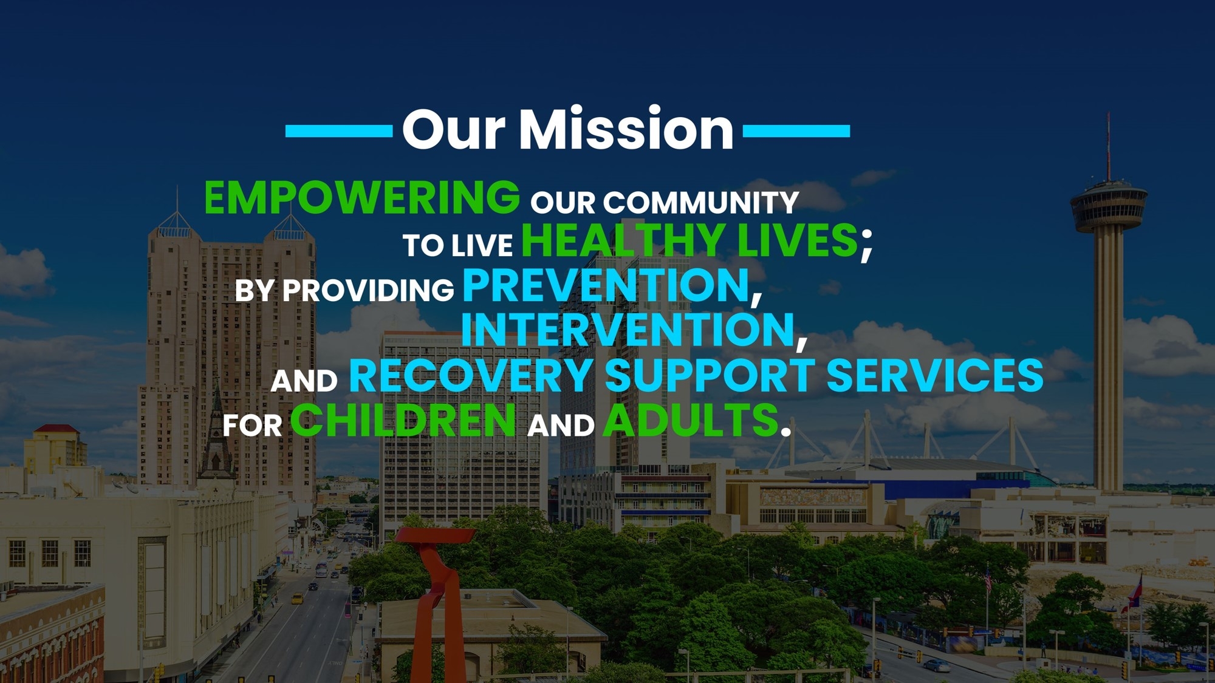

Slide 4
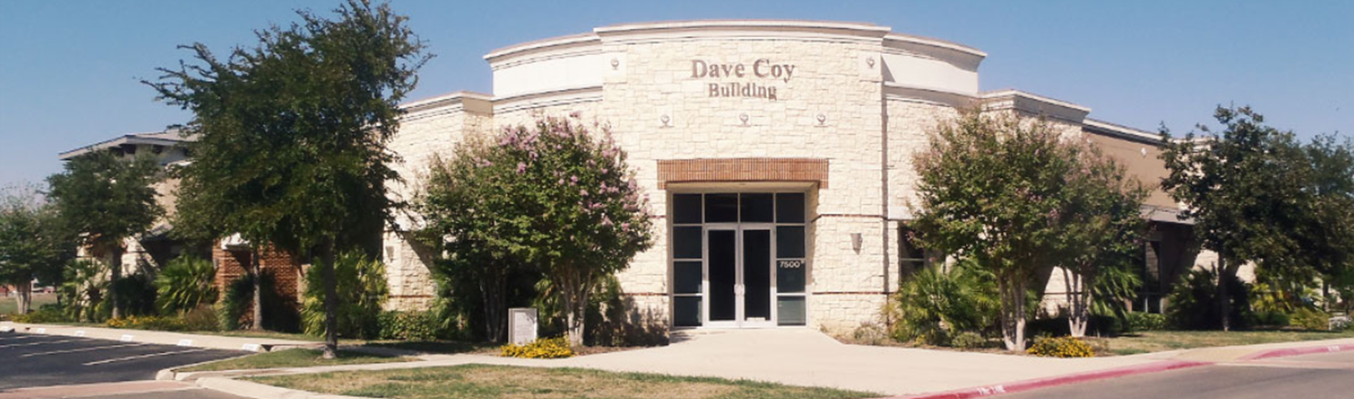
Why I do what I do…
Notes:
( Note To staff: CREATE YOUR OWN INTRODUCTION HERE)

Slide 5

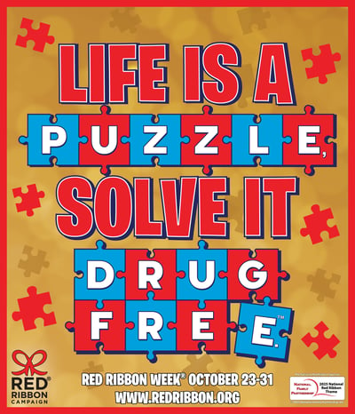
2025
THEME
Notes:
This years Red Ribbon Week Theme is Life is a puzzle, Solve it Drug Free.
This year's theme symbolizes how every choice we make fits into the bigger picture—just like a puzzle coming together.
Living drug-free helps build a stronger, brighter future, one piece at a time.

Slide 6


What Is red ribbon week?
Notes:
*After video*
By a show of hands, how many of you knew the reason why Red Ribbon Week is celebrated?
Now that we have a better idea, we can share the story of Kiki Camarena and the sacrifice he made for our country in order to keep drugs out of the hands of youth.

Slide 7

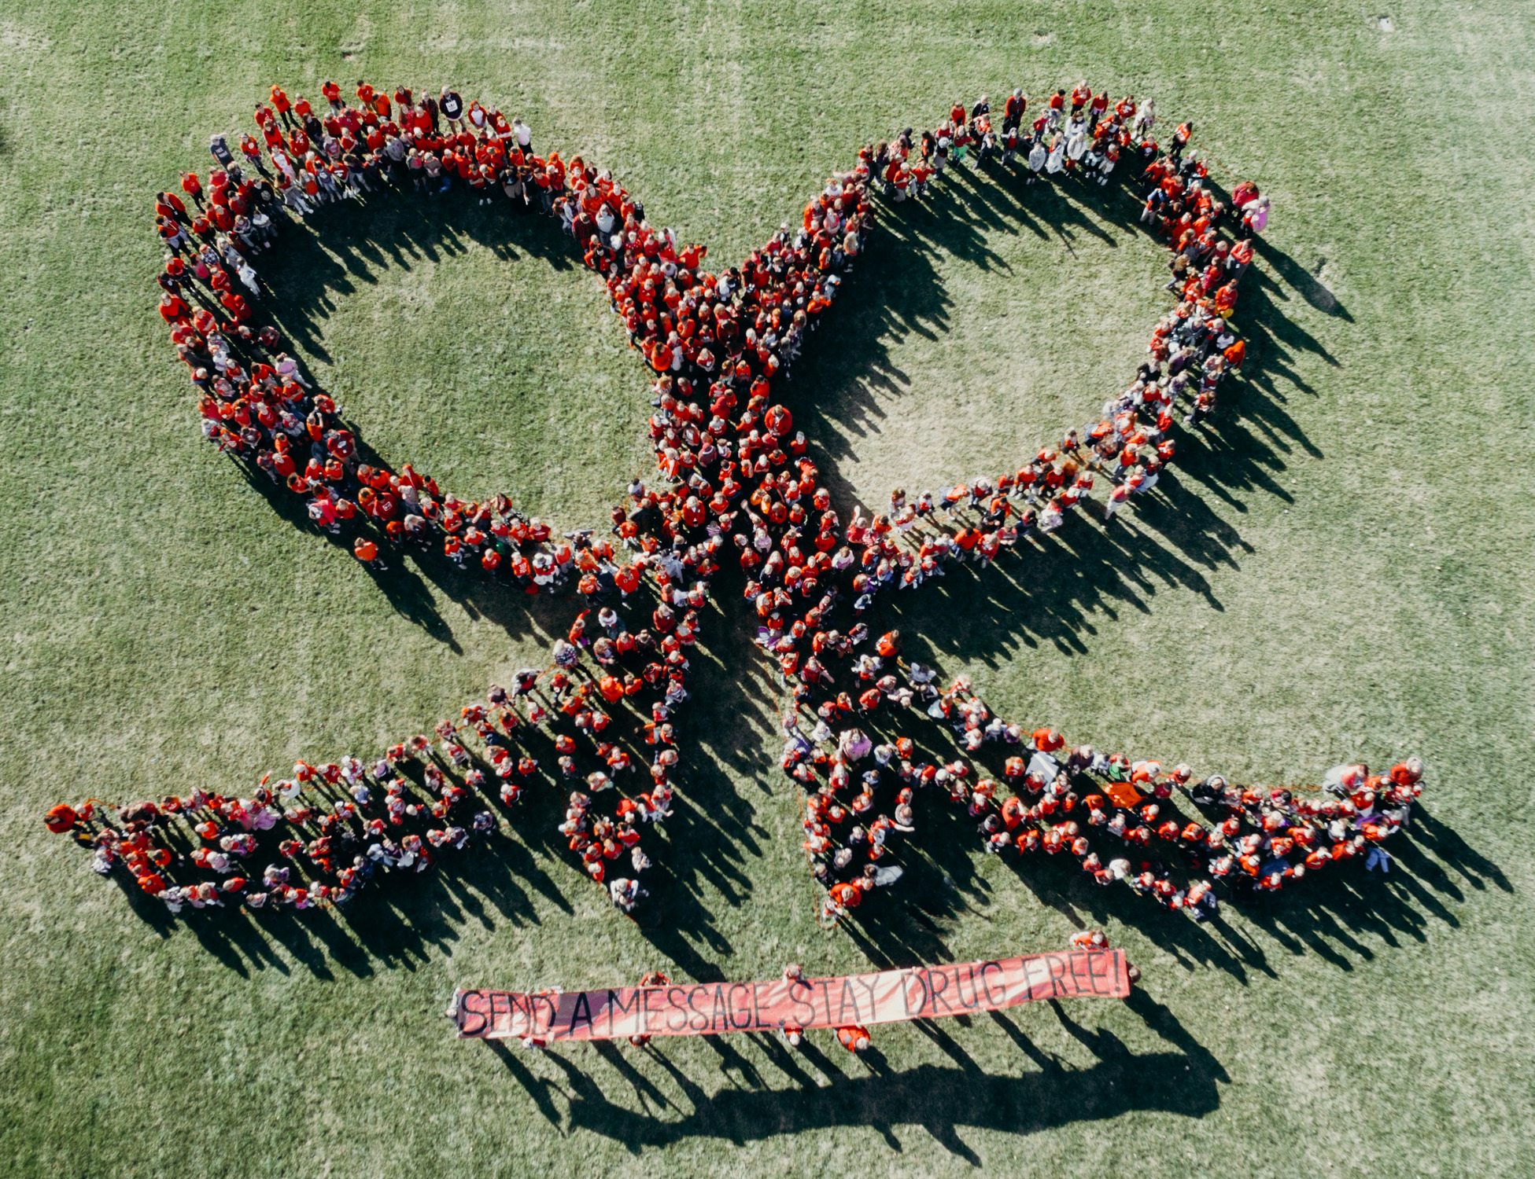
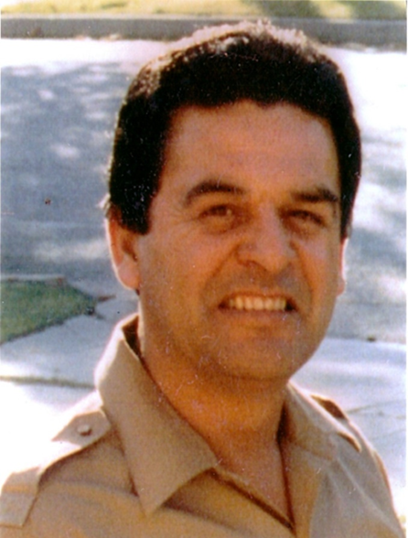
What Is red ribbon week?
Red Ribbon Week unites communities to take a stand against drugs
Began in 1985 as a way to honor the life of DEA agent Enrique Kiki Camarena
Gave his life to keep drugs out of the hands of children
Red Ribbon Week is the nation’s oldest and largest drug prevention awareness program
Notes:
USE IF VIDEO DOES NOT WORK
*Before 3rd point: He was very concerned about the drug problem in this country and wanted to make a difference by helping the people that he cared about.
*After 3rd point: the public wanted to do something to remember the ultimate sacrifice that he made

Slide 8

What We
Will Go Over
What Is A Drug?
Medicines & Are They Safe?
Alcohol & Underage Drinking
The Truth About Marijuana
What You(th) Should Know About Tobacco & Vaping
Notes:
Click after saying each point *5 clicks total*

Slide 9
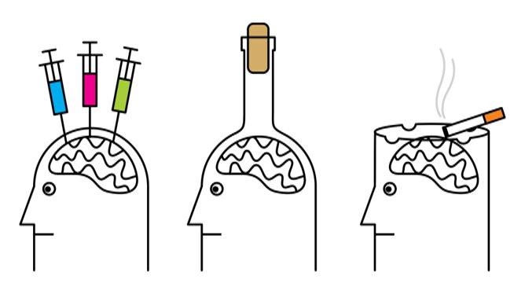
What is a drug?
A drug is a chemical substance that changes a person’s mental or physical state
Notes:
Mental(brain) and physical(body)
*read after*
These includes: alcohol, tobacco, prescription medicine, and marijuana

Slide 10
Medicines

Slide 11


Medicine
Prescription medication
Over-the-counter
Allergy medicine
Pain relievers
Opioids
  To treat pain
Depressants
  To treat anxiety and sleep disorders
Stimulants
  To treat ADHD
Notes:
*read before* When we talk about medicine, there are two different types we will go over: over-the-counter medicine & prescription medication.
*read after OTC points* You may have been given Pepto-Bismol for an upset stomach or Tylenol for a headache, those are examples of over-the-counter medicine. These medicines can be helpful when given to you by a trusted adult, like a parent/guardian or a doctor.
Then we have prescription medication*read after prescription medication* These are medications prescribed specifically for you by a dr to prevent, treat, or relieve symptoms of an injury or disease

Slide 12
TRUE or FALSE?
Prescription Drugs are Safer.

Slide 13
FALSE

Slide 14
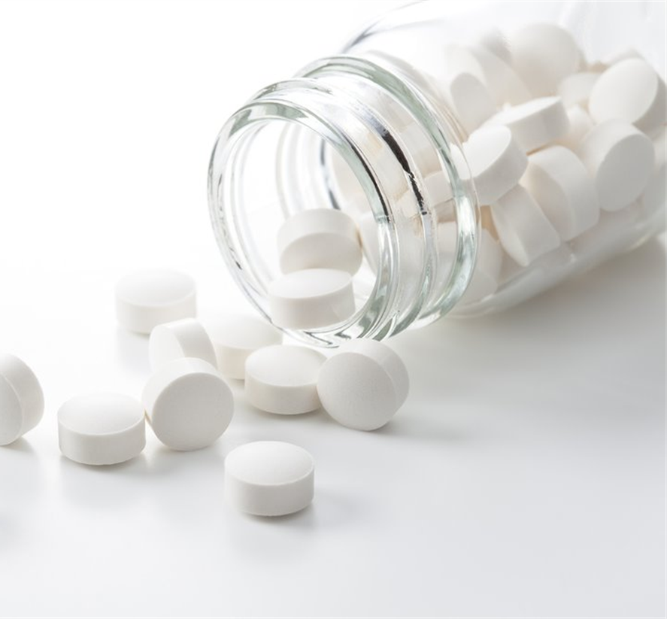
Misuse can look like:
Not following the directions
Taking someone else's medication
Taking medication to get “high”
Notes:
*read after showing FALSE* This is a common misperception: Many people believe that prescription drugs are safer to abuse than illicit drugs (illegal to have) because they are prescribed by a doctor, or since medicine is created and tested in a scientific environment. They don’t necessarily see this behavior as risky.
Most prescription drugs are safe and effective when used correctly for a medical condition and under a doctor supervision. But they can have serious side effects if not used correctly.
*Read before misuse* this brings us to misuse
Misuse:
1-* Taking a medication in a manner or dose other than prescribed
2-* even if for a legitimate medical complaint, such as pain
3-AND, misuse is taking medication to feel euphoria * – to “GET HIGH”
While some teens misuse medicine to party and get high, many are using medicine to manage stress or regulate their lives.
Some are misusing prescription stimulants to provide additional energy, while others are misusing pain relievers, tranquilizers and over-the-counter cough medicine to cope with academic, social or emotional stress.

Slide 15

Prescription drug misuse is among the fastest growing drug problems in the United States
DID YOU KNOW?

Slide 16
Opioid dependence can happen in how many days?

Slide 17

5 DAYS!!
Notes:
Using an opioid — a class of drug that includes prescription painkillers like oxycodone (OxyContin®) and hydrocodone (Vicodin®), as well as the illegal drugs heroin and fentanyl — for just five days causes a sharp increase in the likelihood that a person will use the drug long term. For many people, it can lead to a lifetime of addiction.
Opioid dependence can happen after just five days because the drugs are some of the strongest on the planet. Prescription opioids are chemically similar to heroin, one of the most addictive drugs. The National Institute of Drug Abuse reports nearly 80 percent of heroin users started with prescription opioids.
While Rx drugs serve an important purpose when under a doctor’s care, the misuse of prescription medicines is a growing problem that puts lives at risk for dependence, overdose and death.
Opioid dependence can happen after just 5 days (truthinitiative.org)

Slide 18

How to safely use RX medicine
Keep all doctor's appointments
Make a note of the effects the drug has on your body and emotions
Stay clear of other drugs or activities while taking your prescription
Take dose as prescribed
Notes:
*read before* So how can you make sure your safely using your prescription medication? Here are some tips:
1st point: Your doctor will want you to visit often so they can see how well the medicine is working for you and adjust the dose or change the medication as needed.
2nd point: especially in the first few days as your body gets used to it. Tell your doctor about these
3rd point: Make sure to keep any information your pharmacist gives you about any drugs or activities you should steer clear of while taking your prescription
4th point: Never increase or decrease the dose of your medicine without checking with your doctor's office first.

Slide 19



Alcohol and Underage Drinking
Notes:
*read before* An alcoholic drink can come in many forms. There are:
Beer Wine and liquor

Slide 20
What is underage drinking?

Slide 21
Underage drinking is when anyone under age 21 drinks alcohol.
Notes:
Alcohol is the most used substance among young people in the U.S.

Slide 22
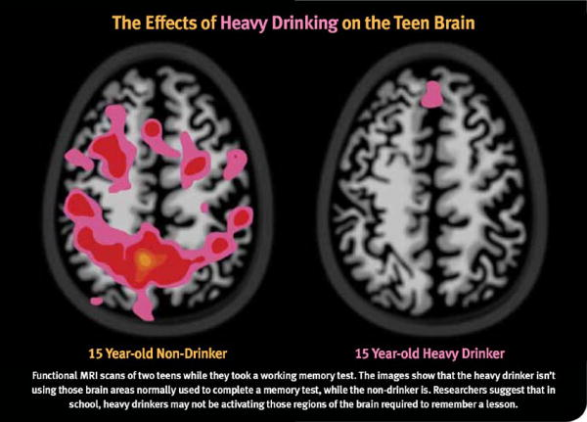
Alcohol & the Teen Brain
Alcohol before age 15
=
5 times more likely to have an
Alcohol Use Disorder
Notes:
*read before* The adolescent brain continues to develop and mature until the age of 25, and drinking alcohol at a young age has been known to have a negative impact on the way it develops.
Such as, alcohol use lowering educational achievement in later years, and the image of these MRI scans further proves that.
*explain picture*
The MRI scans were done of two 15-year-olds while they took a working memory test; one is a non-drinker, while the other is a heavy drinker.
The results of the scan showed that unlike the non-drinker who was able to complete the memory test, the heavy drinker wasn’t using the areas of the brain that would be used to complete the same test. This leads to researchers suggesting that in school, heavy drinkers may not be activating the parts of the brain needed to remember a lesson.
Along with the negative impact on your learning, drinking alcohol at a young age also increases your chance at becoming dependent on it.
*click-box appears*
Alcohol use disorder (AUD) is a condition characterized by an impaired ability to stop or control alcohol use despite social, occupational, or health consequences.
-this means despite all the problems that come along with alcohol use (relationship problems, bad grades, injuries) the person is unable to quit drinking.
*before transition to next slide*
“Adolescent alcohol use is not an acceptable rite of passage, but a serious threat to adolescent development and health.”

Slide 23
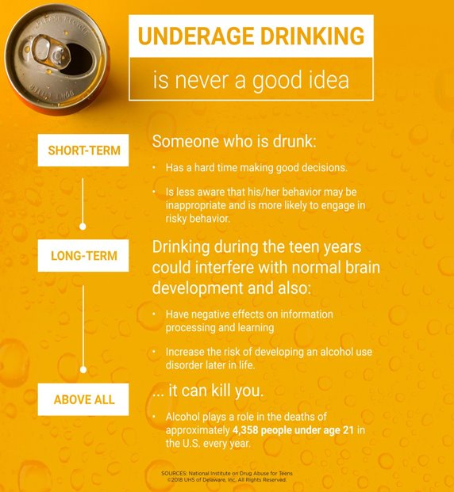
What can happen when you drink?
Notes:
*read before*
Not only does alcohol have a negative impact on your brain development, but there are also other risk you take when drinking at a young age.
*read points from image*
*after above all*
Underage drinking deaths includes about 1,900 deaths from motor vehicle crashes, 1,600 as a result of homicides, 300 from suicide, as well as hundreds from other injuries such as falls, burns, and drownings.
*read after* The Bottom Line: Teens aren’t prepared to deal with the risks of alcohol on their own.

Slide 24

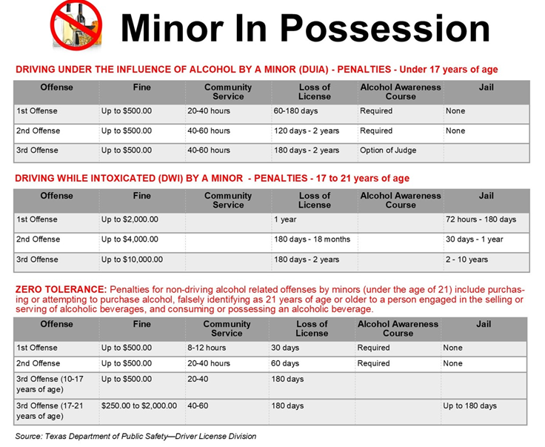



Before you risk it
Know the law
Know the risks
Look around you
Notes:
*read after each point*
1. KNOW THE LAW. The minimum drinking age in the United States is 21. Having a national minimum drinking age saves lives and improves health. There is even evidence that the law protects people from other drug dependence and suicide.
2. KNOW THE RISKS. Underage drinking contributes to more than 4,300 deaths among people below the age of 21 in the U.S. each year. Drinking under age 21 is also strongly linked with death from alcohol poisoning.
3. LOOK AROUND YOU. Although alcohol is the most commonly used substance by teens, most teens don’t drink. Each year, teens’ alcohol use continues to drop

Slide 25
The Truth
About Marijuana

Slide 26
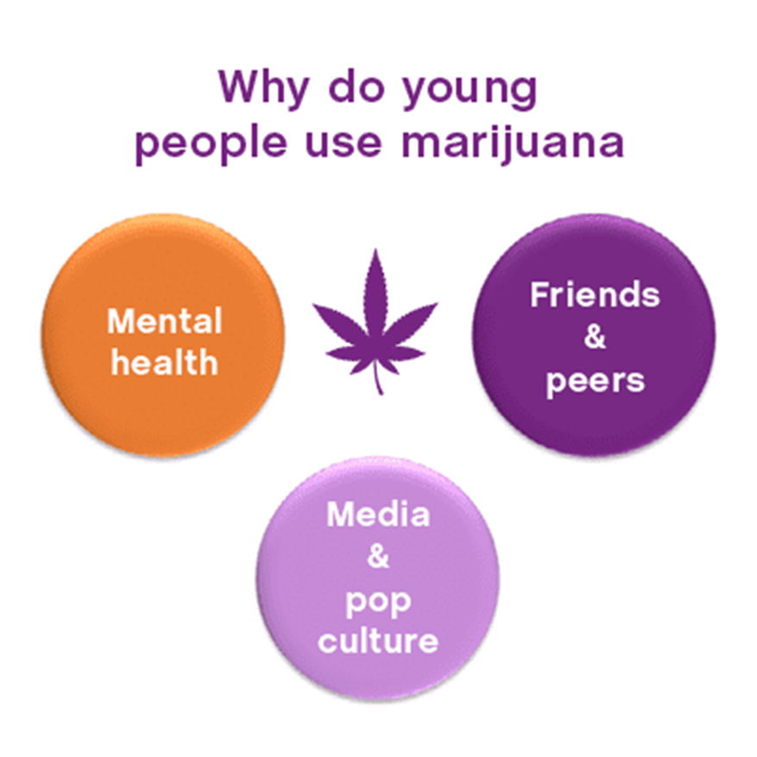
The Truth About Marijuana
Marijuana refers to the dried leaves, flowers, stems, and seeds from the Cannabis sativa plant
Slang: Weed/Pot/Grass/Reefer/Ganja/Mary Jane/Blunt/Trees
Contains the mind-altering chemical THC
Notes:
*before 2nd point* Marijuana goes by many different names, such as
*after 3rd point* which of the roughly 400 chemicals found in the cannabis plant affects the brain the most.
*before why they use* Approximately 1.2 million kids ages 12 to 17 used marijuana for the first time in the past year. That is about 3,300 kids a day
*mental health* Some young people use marijuana to try to relieve their feelings of depression or anxiety, sometimes the result of more responsibilities or school pressures.
*friends & peers* Research shows that having peers who use substances is one of the strongest predictors of a young person’s likelihood of trying and using a drug.
*after media & pop culture* Movies, TV shows, music and social media are strong influences in young people’s lives which tend to glorify marijuana use and downplay its harms. Also receives a lot of attention due to nationwide legalization efforts. It’s often viewed as a harmless substance.

Slide 27
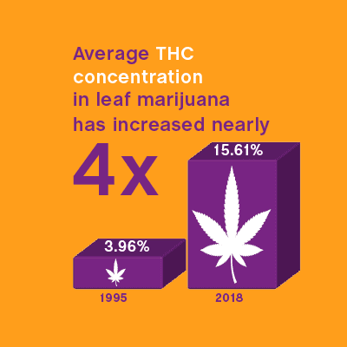
Rising Potency
Today’s marijuana is nothing like the marijuana of the past
There has also been an increase in ER visits involving marijuana
Higher potency is also associated with a greater risk of dependency
Notes:
*after 1st point* Marijuana potency has steadily increased over past decades
*after 2nd point* suggesting that the drug’s current strength is responsible for worse health consequences than decades past.

Slide 28
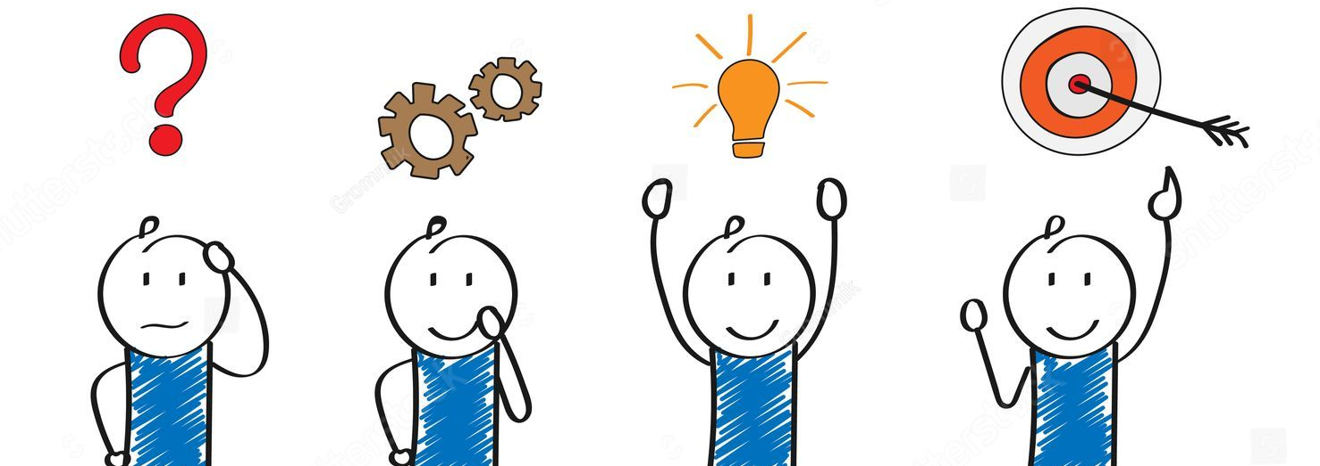
Effects of marijuana
Difficulty with thinking and problem-solving
Notes:
Image address: https://www.shutterstock.com/shutterstock/photos/1503774743/display_1500/stock-vector-stages-of-business-implementation-startup-problem-solving-cartoon-character-flat-design-1503774743.jpg

Slide 29
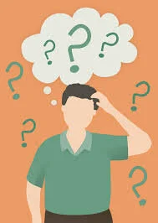

Effects of marijuana
Impaired memory
Distorded Perception
Notes:
Image address: https://images.squarespace-cdn.com/content/v1/57f5409e725e25ac19fd3af5/1582664332229-2J8ZDDV07HCIJLAIK8LW/Memory+Loss.jpeg
Image address: https://images.saatchiart.com/saatchi/2125425/art/11782931/10845171-WNQQZULA-32.jpg
Distorted perception example: altered perception of sights, sounds, time, touch, color

Slide 30
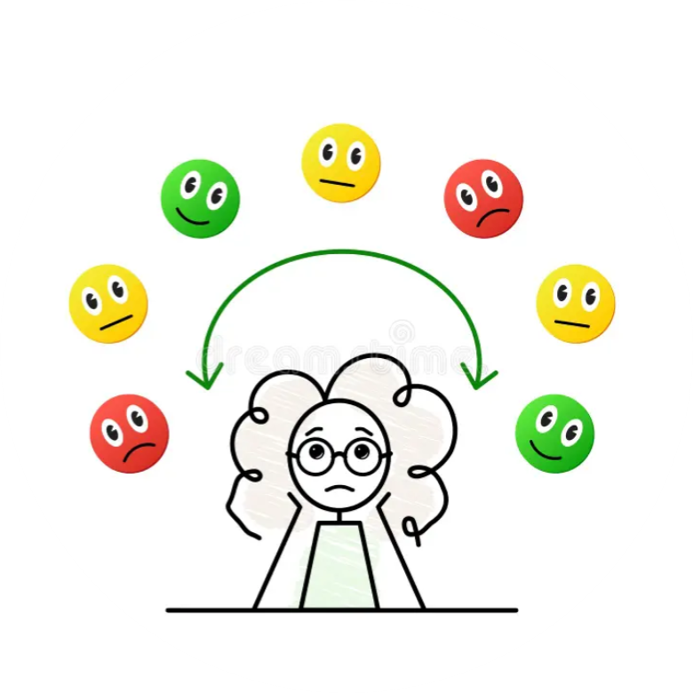
Effects of marijuana
Changes in mood
Notes:
Image address: https://thumbs.dreamstime.com/b/understanding-your-emotions-mood-swings-control-cute-little-teenage-girl-having-mood-changing-rapidly-emotional-roller-246390399.jpg

Slide 31
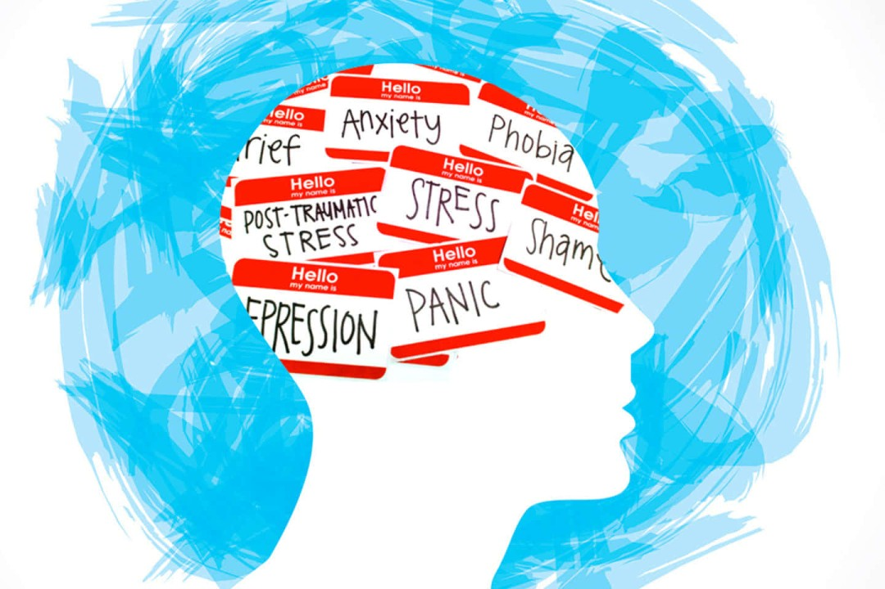
Effects of marijuana
Increased Risk of Mental Health Issues
Notes:
Image address: https://images.squarespace-cdn.com/content/v1/57f5409e725e25ac19fd3af5/1582664332229-2J8ZDDV07HCIJLAIK8LW/Memory+Loss.jpeg
Note**
Marijuana use has been linked to a range of mental health problems, such as depression and social anxiety. People who use marijuana are more likely to develop temporary psychosis (not knowing what is real, hallucinations, and paranoia) and long-lasting mental disorders, including schizophrenia (a type of mental illness where people might see or hear things that aren’t there)

Slide 32

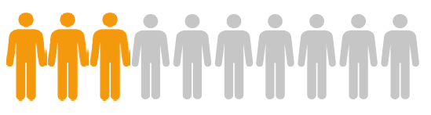
Marijuana Use Disorder
The Facts
What it looks like
Approximately 3 in 10 people who use marijuana have marijuana use disorder
Physical tolerance to the drug
Withdrawal symptoms
Craving for the drug
Problems with day-to-day functioning
Notes:
*before 1st point* Many teens believe that marijuana use is safer than alcohol or other drugs, but just like any other drug, marijuana can lead to dependency (their body starts depending on the drug) *2 clicks* (text & image)
*after the facts* The risk of developing marijuana use disorder is even greater for people who begin using marijuana before age 18
*after tolerance* which means one feels the need to consume a greater quantity or concentration to achieve the same high
*after withdrawal* include problems with sleep, nausea, irritability and restlessness, headaches and abdominal pain
*after problems* not fulfilling your responsibilities (doing schoolwork, chores) or giving up activities that were once enjoyed (playing sports, hanging out with friends)
*read after*
If you know someone who may have a marijuana use disorder, then there is something you can do to help.
BE A FRIEND. SAVE A LIFE.
Encourage your friend to stop using or seek help from a parent, teacher, or other caring adult.

Slide 33

Legal Status
Marijuana is the most used federally illegal drug in the United States
Under Texas law it is still illegal to use or possess marijuana
Recreational marijuana use by children and teenagers is not legal anywhere in the United States.
Notes:
*After 1st point*
Many states allow recreational use of marijuana in adults ages 21 and over.

Slide 34

Minors IN Possession
of THC CONCENTRATE
Possession of THC is a state jail felony charge
Possession of THC on school grounds enhances to a 3rd degree felony charge, resulting in:
  Being placed in alternative campus Disciplinary Alternative
  Education Program DAEP
  Drug Charges
  Possible Probation with Juvenile Court
  Texas Health and Safety Code 481.134d.
Notes:
There are the legal consequences of a minor in possession of a vape and vape with THC. Reminder, all school properties are drug free zones. Possession of THC is a state jail felony charge. Possession of THC on school grounds on school grounds enhances charge to 3rd degree felony charge. ​
When its not on school grounds Texas Health & Safety Code 481.403A1
Reference: SAISD Vaping Presentation for FACE Specialists FINAL

Slide 35
Nicotine & Vaping

Slide 36
What You(th) Should Know About Tobacco & Vaping
Tobacco product use is started and established primarily during adolescence
Each day in the U.S., about 1,600 youth smoke their first cigarette
  Nearly 200 youth will become new, regular daily smokers
If those rates continue, an estimated 5.6 million of today’s youth under age 18 eventually will die early from a smoking-related disease
Notes:
*after 1st point*Almost 90 percent of adult daily smokers started smoking by the age of 18

Slide 37
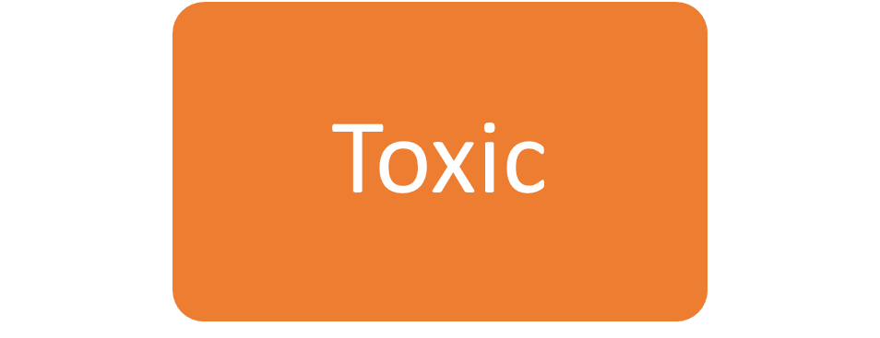
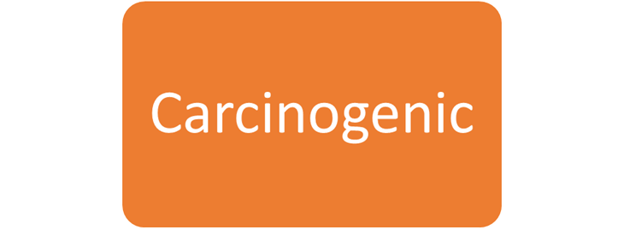
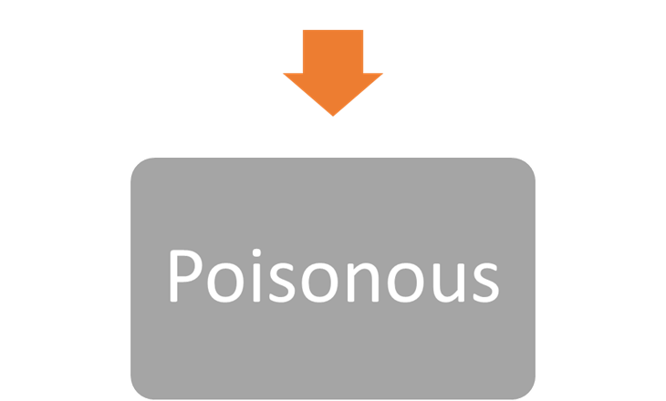
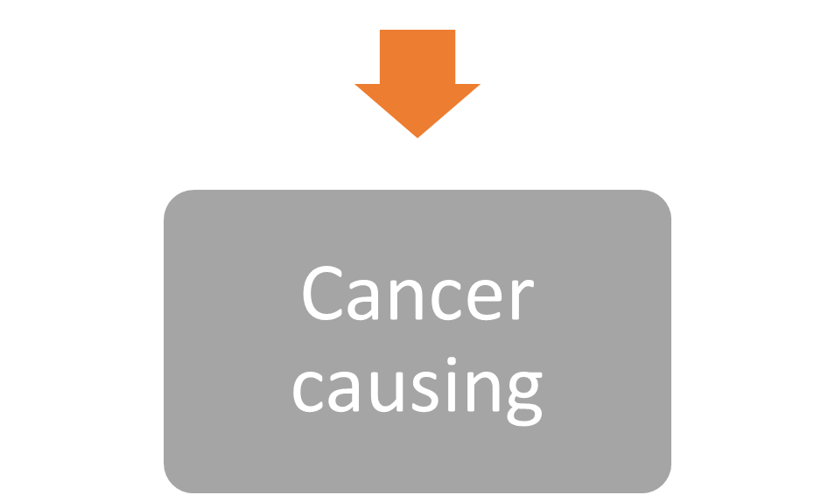
Key Terms
San Antonio Council on Alcohol and Drug Awareness - www.sacada.org
Notes:
These next two key words will be used throughout this section of vaping. It is important to understand that when you hear the word toxic it should be a red flag in your mind because these chemicals are poisonous to the human body.
It is important to understand what this word means. Sometimes vape/cigarette companies use big words that youth may not understand. Sometimes they will tell you that their product contains cancer causing chemicals, but it can be glossed over if you don’t know what the word means. It is important to be informed so you can make the healthiest decision for your life and share this information with others.

Slide 38
Key Terms
If your perception of harm is low, you will be more likely to use a drug.
Perception:
a way of regarding, understanding, or interpreting something; a mental impression.

Slide 39
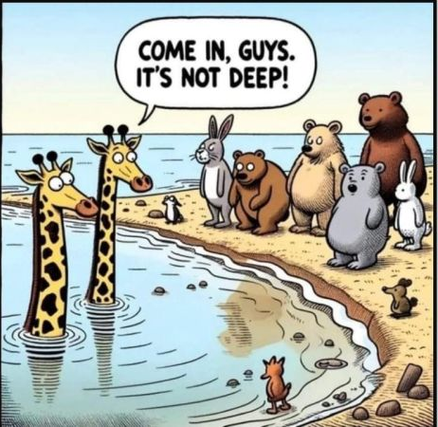
What do you see?
Notes:
What you don’t see is really the depth of the water and that if the smaller animals do go in they will be under water. Our prefrontal cortex is still developing until the age of 25 and when it is not fully developed adolescents have a more difficult time thinking through risks of decisions they make.

Slide 40
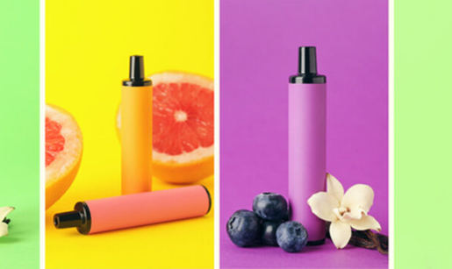
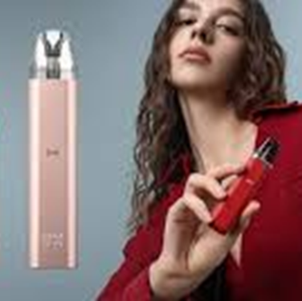

What do you see?
Notes:
Image address: https://t3.ftcdn.net/jpg/05/13/65/32/360_F_513653241_9K6rfNlR5nN1PxezjxykYEIbFYL4minr.jpg
Image address: https://encrypted-tbn0.gstatic.com/images?q=tbn:ANd9GcR--0jJCx4W49QMe2uXFIFwEN71yrvo74b7Kw&s
Image address: https://encrypted-tbn0.gstatic.com/images?q=tbn:ANd9GcRYhklfyS5dTi2Tmbay9uBfYljcOqIRrlOIkw&s
This is a great slide to remind youth that the brain develops till the age of 25. Advertisers understand that if they can get youth addicted at an early age the youth will become lifelong customers, therefore putting more money in the pockets of the vape/cigarette companies.

Slide 41
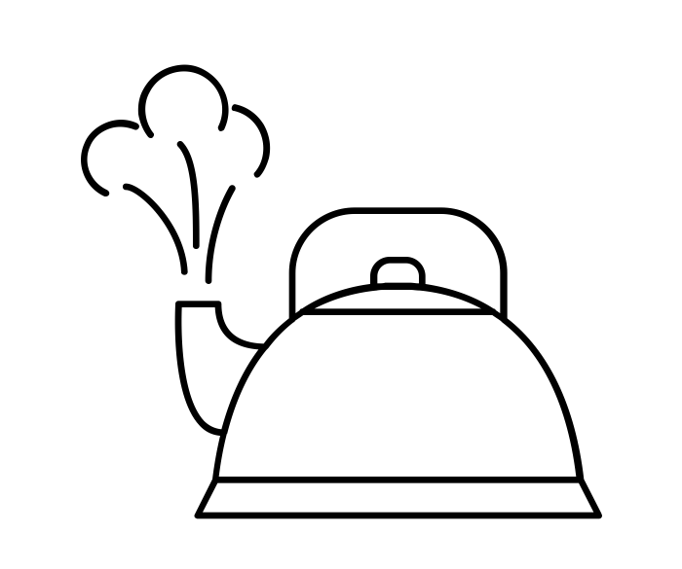

It’s Not a Vapor, Its an Aerosol
Notes:
Teacher Talking Points:
E-cigarettes/vape pens allow the user to make large clouds that many think are just water vapor
In reality the ‘cloud’ is a mixture of many different chemicals that were either present in the e-liquid before or produced during the heating process (click)
A vapor is a chemical that has evaporated
An aerosol is a mixture of liquid particles suspended in a gas and can contain many chemicals
Instead of just mixing with the air like a pure gas, aerosols can leave drops behind.

Slide 42
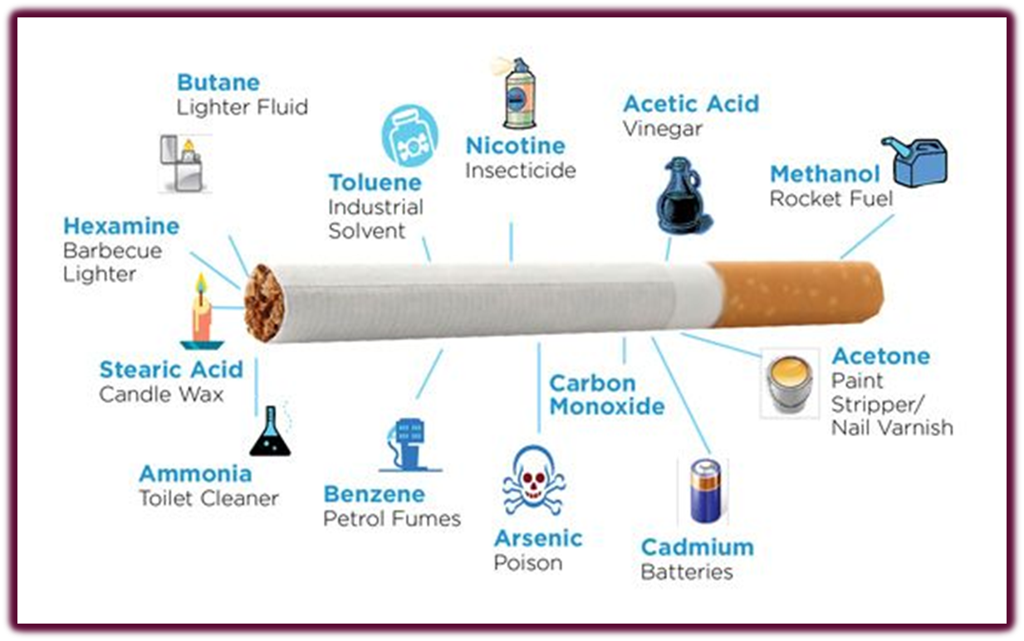
What you don’t see.
There are over 7,000 chemicals inside of a single cigarette. Hundreds are toxic and about 70 are known to cause cancer.
Notes:
There are over 7,000 chemicals in a cigarette – over 70 of which are known to cause cancer.
(Go over each chemical )
“Why do you think they would put lighter fluid in a cigarette?”
(They put lighter fluid in cigarettes so that they light, burn smoothly – but most importantly they add it because it makes the cigarette burn more quickly – the faster a person finishes a cigarette, the sooner they must go buy another pack…)
CDC - 2010 Surgeon General's Report - Chemicals in Tobacco Smoke - Smoking & Tobacco Use
Harmful Chemicals in Tobacco Products | American Cancer Society

Slide 43
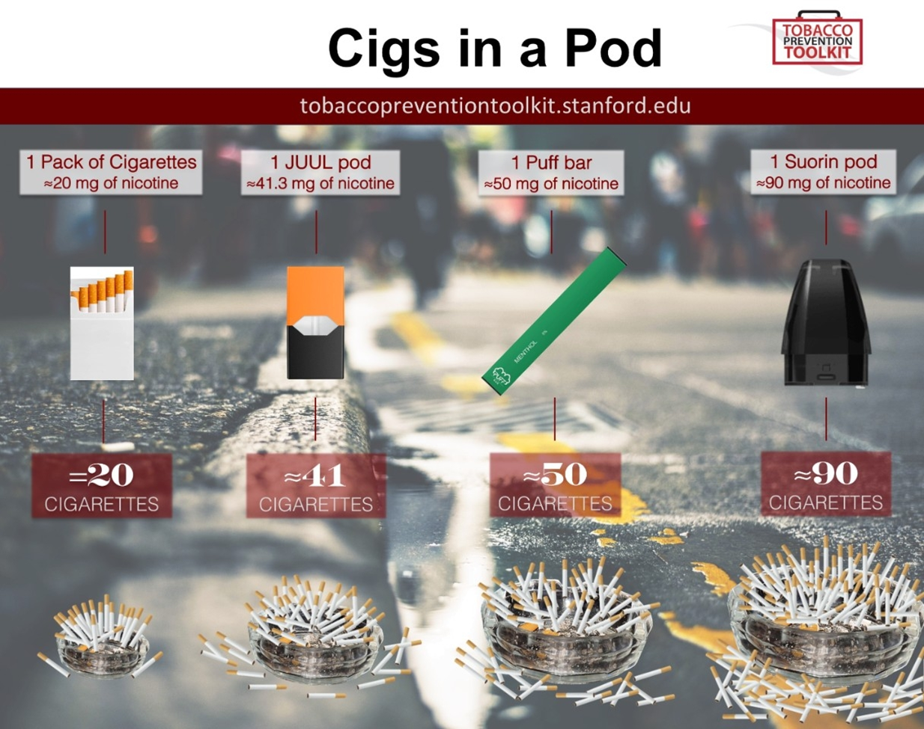
San Antonio Council on Alcohol and Drug Awareness - www.sacada.org
Notes:
This slide can be utilized to help the youth understand potency of nicotine in vapes.
Its easy to underestimate the amount of nicotine inside of these vapes because they come very compact. Just because something comes in a small package or compact device does not mean that it is not harmful or not as potent. Remember more potent means more dangerous to your brain and more addictive.,
A good example to help them understand this is relating potency to the one chip challenge on TIK TOK. It was a challenge to eat a single spicy chip that came in a package. This chip was extremely hot. Now remember this was only one chip, but because it was so potent some people ended up going to the hospital. Because of its potency this chip is not the same as a whole bag of hot Cheetos or a whole ag of Takis. Its potency makes it dangerous. Well let's look at the potency of vapes in the pictures above.
Keep in mind that elf bars are not on the image above but they are the most popular vape among youth and come in 2%and 5%
Elf Bar 600 is created with a built-in 550 mAh battery and 2ml of 20 mg nic salt e-liquid and
The Elf Bar BC5000 has a 5% nicotine concentration, meaning 50mg per ml, or around 0.13mg per puff. ( you can use the milligrams to correlate with the image above.
How Much Nicotine Is In An Elf Bar BC5000? Vape Nicotine Content & Cigarette Comparison (westcoastvapesupply.com)
Flavored E-Cigarette Use
Almost 9 out of 10 current e-cigarette users (89.4%) used flavored e-cigarettes, with fruit flavors being the most popular, followed by candy, desserts, or other sweets; mint; and menthol
Over half (57.9%) of students currently using e-cigarettes reported using flavors with “ice” or “iced” in the name
Type of Device
The most commonly used device among current e-cigarette users was disposables (60.7%), followed by prefilled/refillable pods or cartridges (16.1%)
Commonly Used Brands
The most commonly reported brands reported among current e-cigarette users were: Elf Bar (56.7%), Esco Bars (21.6%), Vuse (20.7%), JUUL (16.5%), and Mr. Fog (13.6%)
Results from the Annual National Youth Tobacco Survey | FDA

Slide 44
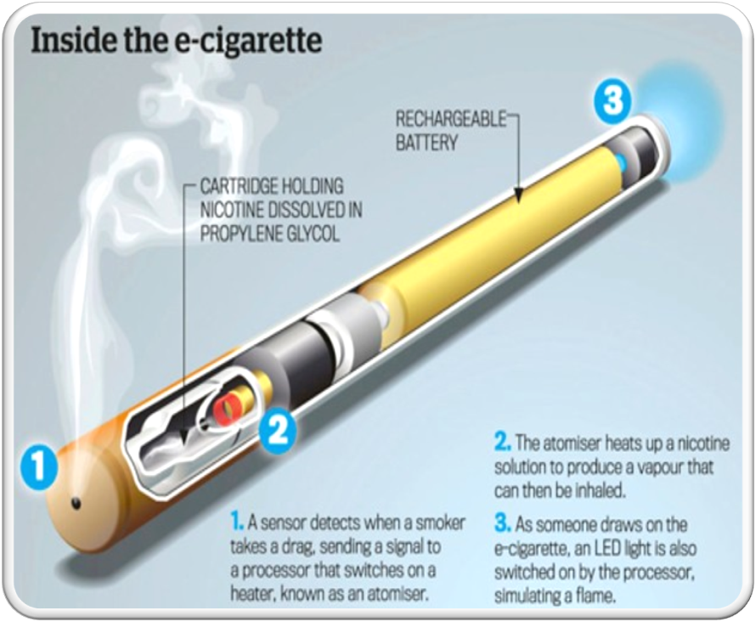
BENZENE (a carcinogen also found in car Exhaust)
FORMALDEHYDE(A carcinogen used to preserve dead bodies)
ACROLEIN (toxic, and can cause irreversible lung damage)
PROPYLENE GLYCOL and/or vegetable glycerin (chemicals used for theatre or stage fog)
HEAVY METALS (such as nickel, lead, and tin)
DIACETYL (a chemical linked to lung damage)

Slide 45
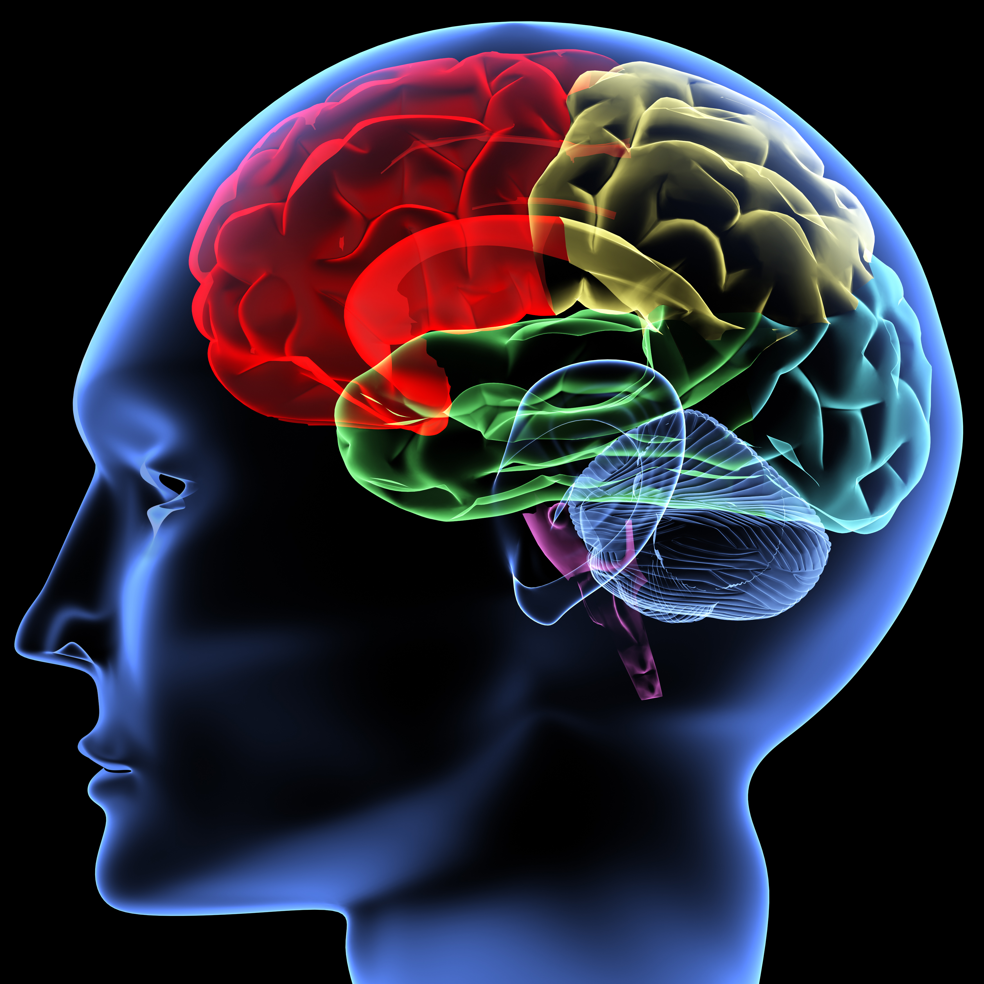
Electronic Nicotine Delivery Systems (ENDS)
Other names include e-cigarettes, e-cigs, vape pens, vaporizers, and e-pipes
Vaping is not harmless
Teens who vape may end up addicted to nicotine faster than teens who smoke cigarettes
Young people who use e-cigarettes may be more likely to smoke cigarettes in the future
Notes:
*read before* Vapes that contain nicotine are a type of tobacco product called electronic nicotine delivery systems (ENDS)
*read after 1st point* according to the National Youth Tobacco Survey, e-cigarettes have been the most commonly used tobacco product among U.S. middle and high school students, For the fifth year running (2021)
*read after 2nd point* youth who use nicotine may experience lasting effects on attention, learning, and memory that promote addiction to nicotine. They also may experience
coughing, wheezing, nausea, vomiting, headaches, and dizziness.
*read after 3rd point* This is because vapes may expose users to more nicotine and may be used more frequently.

Slide 46
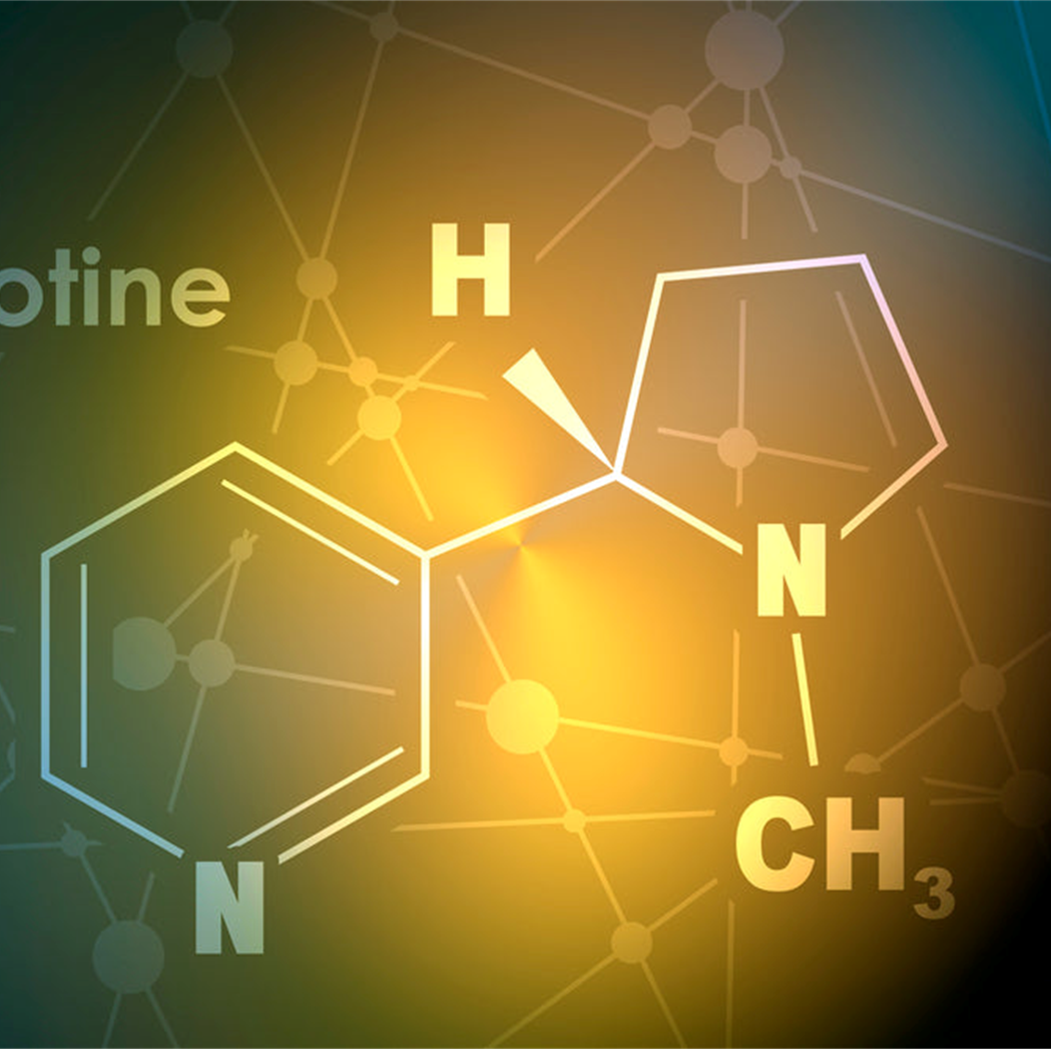
What does nicotine dependency look like?
Needing to vape after waking up in the morning
Feeling anxious or irritable due to cravings
Vaping without thinking about it
Having trouble concentrating or sleeping
Notes:
*read before* now we’re going to take a look at what a nicotine dependency can look like, because chances are there are youth out there that don’t even realize that they have become dependent
*after reading symptoms* these symptoms apply to all tobacco products that contain nicotine, not just vaping. If you are using a different type of tobacco product, replace the word ‘vape’ with what you are using.

Slide 47
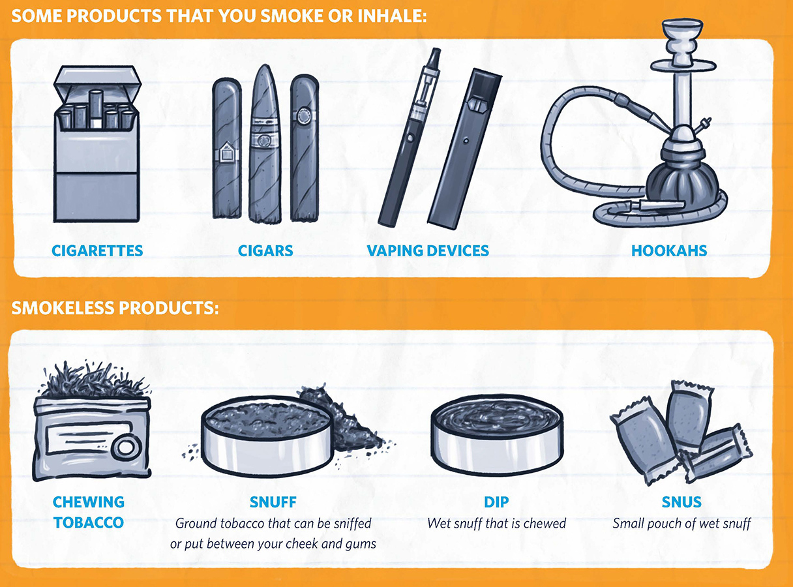
No matter how it's delivered, nicotine is addictive and harmful for youth and young adults
Notes:
*read before* People who smoke know what can happen if they continue to smoke, but they keep doing it anyway.
If you ask them if they could go back and do it over, would they start smoking again, most of them would say “NO”
So, why do they continue to smoke? Because they are addicted nicotine.
*Read after* Nicotine has been proven to be as addictive as cocaine and heroin and may even be more addictive

Slide 48
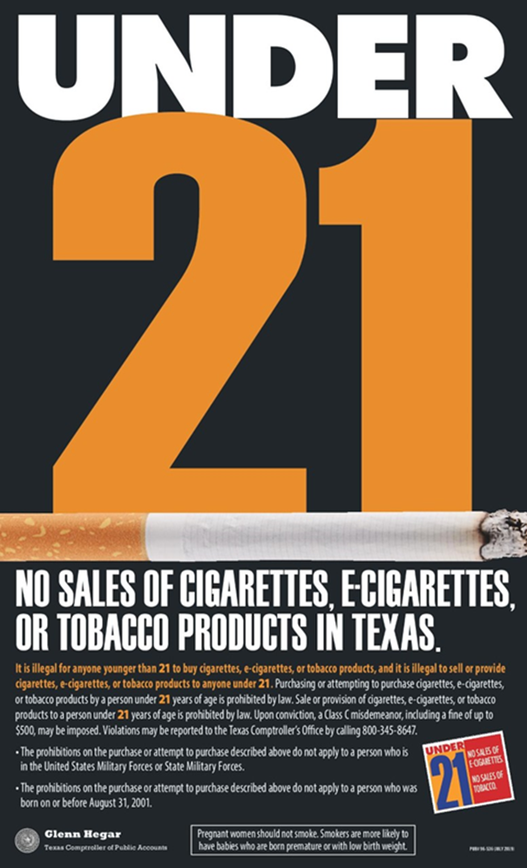
Tobacco 21
On September 1st of 2019 it became illegal for anyone under the age of 21 to purchase tobacco or e-cigarette products
This law is an important step toward reducing youth smoking and preventing a lifetime of dependency and disease
Notes:
*Read before* In order to Reduce Smoking and Save Lives, Tobacco 21 came into effect
*before 2nd point* Due to the majority of tobacco users starting before age 18

Slide 49

Minors & Tobacco
Must attend a state-approved tobacco awareness class
Perform tobacco-related community service
Pay a fine not to exceed $250
Suspension of driver’s license
Notes:
*read before* For those minors who do try to possess, consume, or purchase tobacco products, there are legal consequences that come along with that decision
*read after* along with these legal consequences, keep in mind any consequences that your parent/guardian might add, or consequences if you are found using these products at school

Slide 50
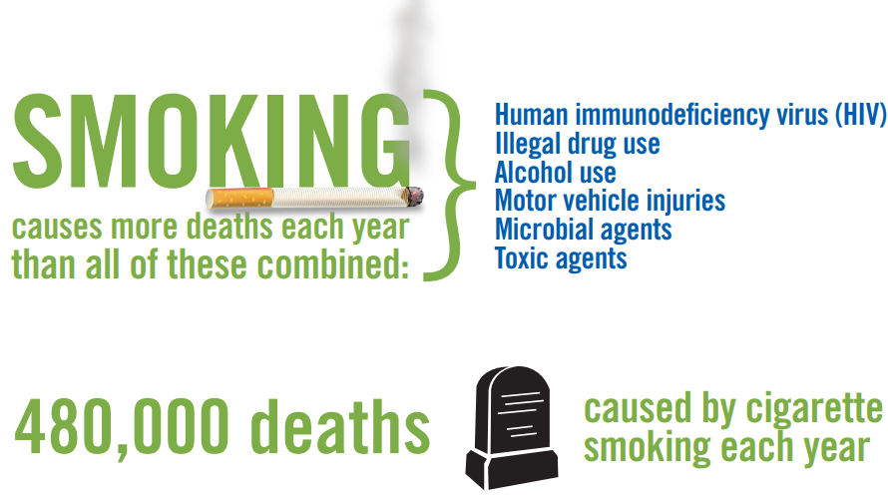
THE NUMBER ONE CAUSE OF PREVENTABLE DEATH
100 million people in the 20th century
480,000 Americans
7 Million worldwide
Notes:
*read before* Tobacco use is the number one cause of preventable death in the United States and around the world.
*1st point* Tobacco killed * one hundred million people worldwide in the 20th century — and if current trends continue, it will kill one billion people in the 21st century.
*2nd point* Every year, tobacco kills more than * 480,000 Americans (including more than 41,000 deaths resulting from secondhand smoke exposure)
And seven million people worldwide.
*read after* THE MAJORTIY STARTED SMOKING AS CHILDREN

Slide 51
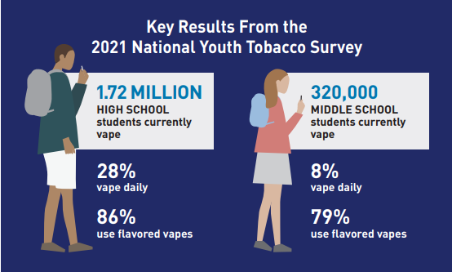
Electronic Nicotine Delivery Systems (ENDS)
Other names include e-cigarettes, e-cigs, vape pens, vaporizers, and e-pipes
Vaping is not harmless
Teens who vape may end up addicted to nicotine faster than teens who smoke cigarettes
Young people who use e-cigarettes may be more likely to smoke cigarettes in the future
Notes:
*read before* Vapes that contain nicotine are a type of tobacco product called electronic nicotine delivery systems (ENDS)
*read after 1st point* according to the National Youth Tobacco Survey, e-cigarettes have been the most commonly used tobacco product among U.S. middle and high school students, For the fifth year running *read image*
*read after 2nd point* youth who use nicotine may experience lasting effects on attention, learning, and memory that promote addiction to nicotine. They also may experience
coughing, wheezing, nausea, vomiting, headaches, and dizziness.
*read after 3rd point* This is because vapes may expose users to more nicotine and may be used more frequently.

Slide 52
It’s never too late to quit!
Notes:
*read first* Whether you have been vaping for weeks or years, there is still time for you to make a change and quit. Quitting can be tough, but you are tougher! And there are resources available during this transition.
This is Quitting is a free and anonymous text messaging program from Truth Initiative designed to help young people quit vaping.

Slide 53
How to take back control
Choose a quit date
What is it costing you?
Why are you quitting?
Know your triggers
Set yourself up for success
Notes:
*Read before* Deciding to quit using drugs is a huge step, and it can be a difficult time to go through. Making a quit plan will set you up for success and get you back to taking control of your life.
*read after each point*
Pick a day during the next 2 weeks. Try not to choose a date that will be stressful, like the day of a big game or a test
Calculate how much the drug you use is costing you. You’ll then find out how much money you can save by quitting.
Knowing your reasons for why you want to quit can help you stay motivated and on track, especially in difficult moments. (examples: to take back control, people you care about want you to quit)
After you stop using your drug of choice, certain places and situations can remind you of it and make it hard to stay drug free. Think of the social situations( going to a party,) Everyday situations(seeing that drug on tv or in movies,) Emotions you feel(bored, lonely, excited)
Set yourself up for success by thinking about who in your life you will reach out to for support, how you will get expert help, and how you will distract yourself when you have the urge to use. This will keep you on track and boost your chances of quitting for good.

Slide 54



is not good for your brain
The
Bottom
Line
it interferes with growing up healthy
it can interfere with, or prevent you from reaching your goals and dreams
Notes:
*read before*
I know this was a lot of information, but the main thing I would like you to remember is this:
Using drugs at an early age:
*read after 1st point* Your brains are still growing and developing
*read after*
Take a moment and think about what your goals are in life. Will any of these substances help you get there?

Slide 55





How to Celebrate Life
Fall in love with something
Use your days
Keep a journal
Be grateful
Notes:
*read before*
So how are you going to celebrate life, and be the best you can be because you live Drug-Free? Here are just a few things you can do!
*read after each click*
Fall in love with a hobby (reading, hiking, making TikTok videos), fall in love with yourself and discover what makes you , YOU.
Get out of bed early on the weekend and go and do things. Spend more time with your friends/family, and less time on your phone. Get the most out of your day!
Whether it be in a notebook or the notes app on your phone, take time to write down and reflect upon your day. What were some moments that made you happy? What about today frustrated you?
Be thankful for what you have done with your life so far, and thankful for those that you have in your life. Look to the future and all the dreams/goals that are waiting for you to accomplish.
*read after*
Remember that you are worth it, you are special, and have a lot to contribute to this world! Make your life goals your priority and don’t let anything get in the way of you achieving those goals.

Slide 56
Resources
https://kidshealth.org/en/teens/prescription-drug-abuse.html
https://www.cdc.gov/alcohol/fact-sheets/underage-drinking.htm
https://store.samhsa.gov/sites/default/files/SAMHSA_Digital_Download/PEP21-03-03-001.pdf
https://www.hhs.gov/sites/default/files/underage-drinking-community-guide.pdf
https://www.talkitoutnc.org/underage-drinking-facts/
https://www.brainandlife.org/articles/how-does-alcohol-affect-the-teenage-brain
https://www.cdc.gov/healthreport/publications/compendium.pdf
https://www.cancer.gov/publications/dictionaries/cancer-terms/def/drug
https://year13.com.au/articles/14-things-need-teenage-years?next=14-things-need-teenage-years
https://www.niaaa.nih.gov/publications/brochures-and-fact-sheets/understanding-alcohol-use-disorder
https://www.aacap.org/aaCaP/Families_and_Youth/Facts_for_Families/FFF-Guide/Marijuana-and-Teens-106.aspx/
https://www.cdc.gov/marijuana/health-effects/teens.html
https://drugfree.org/drugs/cannabis-marijuana/
https://truthinitiative.org/thisisquitting#:~:text=What%20is%20This%20is%20Quitting,successfully%20quit%2C%20e%2Dcigarettes.
https://teen.smokefree.gov/quit-plan?variant_key=teen_smoking_quit_plan
https://digitalmedia.hhs.gov/tobacco/hosted/Vaping-ECigarettes-Youth-Toolkit.pdf

Slide 57

South Texas Centre – Dave Coy Building
7500 U.S. Highway 90 West, Suite 201
San Antonio, Texas 78227
Phone: (210) 225-4741  Fax: (210) 225-4768
www.sacada.org
Mrs. Abigail Garza Moore, Chief Executive Officer

