Slide 1



2025

Slide 2
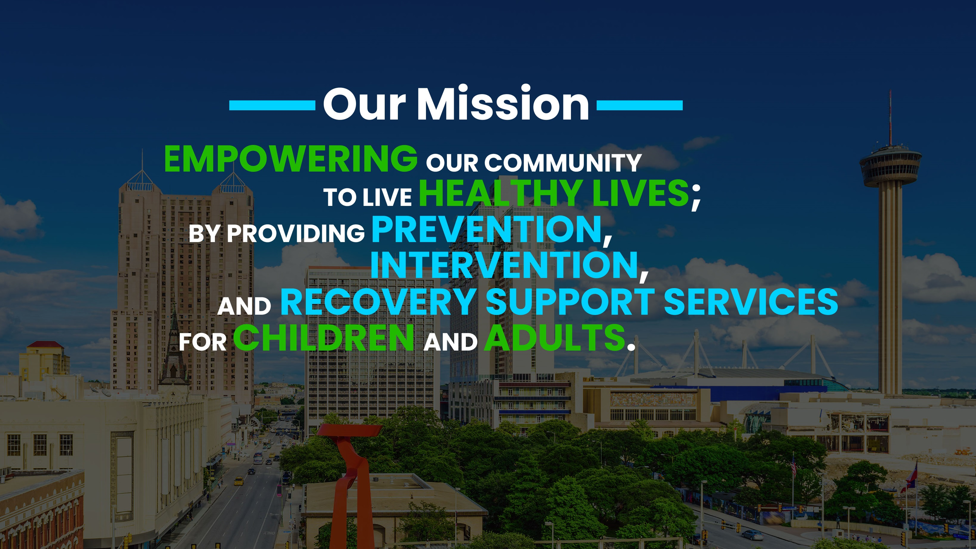
Notes:
Good morning, my name is __________________________ I am a prevention specialist with the San Antonio Council on Alcohol and Drug Awareness.
SACADA’s mission is:
Empowering our community to live healthy lives by providing Prevention, Intervention and Recovery Support Services for Children and Adults.

Slide 3
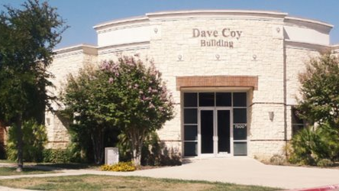
WHY I DO WHAT I DO…​
Notes:
( Note To staff: CREATE YOUR OWN INTRODUCTION HERE)​

Slide 4
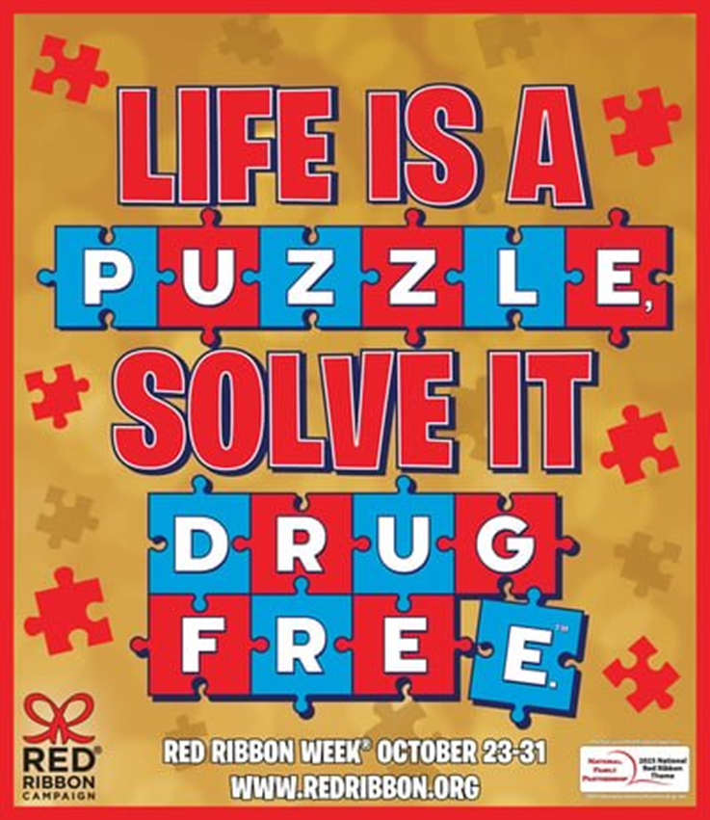
2025
THEME​
Notes:
We’re excited to announce the 2022 Red Ribbon Campaign Theme, Celebrate Life. Live Drug Free.™. Submitted by Emily King, Chelsea Abbott, and Celise Wicker, 7th graders at Wayland-Cohocton Middle School in Wayland, New York, the theme is a reminder that everyday Americans across the country make significant daily contributions to their communities by being the best they can be because they live Drug-Free!

Slide 5
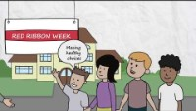
WHAT IS RED RIBBON WEEK?

Slide 6

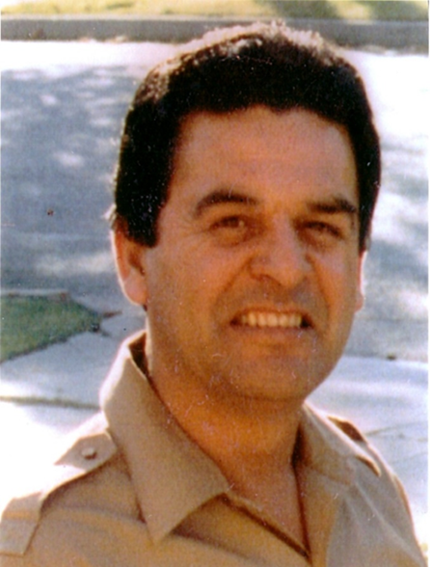
Enrique “Kiki” Camarena 1947-1985
Grew up in Mexico, moved to the US
Served in the Marine Corps
Joined the Drug Enforcement Administration (DEA)
Gave his life to keep drugs out of the hands of children
Notes:
Red Ribbon week honors the memory of Enrique “Kiki” Camarena . In 1956, Kiki moved from Mexico to California. * After he graduated from high school, he joined the Marine Corps. * He was a policeman before he became a Special Agent with the Drug Enforcement Administration (DEA) * in 1974.
He was very concerned about the drug problem in this country, * and wanted to make a difference by helping the people that he cared about.
(Presenter’s) please read more about his life and his story there is information on Wikipedia and these other sources below.
https://en.wikipedia.org/wiki/Kiki_Camarena
DEA https://www.getsmartaboutdrugs.gov/get-involved/red-ribbon-week,
and here, https://www.dea.gov/redribbon

Slide 7
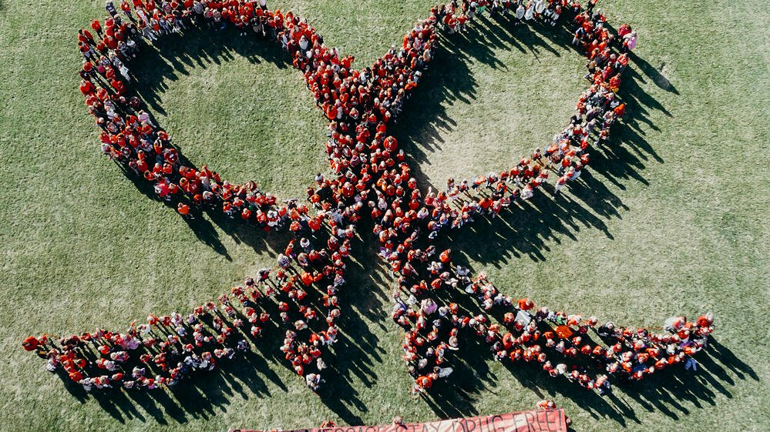
DRUG PREVENTION AWARENESS
Notes:
Officer Camarena gave his life in the fight against drugs, and the public wanted to do something to remember the ultimate sacrifice that he made.
Red Ribbon Week started in 1985 in Kiki’s hometown of Calexico, California, and soon spread to the rest of the country.
Red Ribbon Week * is the nation’s oldest and largest Drug Prevention Awareness Program.

Slide 8

we will ANSWER THESE QUESTIONS:
What is a Drug?
Are medicines SAFE?
Alcohol, the brain and goals
Tobacco & vaping
Ways to Say "NO"
Notes:
Today we will be talking about Drugs, including Medicine, Alcohol, and Tobacco.
I’m hoping that if you have the facts, you will make healthy choices.

Slide 9


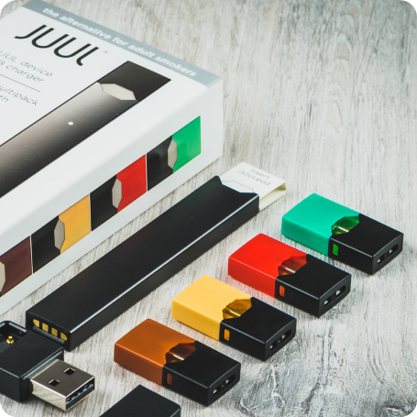
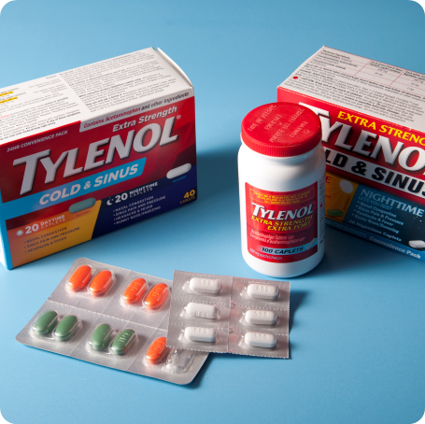
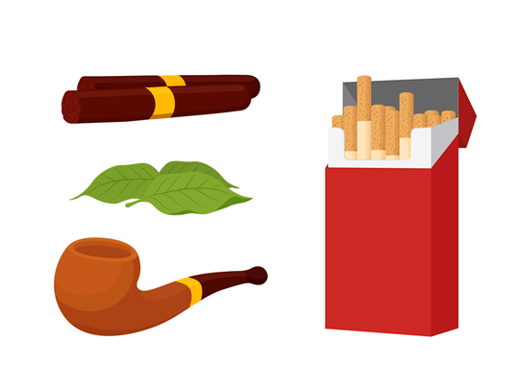
WHAT IS A DRUG?
A drug is anything that changes the way your mind and body work.
Notes:
*click* A drug is anything that changes the way your mind and body work.
Examples of drugs are: * Medicine * Alcohol and Tobacco

Slide 10
Medicine

Slide 11
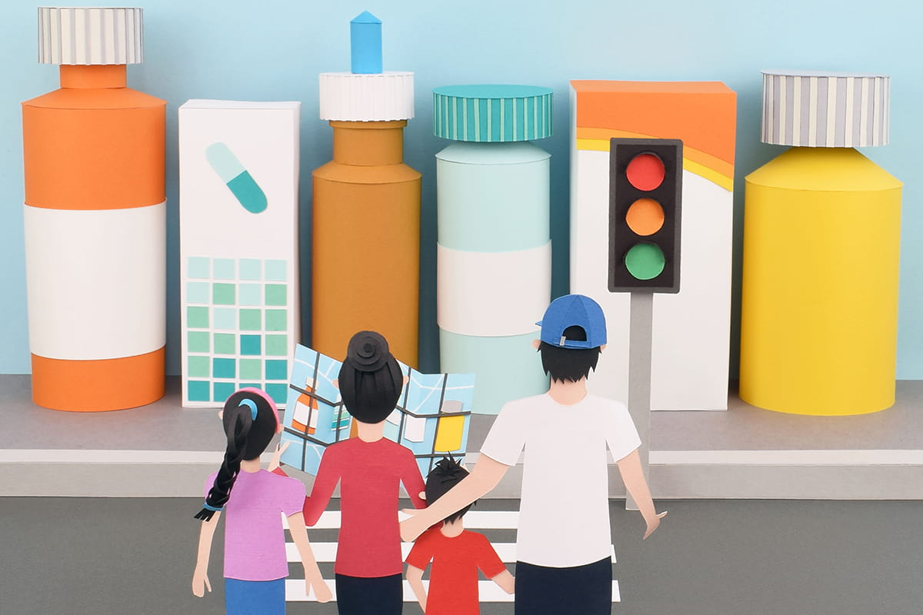
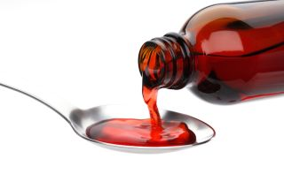
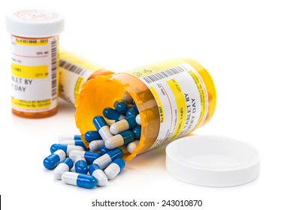
Medicine
Notes:
Medicines can be very helpful when given to you by a trusted adult like your parent or a doctor.
There are two different types of medicine. Over the counter medicine and prescription medication. Does anyone know the difference?
You may have been given Tylenol or Pepto-Bismol, from time to time. Those are examples of Medications - helpful drugs. These are medicines over the counter.
Prescription medications are prescribed specifically for you by a Dr to prevent, treat, or relive symptoms of an injury or disease.
REMEMBER: Only take medicine from a trusted adult, like a parent, grandparent, doctor or nurse.

Slide 12
Alcohol

Slide 13



Alcohol
BEER
WINE
SPIRITS
Notes:
Another type of drug is Alcohol – something some adults drink.
It is legal for adults over the age of 21 to drink alcohol. There are three types of Alcohol: Beer , Wine and Spirits (Hard liquor)
Alcohol is not healthy for a young person's brain.

Slide 14

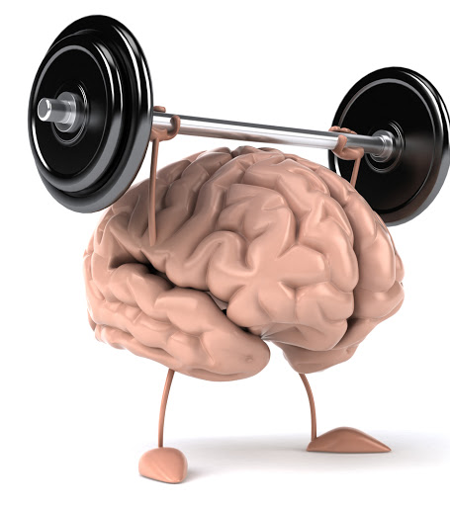
AT
LEAST
AGE 25
Notes:
Did you know your brain is not fully developed until about the age of 25? *
Drinking alcohol during this critical growth period can lead to lifelong damage in brain function, particularly memory, motor skills (ability to move) and coordination.
Additionally, the impact of alcohol on a developing brain is far more damaging than it is to the adult brain.
When a young person, whose brain is still developing, tries any drug, the risk of addiction is great !
(Addiction means someone wants to do something over and over even though it may be unhealthy for them.)

Slide 15
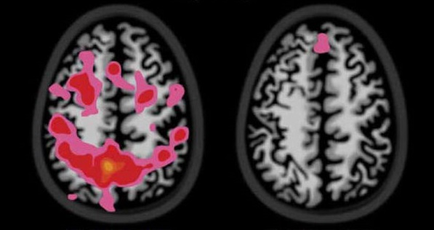

Healthy
Control
Alcohol Dependent
Notes:
As I mentioned earlier, Alcohol effects the brain.
Look at the picture on the left. See all the bright colors in the healthy brain - that is a lot of healthy brain activity. *
But you can see on the right, here, that there is very little brain activity in an alcohol drinker’s brain.
Underage drinking increases the risk of developing an alcohol use disorder later in life.

Slide 16


Alcohol
It can interfere with or prevent you from reaching your goals and dreams.
Notes:
The main thing I would like you to remember about alcohol is it is not healthy for young people, it interferes with growing up healthy,
And it can interfere with or prevent you from reaching your goals.

Slide 17
Tobacco

Slide 18
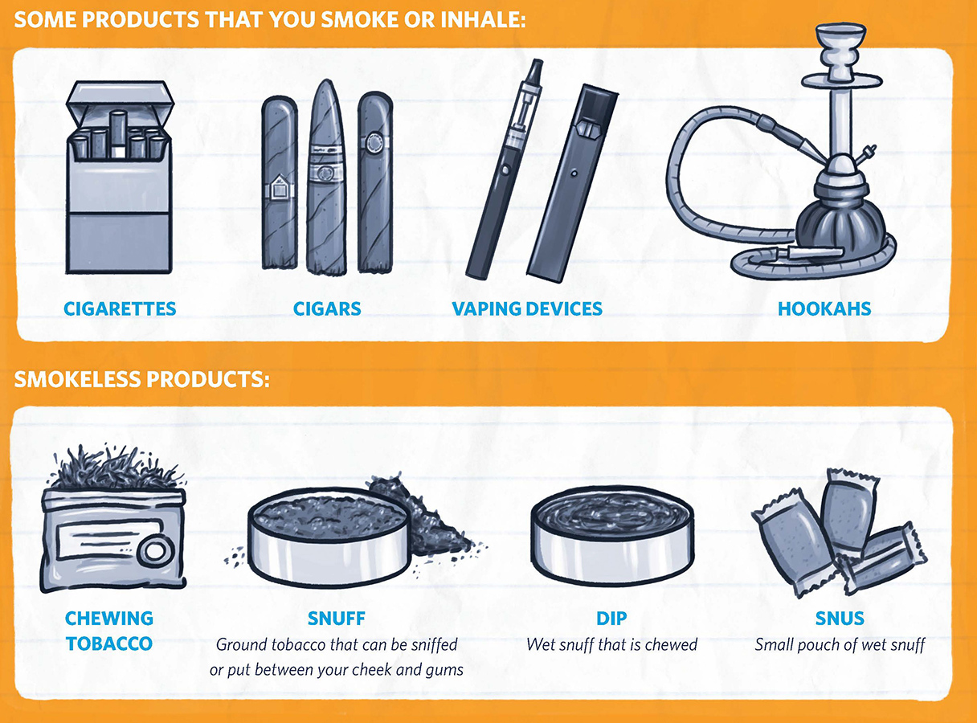
TOBACCO IS A DRUG
Notes:
Did you know that TOBACCO is a drug.
It comes many forms: Smokeless or Chewing Tobacco, Cigarettes and Cigars. AND E-Cigarettes or JUULS
There is a chemical found in tobacco called nicotine, which is addictive and harmful for youth and young adults no matter how it’s delivered,

Slide 19
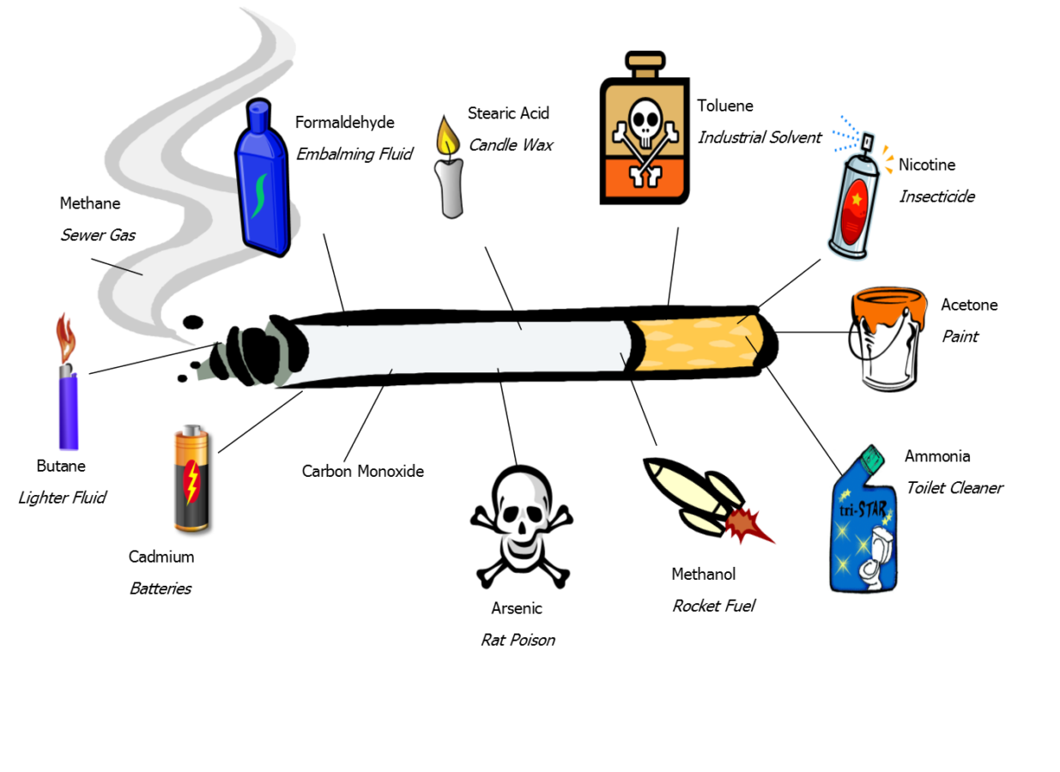
What’s in a Cigarette?
Notes:
There are over 4000 chemicals in a cigarette – over 70 of which are known to cause cancer.
(Go over each chemical )
*Ask students* “Why do you think they would put lighter fluid in a cigarette?”
(They put lighter fluid in cigarettes so that they light, burn smoothly – but most importantly they add it because it makes the cigarette burn more quickly – the faster a person finishes a cigarette, the sooner they must go buy another pack…)

Slide 20
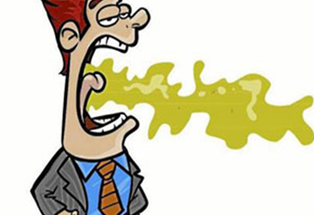
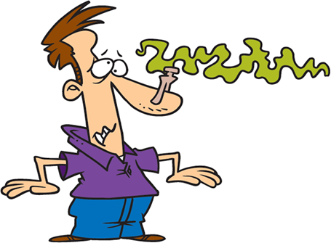

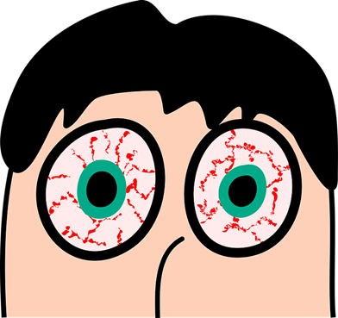
SHORT-TERM EFFECTS
BAD BREATH
STINKY CLOTHING
YELLOW TEETH
RED EYES
Notes:
I know you have probably been taught the long-term negative health consequences of smoking, but I want you to know that some of the negative health consequences start from the very first puff….
Immediate effects are: * Bad Breath *Yellow Teeth * Stinky hair and clothing * Red Eyes

Slide 21
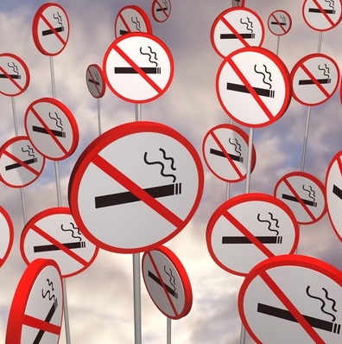


LUNG CANCER
HEART DISEASE
STROKE
BREATHING PROBLEMS
LONG TERM EFFECTS
Notes:
Remember, there are severe long - term consequences of smoking:
LUNG CANCER
HEART DISEASE
STROKE
BREATHING PROBLEMS

Slide 22
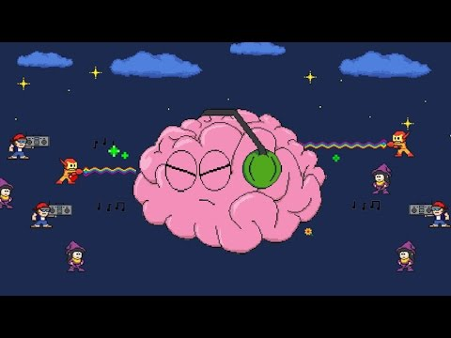
Notes:
This video gives an inside look into how tobacco addiction changes your brain, and what happens every time you smoke a cigarette.
https://youtu.be/uFX9F-KD7co?si=QZCtDzrTzGCnQr5a

Slide 23
E-cigarettes/
Vaping

Slide 24
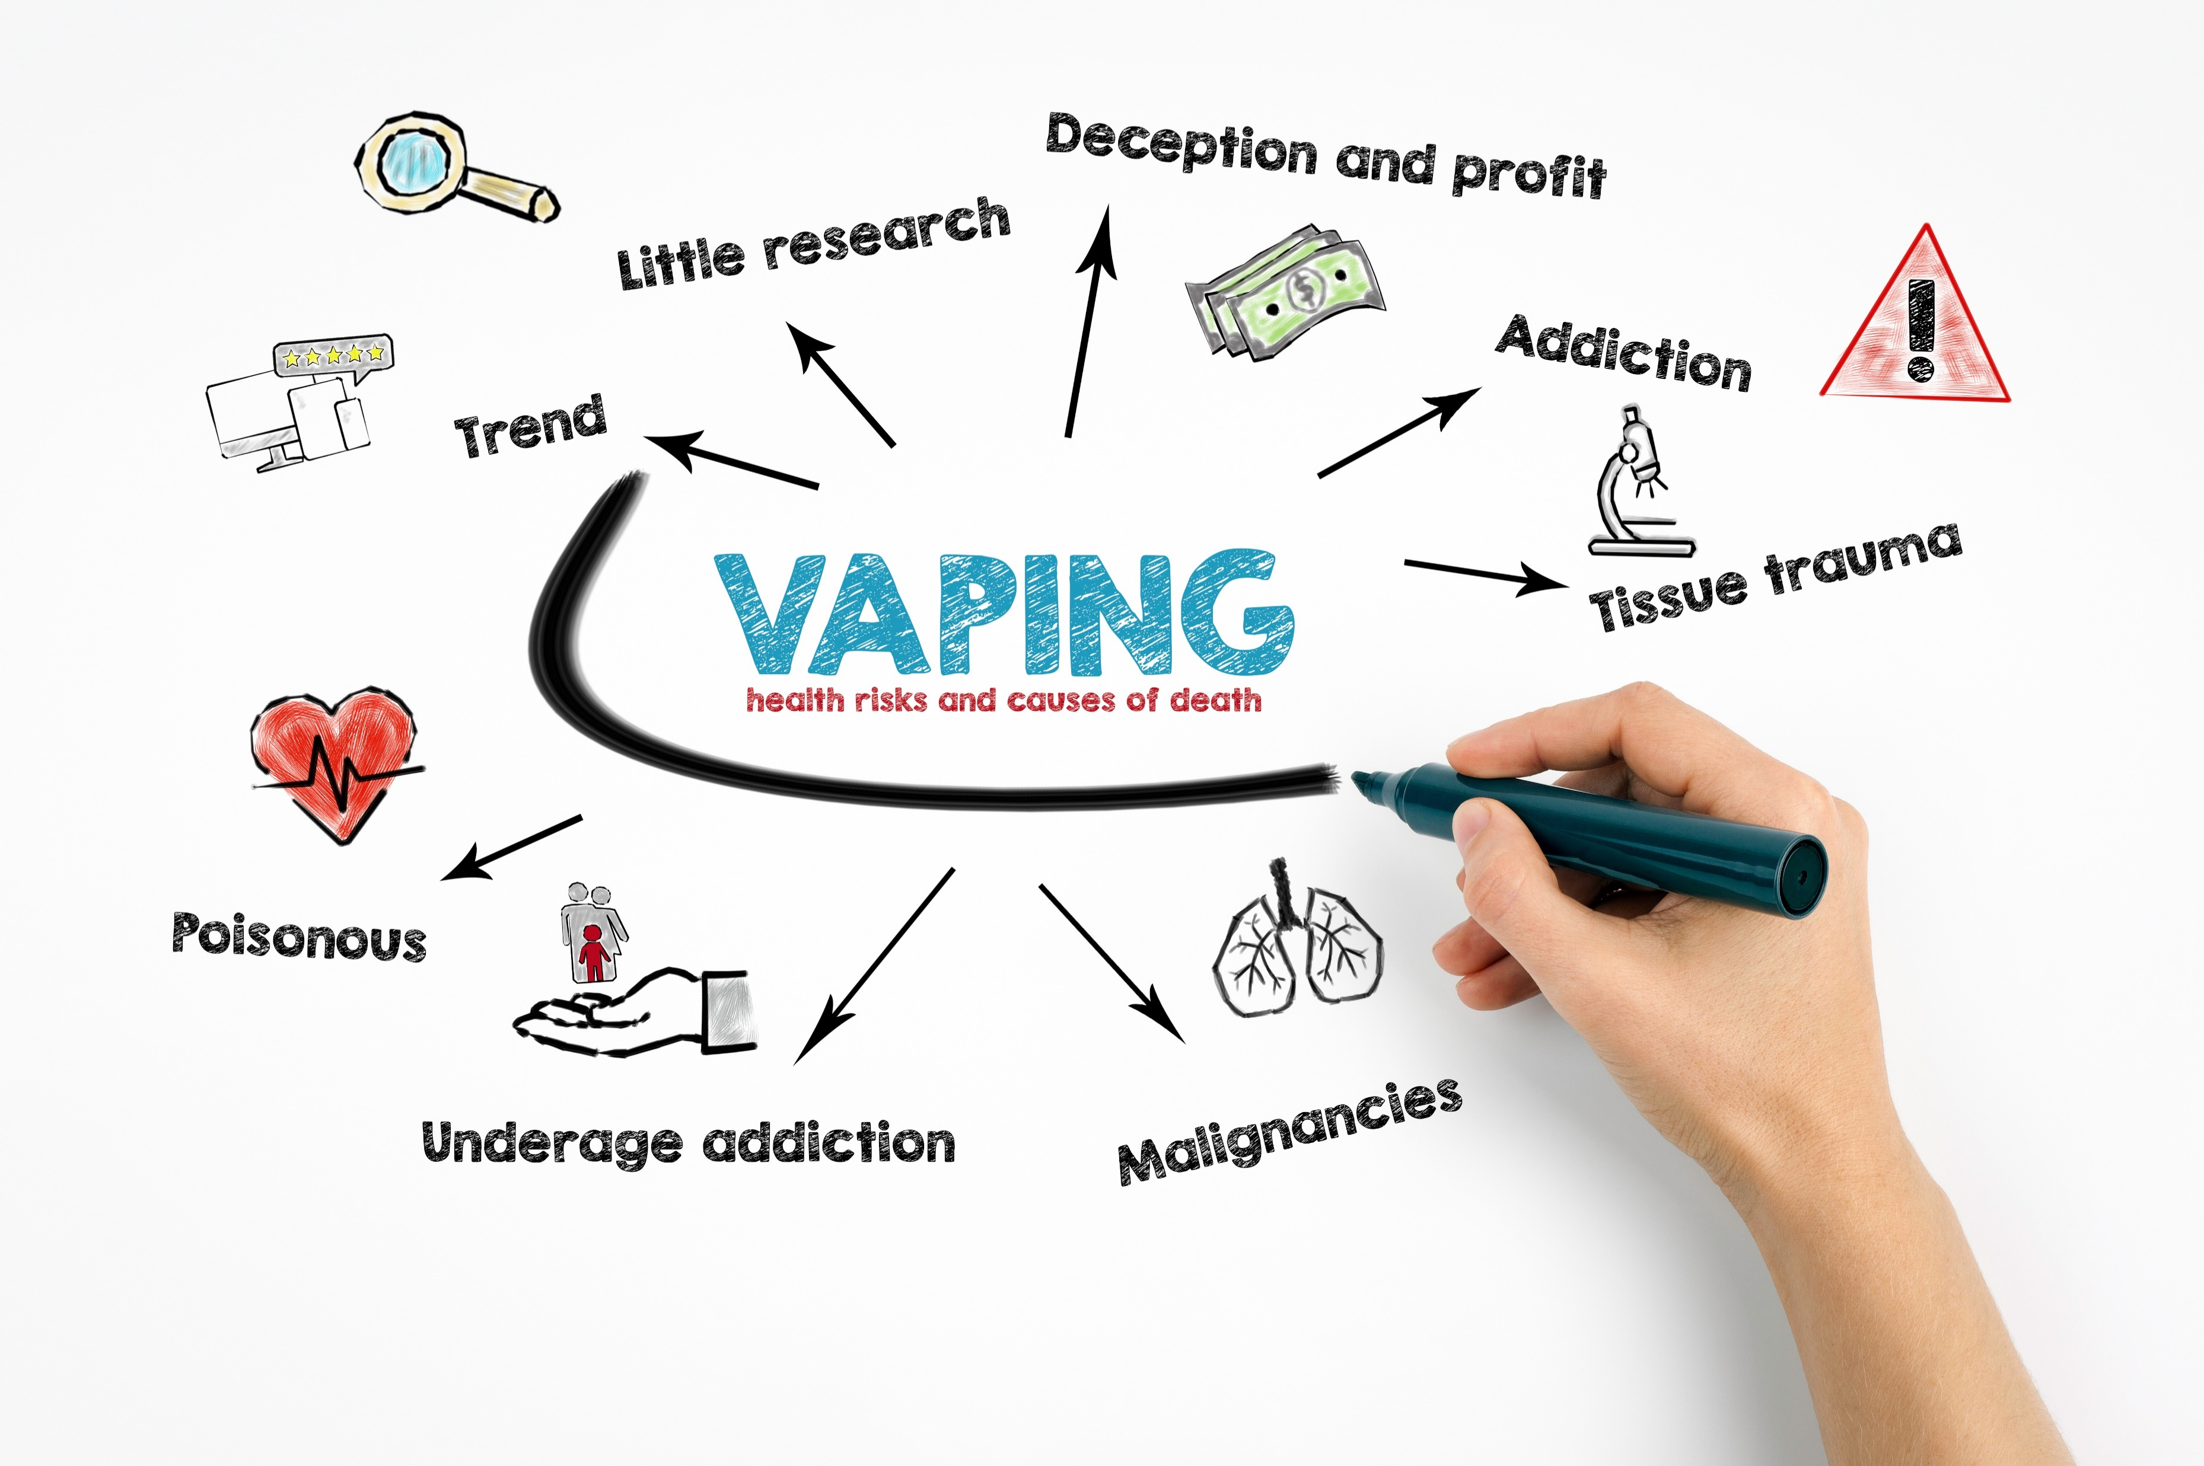
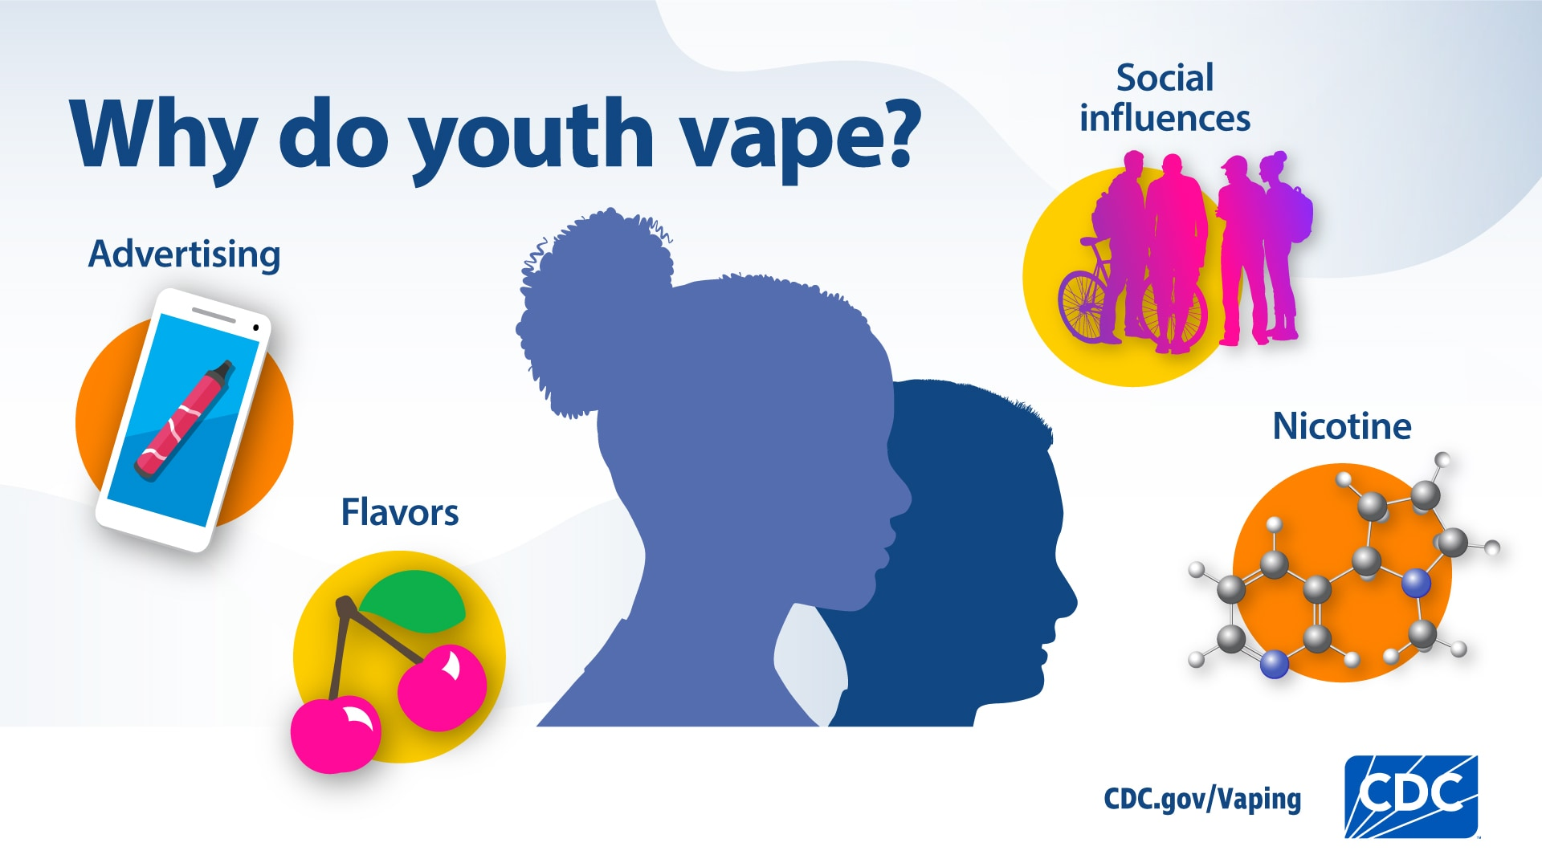
E-CIGARETTES AND VAPING
Notes:
E-cigarettes are the most commonly used tobacco product among U.S. youth, and they are not harmless like most people believe.
The Chemicals in e-cigarettes, and JUULS’s can damage the lungs
That damage can reduce the ability of the lungs to keep out germs and other harmful substances and can lead to permanent lung damage.
In addition, these products contain nicotine, and we know that Nicotine is harmful to the developing brain.

Slide 25

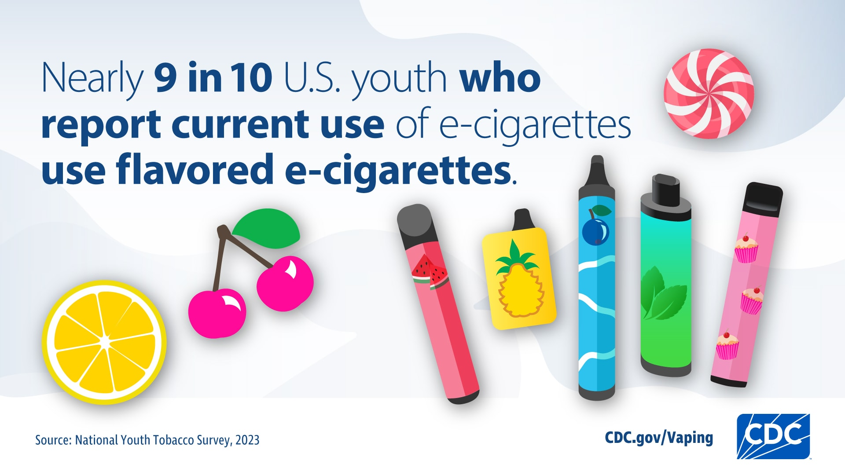
Notes:
The CDC (Center for Disease Control and Prevention) reported that most youth who use e-cigarettes first start with a flavored product
A young person who is used to the taste of candy is more likely to be interested in vaping than a conventional cigarette.
For example, a young person who is naïve to nicotine and tobacco would probably be more likely to begin by experimenting with a mango flavored electronic cigarette, as opposed to a traditional non-flavored cigarette.
The liquid in the e-cigarette, called e-liquid, or e-juice, is not just flavoring; it also contains toxic chemicals like nicotine, propylene glycol, and glycerin.

Slide 26
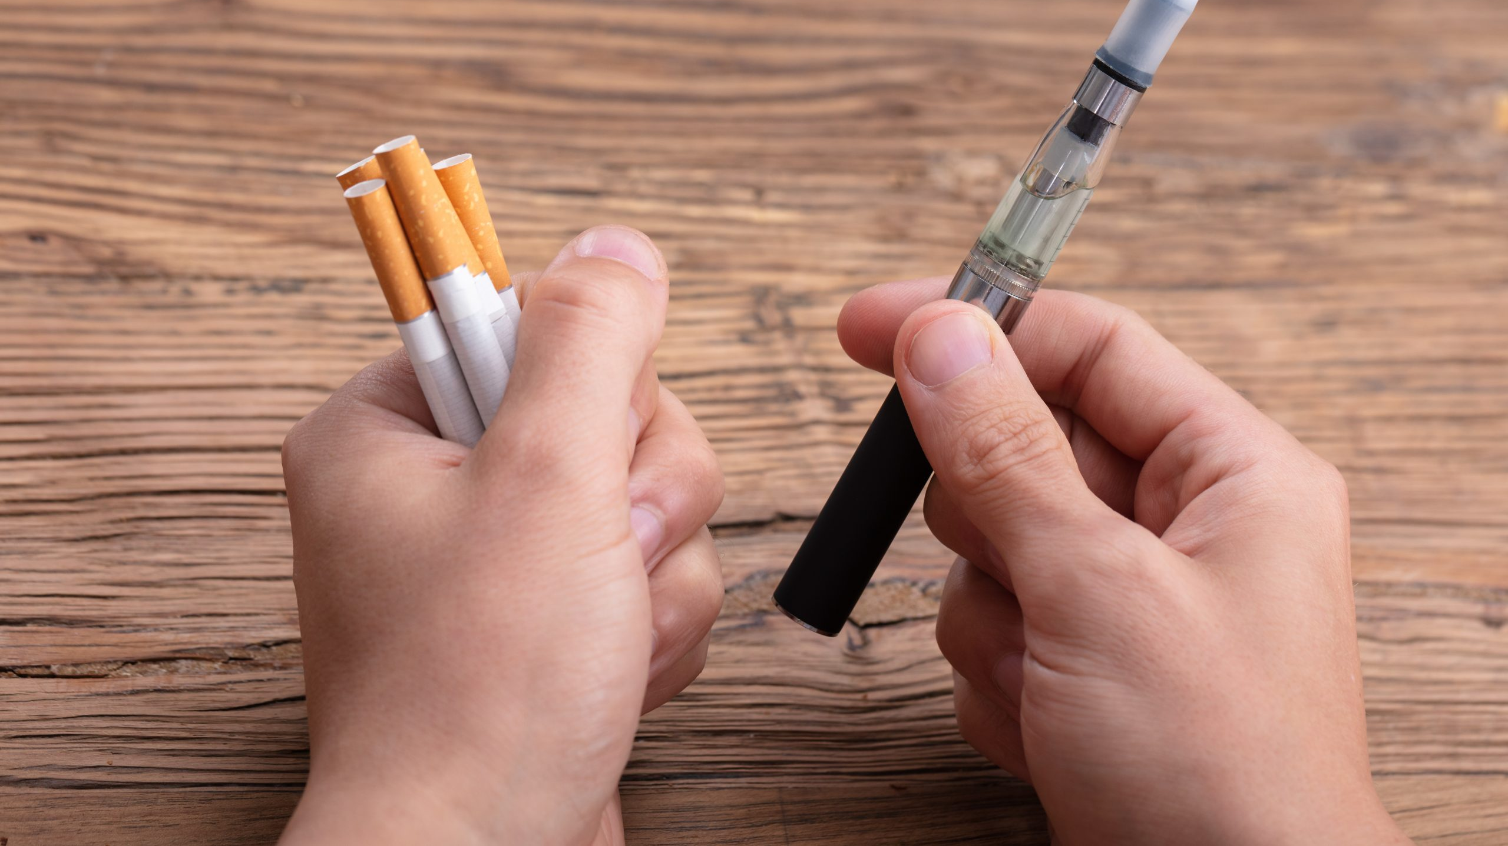

Are e-cigarettes safe?
Notes:
Because your brain is still developing, scientific studies show that it isn’t safe for you to use any tobacco product that contains nicotine.
Some e-cigarette batteries have even exploded and hurt people.
One pods can contain as much nicotine as a pack of cigarettes.
Can still lead to serious lung illnesses and deaths.
Short term effects: chest pain, vomiting, shortness of breath, coughing.
Youth may turn to vaping to try and deal with stress or anxiety, creating a cycle of nicotine dependence. But nicotine addiction can be a source of stress. Withdraws include irritability, restlessness, feeling anxious or depressed, trouble sleeping, problems concentrating etc.
For more info: Commonly Used Drugs Charts | National Institute on Drug Abuse (NIDA) (nih.gov)

Slide 27

8 TIMES
Vaping increases young people’s risk of smoking.
Notes:
You might have seen some people around you vaping. It looks different than a cigarette that is actually burning at the end. It's an electronic cigarette and when it's used you may see a light that turns on.
Vaping increases young people’s risk of smoking.
Experts are concerned that youth – who otherwise might not become smokers – could be lured into trying cigarettes by first vaping nicotine, which as I mentioned earlier, is a highly addictive drug.
The research also showed that young people who reported using e-cigarettes were more than * eight times as likely to start smoking conventional cigarettes as those who were not e-cigarette users.

Slide 28
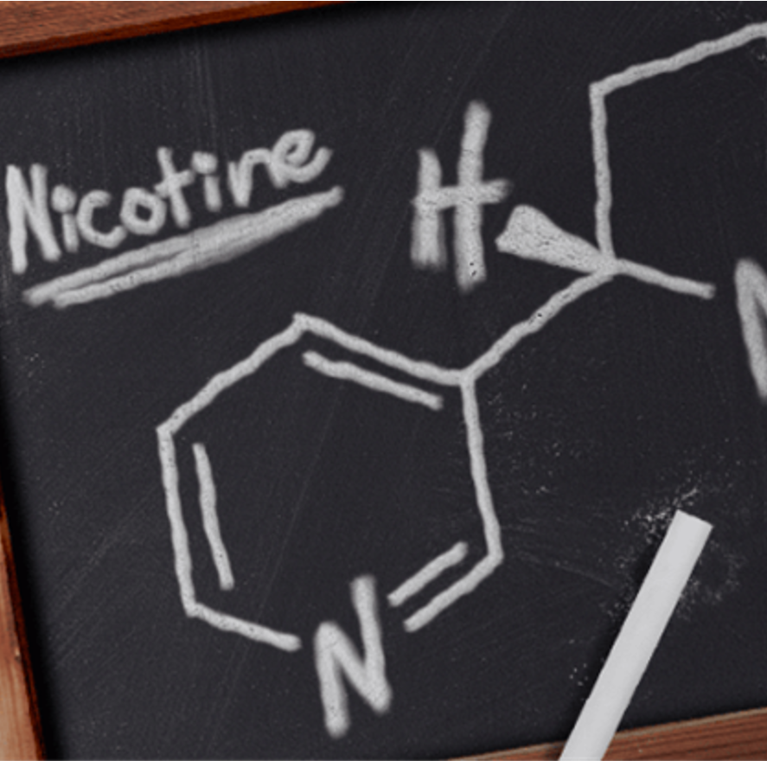
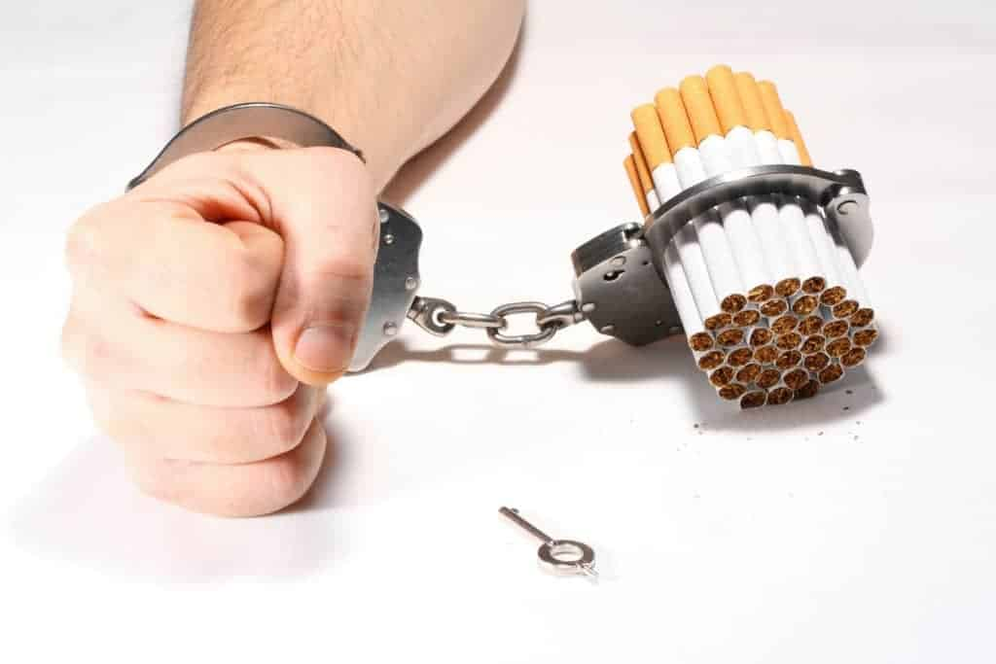
Nicotine is a stimulant, which means it causes your heartrate and blood pressure to increase.
WHY can’t people stop?
Notes:
People who smoke know what can happen if they continue to smoke, but they keep doing it anyway. If you ask them if they could go back and do it over, would they start smoking again, most of them would say “NO”
So, why do they continue to smoke? Because they are addicted nicotine.
Nicotine is a toxic oily liquid that is the chief active ingredient of tobacco.
NICOTINE IS A DRUG. It is a stimulant, which means it speeds up the processes of the body like breathing and heartrate.
Nicotine is highly addictive. (Do you know what addictive means?)
Using Nicotine at your age may make it harder for you to concentrate, learn, or control your impulses.

Slide 29

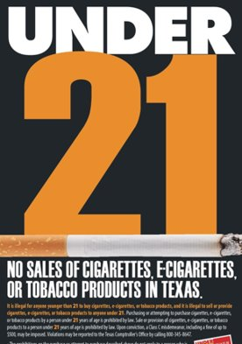

Minors and Tobacco
$250 fine under the age of 21
8-40 hours of community service
Tobacco Awareness classes
Driver’s License revoked for up to 6 months
Notes:
In the state of Texas, you must be 21 years or older to buy or use any tobacco product, including juuls or e-cigs.
These are the legal consequences of a minor in possession of Tobacco
* $250 fine if found with tobacco under the age of 21
* 8-40 hours of community service
* Tobacco Awareness classes
* Driver’s License revoked for 180 days

Slide 30

House Bill 114
Effective September 1, 2023, students caught vaping or with e-cigarettes will be removed from class and placed in a Disciplinary Alternative Education Program, or DAEP
Notes:
The bill also covers any school-sponsored or school-related activity on or off school property. Students caught selling or under the influence also fall under the new bill.

Slide 31


GOOD NEWS!
As soon as someone quits smoking, the body will begin to heal. So, it’s never too late to quit!
Notes:
I’ve talked a lot about the harmful effects of smoking and vaping.
But there is good news: * AS soon as someone quits smoking, the body will begin to heal. So, It’s never too late to quit.
Additionally, Most young people make the healthy choice when it comes to smoking and vaping.
You have the power to be a good friend and to be a positive influence in the world.
You have the knowledge, and knowledge is power!

Slide 32

Peer Pressure Refusal Strategies
BROKEN RECORD | MAKE AN EXCUSE
STATE THE FACTS | WALK AWAY
Notes:
The best way to avoid problems with Tobacco, Alcohol and other drugs, is to make a promise to yourself to never try drugs.
If you are asked to try tobacco, alcohol or other drugs , or if you’re feeling pressured by your friends, there are things you can do to resist the pressure.
We call these techniques Peer Pressure Refusal Strategies.
(Discuss and give examples of strategies and if time permits practice with the students)
Example: Broken Record “No, I don’t smoke. No, I don’t smoke; no I don’t smoke. No, I don’t smoke!”
Example: Make an Excuse: No, I can’t do that, I have a dentist appointment.
Example: State the Facts: No. “Did you know that smoking causes heart disease?” No; did you know that Nicotine is a poison that kills bugs?”
Example: Walk Away: Leave the situation. Leave quickly, as soon as you know that this is not safe, or healthy, leave. The quicker the better.
Tell the students to choose one of the strategies that is their favorite and use it the next time they feel pressured to do anything they don't want to do.

Slide 33

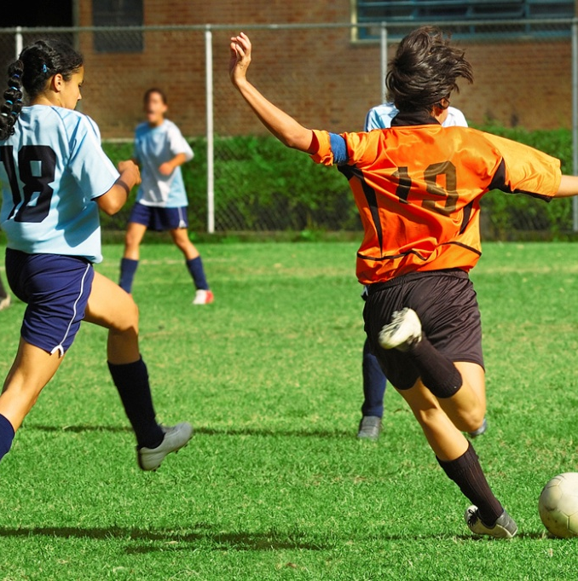


What kind of things can you do that are healthy?

Slide 34


MAKE HEALTHY CHOICES
Notes:
I KNOW I gave you a lot of information. If you can’t remember all of it, Please Remember:
>A good way to avoid substance misuse is to make a personal decision to never try drugs, and don’t befriend people who use drugs.
>When you’re grown up, if you choose to try alcohol, wait until your mid-twenties when your brain is fully developed, and the risk of addiction is much lower.
Make your life goals your priority and don’t let anything get in the way of you achieving those goals.
>Say “YES” to being healthy. There are many healthy choices like playing sports, reading, eating fruits and vegetables, playing music, exercising your brain and body.
We are all empowered with shaping the communities around us through positivity, bravery and strength.

Slide 35

QUESTIONS
What did Mr. Camarena give up his life to do?
How can tobacco hurt a person’s body & brain?
Name an ingredient inside of tobacco?
Why is it not okay to take another person’s medicine?
Notes:
What did Mr. Camarena give up his life to do?
Officer Camarena gave his life in the fight against drugs, and the public wanted to do something to remember the ultimate sacrifice that he made. He was very concerned about the drug problem in this country and wanted to make a difference by helping the people that he cared about.
How can tobacco hurt a person’s body?
Remember the 480,000 deaths per year in the US? The short- and long-term effects (lung cancer, difficulty breathing, stroke)
Name an ingredient inside tobacco?
The same chemicals used in batteries, barbecue lighter, insecticide, toilet cleaner, poison, sewer gas, rocket fuel
Why is it not okay to take another person’s medicine?
It’s important to only take medicine from a trusted adult because they know what’s best for you and your body. If you take a friend’s medicine you may not know the effect it may have on your body.

Slide 36
Resources
www.health.ny.gov/publications/1021
https://www.justthinktwice.gov/article/special-agent-enrique-kiki-camarena
https://tobacco21.org/
file:///C:/Users/edavis/Downloads/Youth-Vaping%20(1).pdf
https://www.dshs.texas.gov/vaping/
https://teens.drugabuse.gov/teens/drug-facts
https://kidshealth.org/en/teens/prescription-drug-abuse.html
https://www.drugabuse.gov/publications/marijuana-facts-parents-need-to-know/want-to-know-more-some-faqs-about-marijuana
The Adolescent Brain (Casey, Jones, & Hare, 2008).

Slide 37
Resources
Recovery Services in Bexar County: 210-SAY-CARE
Recovery Coaching for Adults: www.sacada.org 210-225-4741
Recovery Coaching for young Adults: www.RiseRecovery.org 210-227-2634
TEXAS Mental Health Support Line: 1-833-986-1919 (24 Hour Hotline)
National Suicide Prevention Lifeline: 1-800-273-TALK (8255)
Notes:
Here are some helpful resources: Recovery Services in Bexar County: 210-SAY-CARE
Recovery Coaching for Adults: www.sacada.org 210-225-4741
Recovery Coaching for young Adults: www.RiseRecovery.org 210-227-2634
TEXAS Mental Health Support Line: 1-833-986-1919 (24 Hour Hotline)
National Suicide Prevention Lifeline: 1-800-273-TALK (8255)
Thank you.

Slide 38

South Texas Centre – Dave Coy Building
7500 U.S. Highway 90 West, Suite 201
San Antonio, Texas 78227
Phone: (210) 225-4741  Fax: (210) 225-4768
www.sacada.org
Mrs. Abigail Garza Moore, Chief Executive Officer

