Slide 1
2024​
Red Ribbon Presentation
for​
PreK – 2nd Grade
Notes:
Welcome to Red Ribbon Week 2024!

Slide 2
Being our best selves and making good and healthy decisions!
Notes:
My name is ___________________________________, I am a Prevention Specialist with the San Antonio Council on Alcohol and Drug Awareness, known as SACADA.
Today we are going to talk about Red Ribbon Week and being our best selves and making good and healthy decisions!

Slide 3
Notes:
Our mission at SACADA is to Empower our community to live healthy lives by providing Prevention, Intervention and Recovery Support Services for Children and Adults.

Slide 4
PROGRAMS & SERVICES AT SACADA
Youth Prevention: Project Strong Life offers personalized case management for youth ages 12-19, focusing on social and emotional development and substance use prevention through evidence-based strategies. The Adolescent Substance Use Treatment (TREE Project) targets high school students (grades 9-12), providing early intervention, treatment, and recovery support for those with substance use and/or mental health disorders, including case management. Additionally, awareness presentations on topics such as tobacco/vaping, alcohol, marijuana, and other drug awareness. These services are at no cost to participants.
Coalitions: The Tobacco Prevention and Control Coalition (TPCC) and Breathe Clear Coalition focus on preventing and reducing tobacco use among adolescents in Bexar County through evidence-based community and environmental strategies. The Partnership for Success (PFS) and Circles of San Antonio Community Coalition aim to expand and strengthen the capacity of local prevention providers to implement evidence-based programs that reduce substance misuse and its related problems, as well as promote mental health through community-based services.
Intervention, Treatment & Recovery Support services are provided by Peer Recovery Support Specialists for adults struggling with a substance use disorder by promoting all pathways to recovery and partnering with community organizations across the region to enhance recovery-focused efforts. Recovery services are at no cost to participants.
Education & Training – Fee for court mandated classes for youth and adults including Driving While Intoxicated (DWI), DWI Intervention (2nd+ offenses), and Alcohol Awareness Court/Minor in Possession. SACADA is a certified provider of DWI and MIP by the Texas Department of Licensing and Regulation. Also available is Marijuana Awareness Course and Drug-Free Workplace Training.
Mental Health Awareness Training - SACADA offers Mental Health First Aid (MHFA) and Youth Mental Health First Aid (YMHFA) training to school personnel, emergency first responders, law enforcement, and other community members, enabling them to provide referrals to mental health services. There is no cost, but you must register as space is limited.
Prevention Resource Center – PRC serves as a vital data hub and training liaison for Region 8. Through its role, the PRC compiles and disseminates an annual Regional Needs Assessment, offering a valuable community reference tool. This assessment provides region-specific substance use and related information to support informed decision-making and prevention efforts.
Notes:
There are 6 different programs a t SACADA. I work in Youth Prevention. I have a great job; I get to go around to schools and communities to teach people to make healthy choices!

Slide 5
Notes:
Today I’m here to Celebrate Red Ribbon Week 2024! This year’s Red Ribbon Week Theme is LIFE IS A MOVIE, FILM DRUG FREE.™"
“It serves as a powerful reminder that ordinary Americans nationwide contribute significantly to their communities every day by embracing a drug-free lifestyle.”

Slide 6
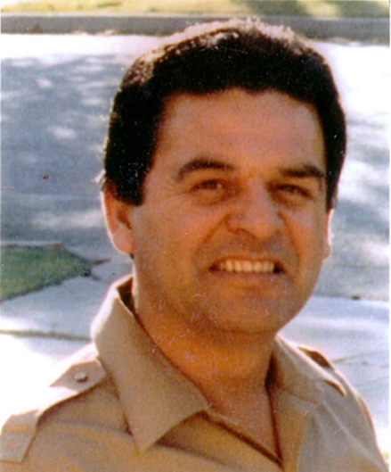
Enrique “Kiki” Camarena 1947-1985
Notes:
Red Ribbon week honors the memory of Enrique “Kiki” Camarena. He was very concerned about the drug problem in this country and wanted to make a difference by helping the people that he cared about.
After his passing, “parents and youth in communities across the country began wearing Red Ribbons as a symbol of their commitment to raise awareness of the destruction caused by drugs in America”

Slide 7
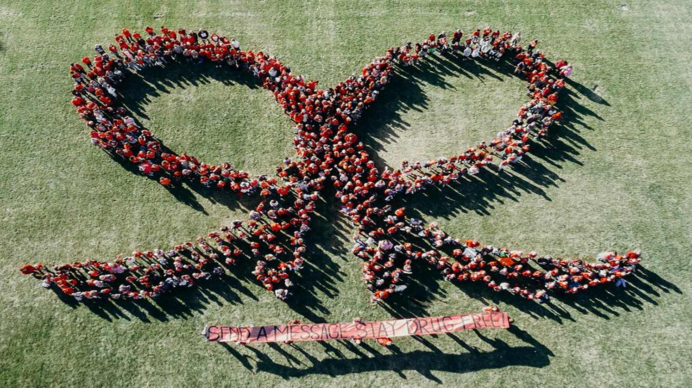
Drug Prevention Awareness Program
Notes:
We honor the memory of Officer Camarena by celebrating Red Ribbon Week
*Click* which is the nation’s oldest and largest Drug Prevention Awareness Program
During Red Ribbon Week we also talk about making good decisions and living a healthy life!

Slide 8
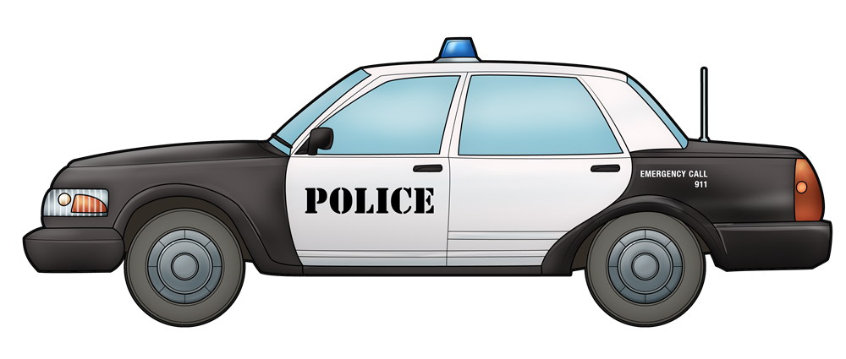
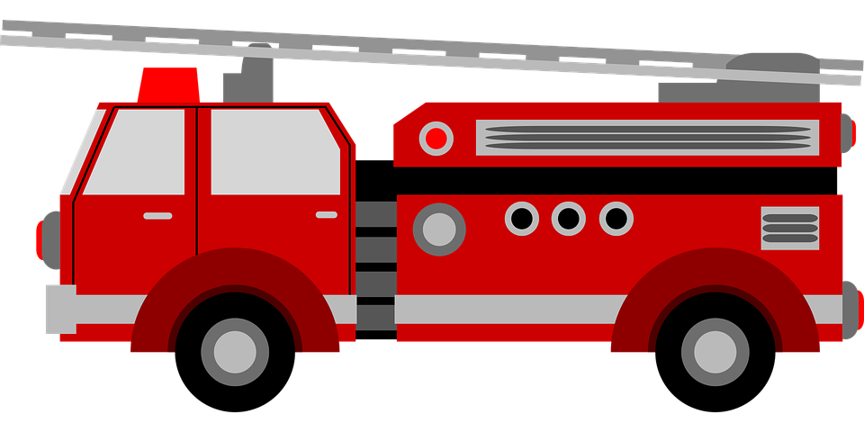
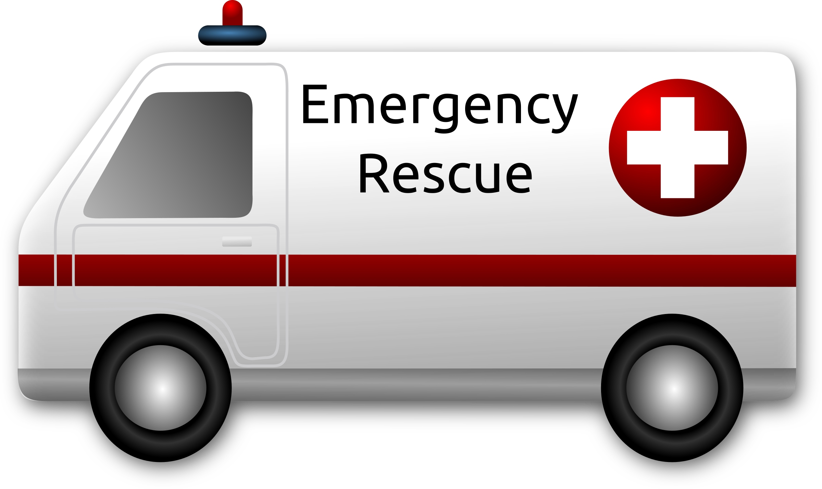
Help us stay safe!
COMMUNITY HELPERS & FIRST RESPONDERS
This Photo by Unknown Author is licensed under CC BY-NC
This Photo by Unknown Author islicensed under CC BY-NC
Notes:
Red Ribbon Week is also a time to honor members of Law Enforcement like
*Click* Policemen
*Click* firefighters
*Click* EMTs and other First Responders who keep us safe!

Slide 9
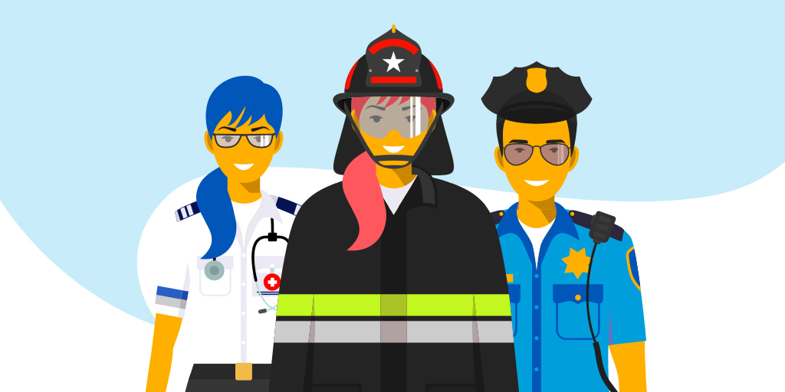
What do you do when you need a first responder?
Notes:
What do you do when you need a first responder? Take a minute and think about the first steps you take.

Slide 10
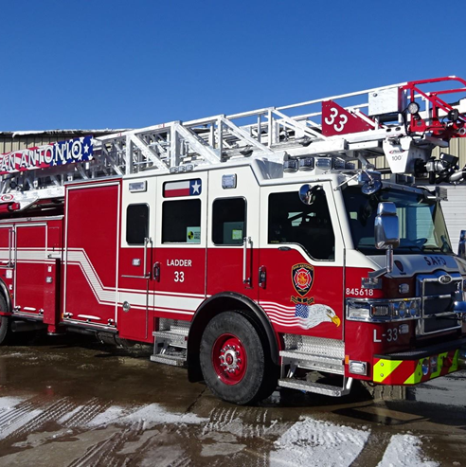
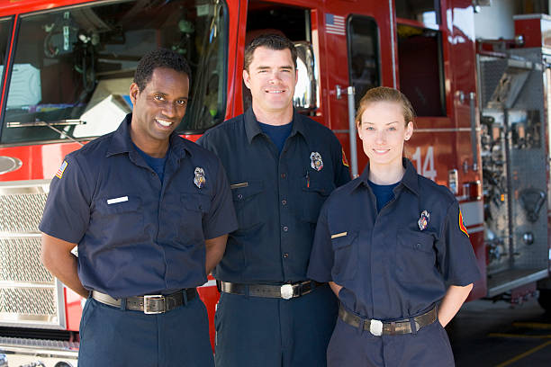
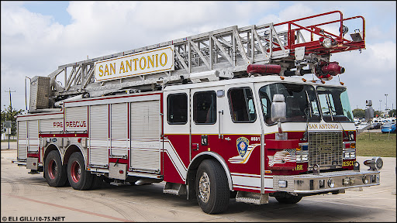
Call 911
Notes:
When there is a fire, or other emergency, we call * “911” and Trained first responders will come and help with the situation.

Slide 11
Before you call 9-1-1, what is the very first thing you should do?
Look for a trusted adult!
Notes:
If there is an emergency, before you pick up a phone to call 9-1-1, what is the very first thing you do?
*Click* Look for a trusted adult!
Try to tell a parent or any grown–up, babysitter or whoever is staying with you.
If you can’t tell a trusted adult, then call 9-1-1 in case of an emergency!

Slide 12
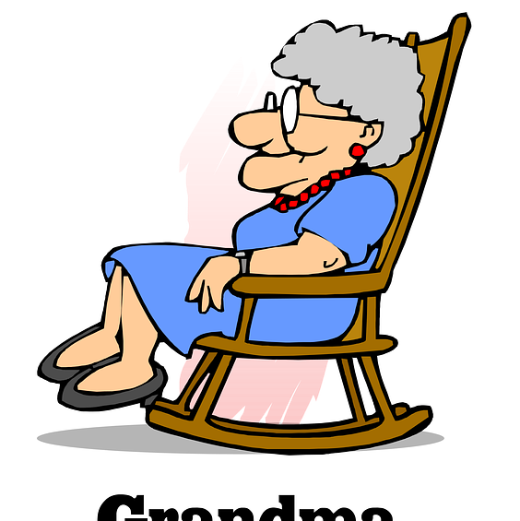
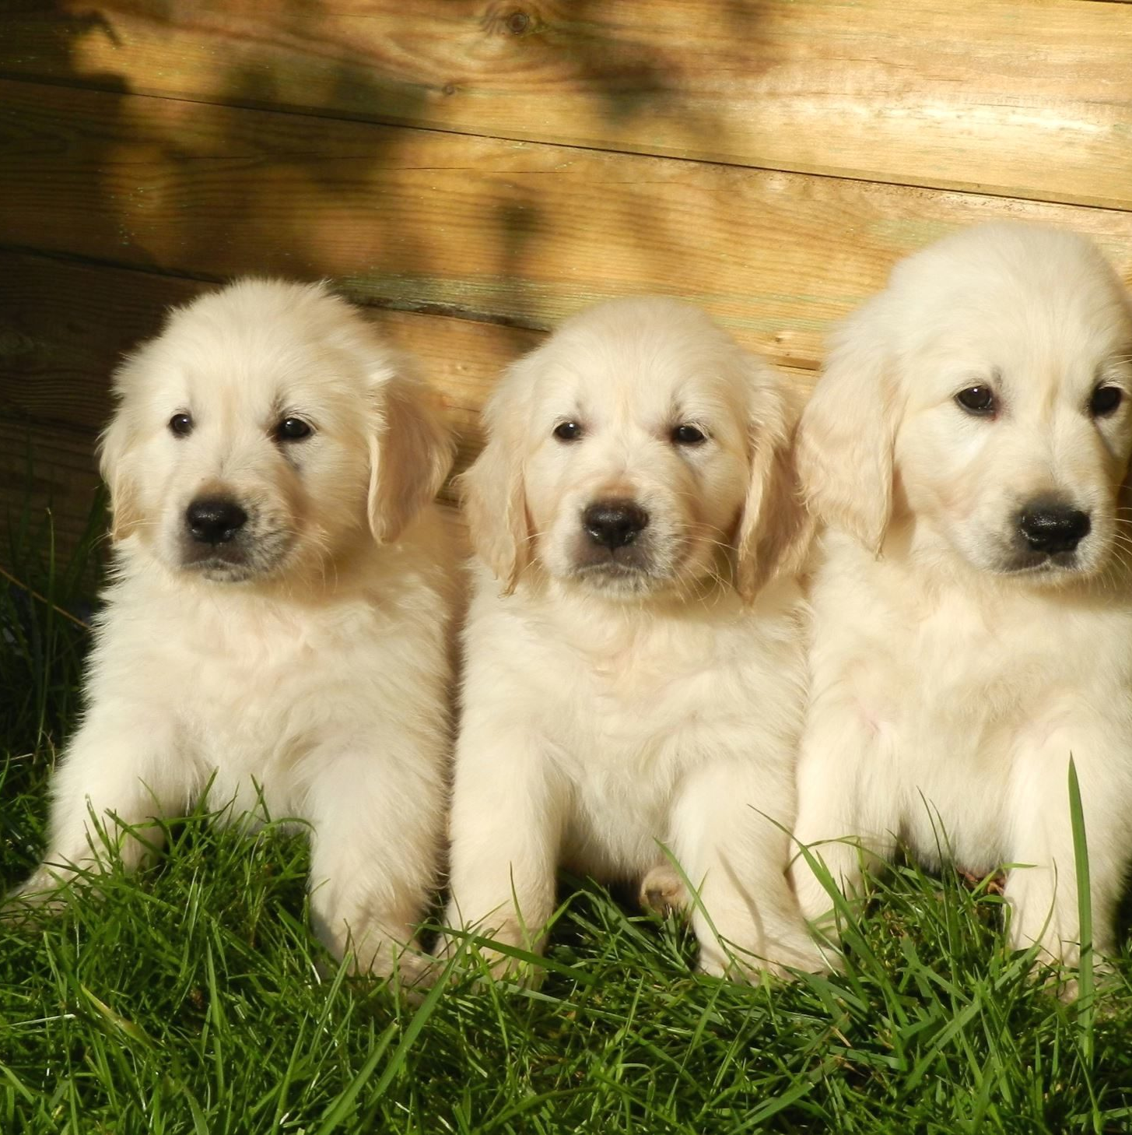
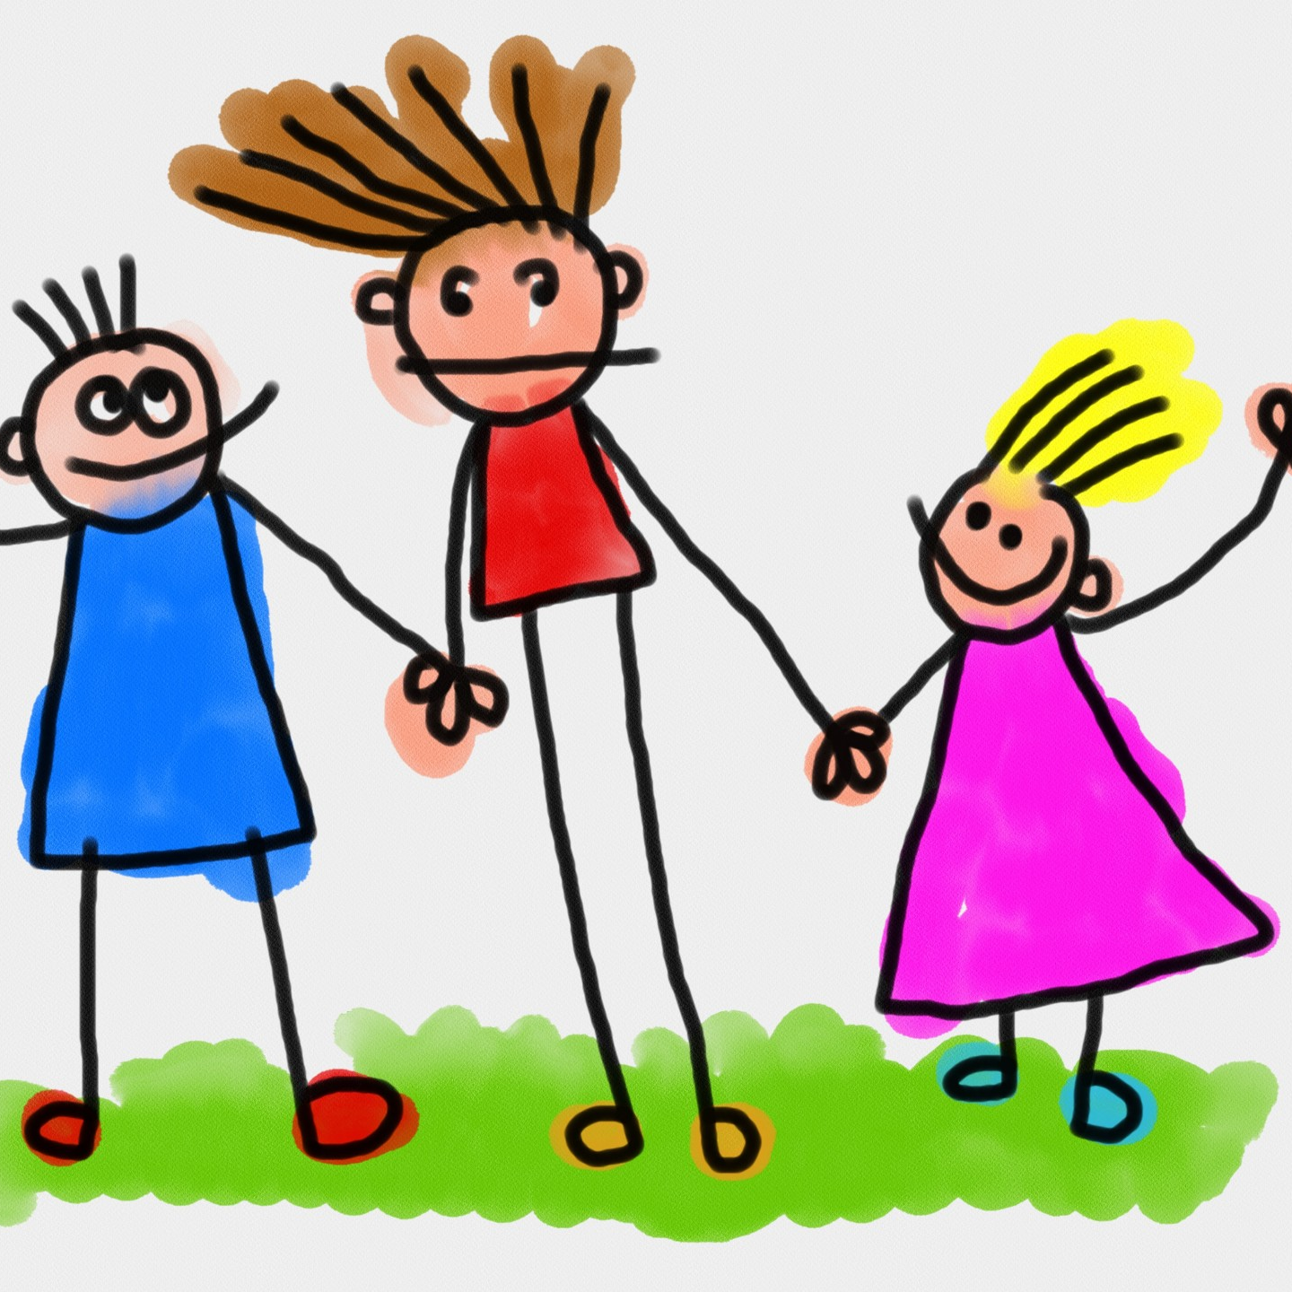
YES!
No
No
What is an emergency?
Notes:
Now let’s see if you know what is a real emergency.
Is it an emergency if you can’t find your puppy?
*Click* No, that is troublesome, but it is not an emergency for which you would call 9-1-1.
How about if your sister won’t play with you, or is being mean? \
*Click* Nope, you can’t call 9-1-1 for that either.
How about if your mother or grandmother has fallen and is hurt, or you can’t wake up your grandparent?
*Click* Yes, those are true emergencies, and you could call 9-1-1 if there isn’t another adult around to help.

Slide 13
The 911 Song!
Notes:
To help you remember to call 9-1-1 for help I found this song, sung to the tune of “Three Blind Mice”
As you start to understand and remember the lyrics you can start to sing along. After the video we will all sing it together!
Helps on the way. Helps on the way.
If I need help, I know what to do.
I can call the police, fire and ambulance, too,
It makes me feel safe to know what to do.
Dial 9-1-1, Dial 9-1-1

Slide 14
9-1-1 SONG sung to “Three Blind Mice”
Help's on the way. Help's on the way.
If I need help, I know what to do.
I can call the police, fire, ambulance too
It makes me feel safe to know what to do.
Dial 9-1-1, Dial 9-1-1
Notes:
I will sing it and then you guys can repeat after me!
If you would like to sing with me feel free!
Helps on the way. Helps on the way.
If I need help, I know what to do.
I can call the police, fire and ambulance, too,
It makes me feel safe to know what to do.
Dial 9-1-1, Dial 9-1-1

Slide 15
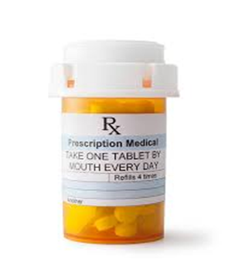
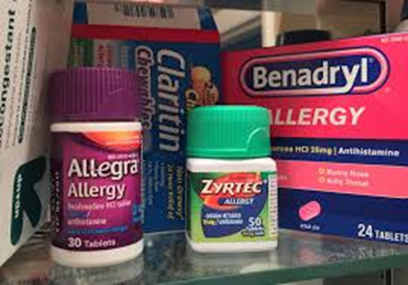
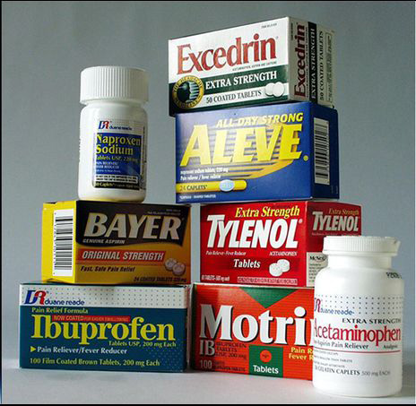
Medicine
Antibiotics
Over the Counter Allergy Medicine
Medicines
Over the Counter
Pain Relievers
Notes:
Did you know a drug is anything that changes the way your mind or body work.
Today we are going to talk about Medicine, which is a helpful drug, and when used correctly can make people feel better.
Medicines, should always be given to you by a trusted adult, and they can be very helpful.
Examples of some medicines are
*Click* Antibiotics - which are prescribed by a doctor, and can help your body fight an infection
*Click* Allergy medications – which a trusted adult can give you if you are experiencing allergies
*Click* Pain relievers – which a trusted adult can give you to help you if you are hurt
These are all examples of Medicine - which are helpful drugs.
Medicines like these are NOT things you should take without permission.
Only take medicine from a trusted adult, like a parent, grandparent, doctor or nurse.
These things you don't share with anyone. You should always tell a trusted adult if you find something, laying around, that looks like a pill or other medicine.

Slide 16
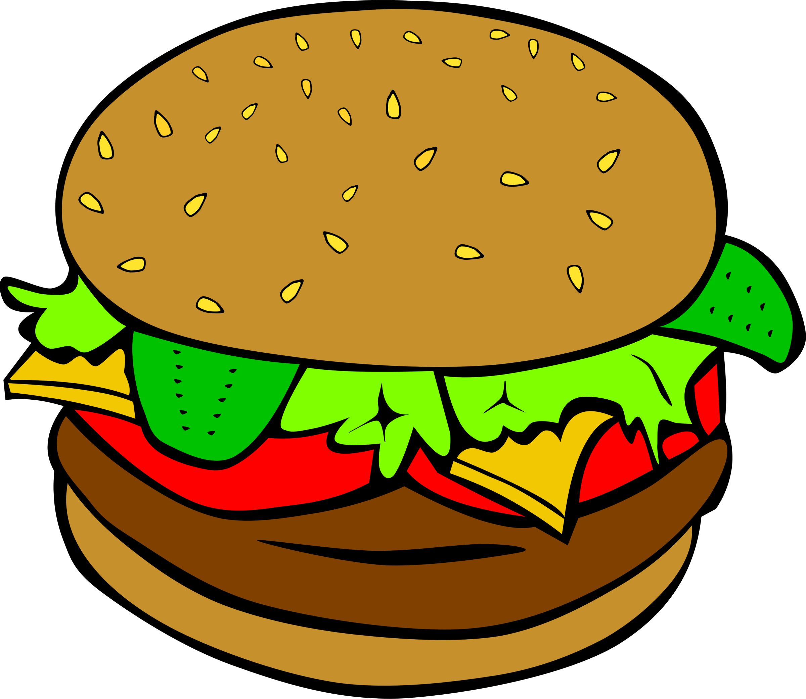
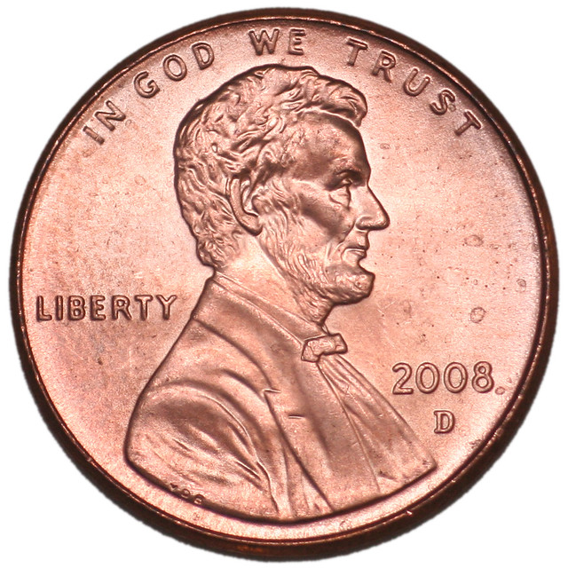
SAFE OR NOT SAFE?
(To Put in Your Mouth)
Notes:
Let’s look at some things, including medicines, that might be Safe, or Not Safe.
Think for a minute, of these things, think, “What is safe to put in my mouth….”
I see some things that are safe to put in your mouth and some things that are NOT safe to put in your mouth…
And remember this is with
** Start from top left and go to the right, then go to the bottom line and go left from right… the clips move based on if they are safe or unsafe to put in your mouth.

Slide 17
SAFE OR NOT SAFE?
(To Use WITHOUT Adults permission)
Notes:
Now let’s look at the items that are not safe to put in your month.
Some of these are safe for you to use by yourself and some are not. Take a minute to think what up here is ok for you use by yourself.
** Start from top left and go to the right, then go to the bottom line and go left from right… the clips move based on if they are safe or not safe to use by yourself.

Slide 18
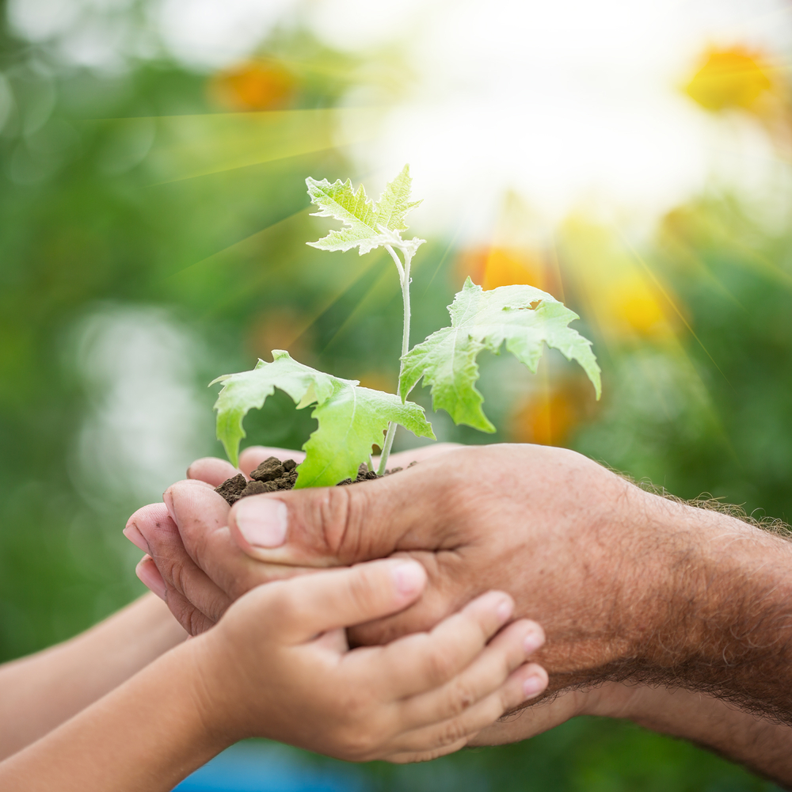
During Red Ribbon Week we want to:
STAY HEALTHY!
Notes:
During Red Ribbon Week we talk about living healthy lives and making healthy choices.
Let’s go over some things that you can do to stay healthy…

Slide 19
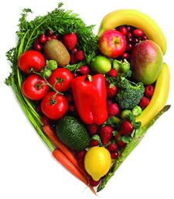
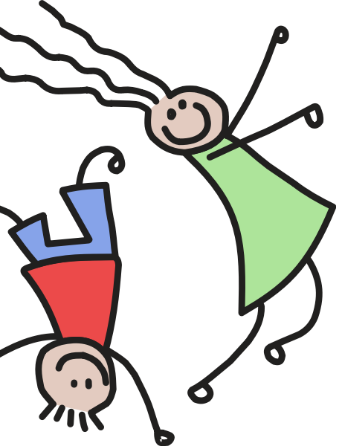
What are some ways we can stay healthy?
This Photo by Unknown Author is licensed under CC BY-NC
This Photo by Unknown Author is licensed under CC BY-NC-ND
Notes:
Let’s take a moment and think about some way to stay healthy!
What are some ways you stay healthy?

Slide 20
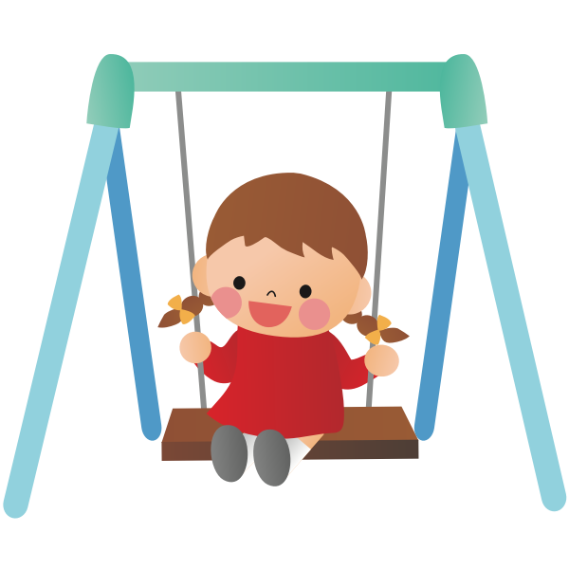
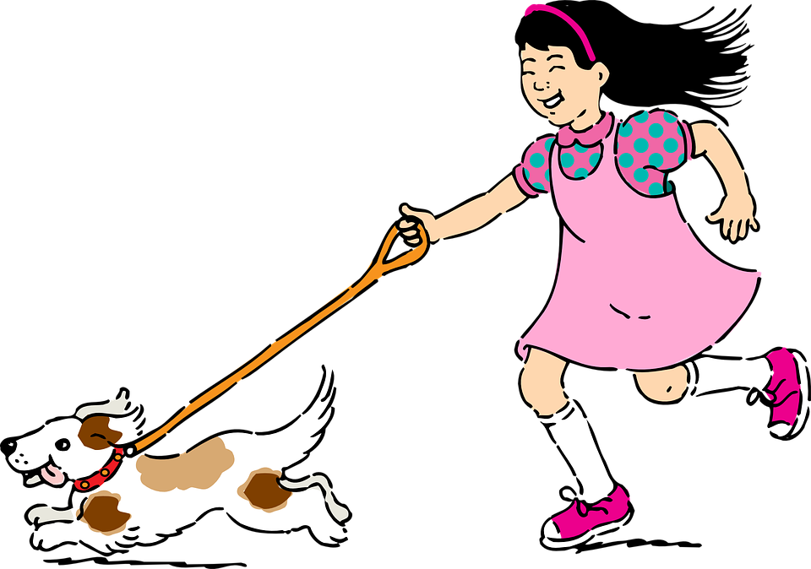
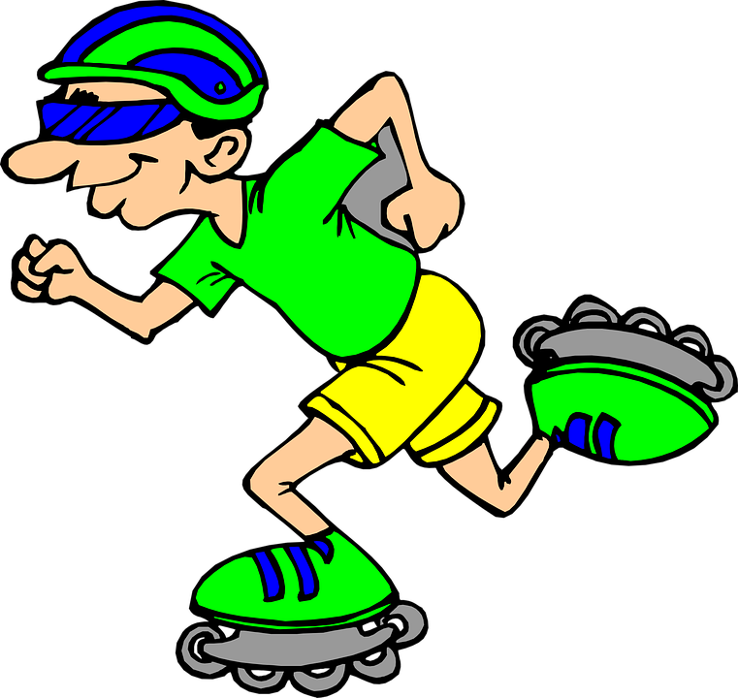
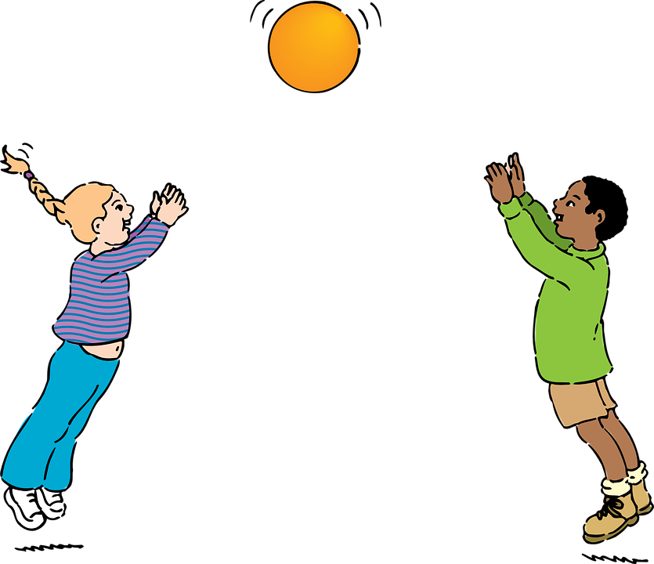
EXERCISE!
Notes:
One way we can stay healthy is to exercise every day!
Get outside in the fresh air, play and run around, these are all great ways to get exercise!

Slide 21
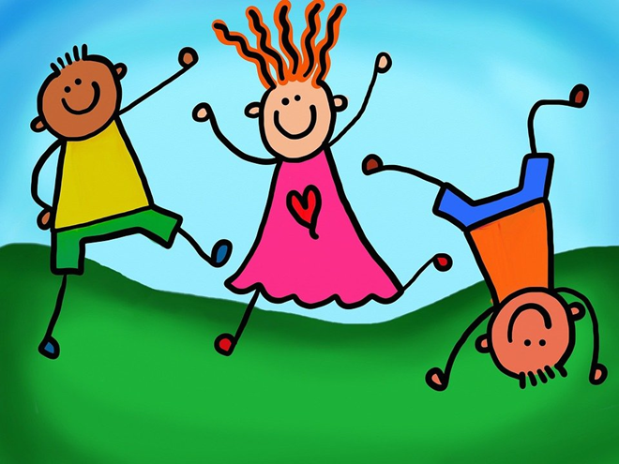
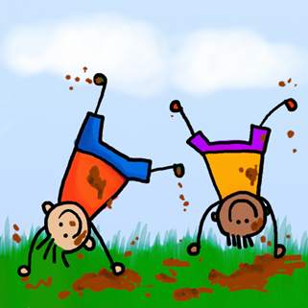
How do YOU exercise?
Notes:
What are some ways you exercise?

Slide 22
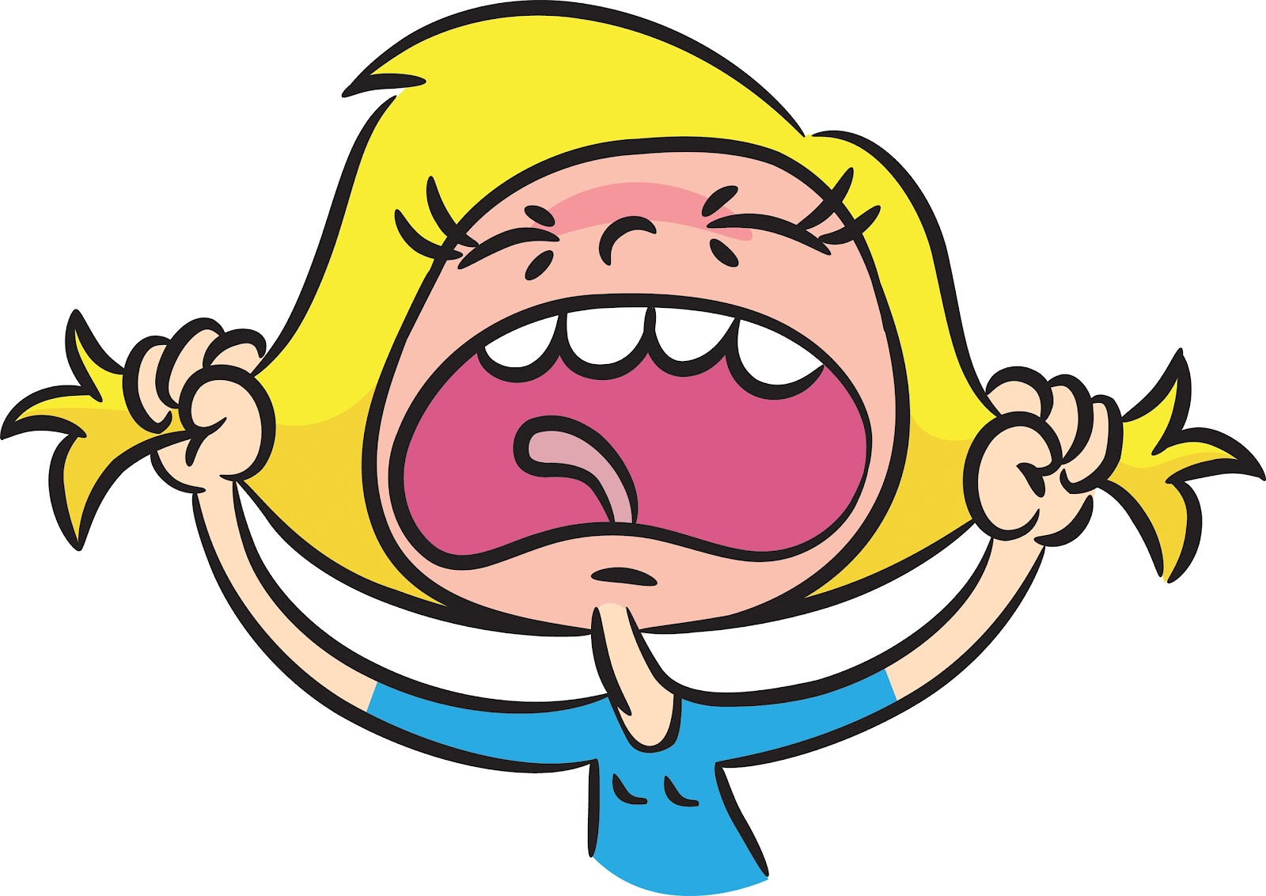
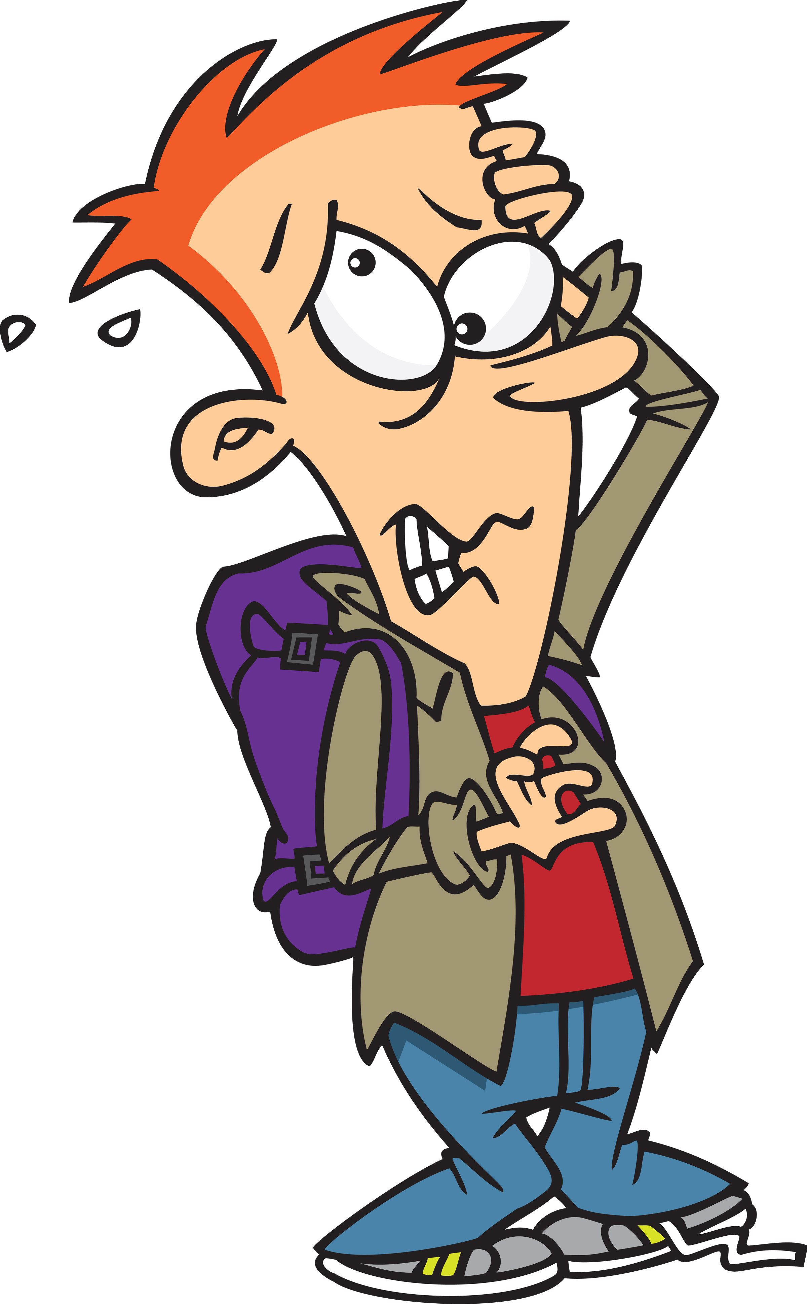
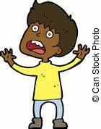
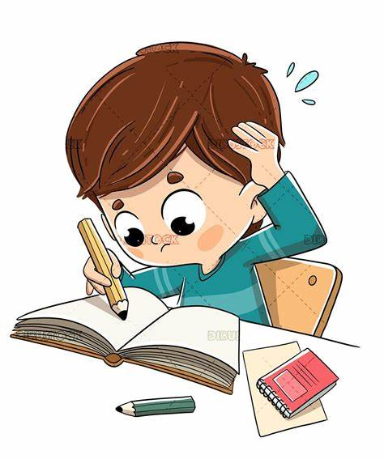
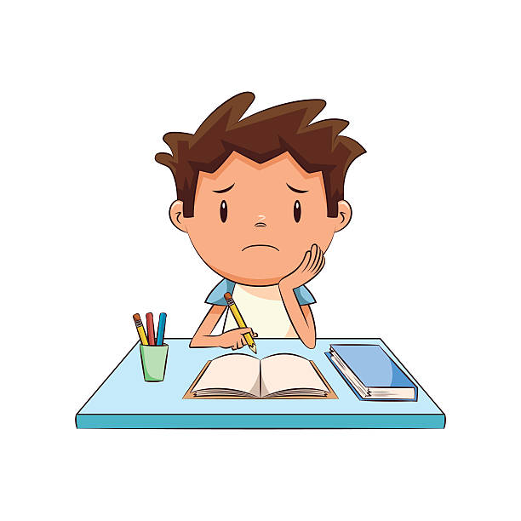
Who Has Felt Stress Before?
Notes:
Who here has felt stress before?
Most likely everyone has felt some sort of stress before.

Slide 23
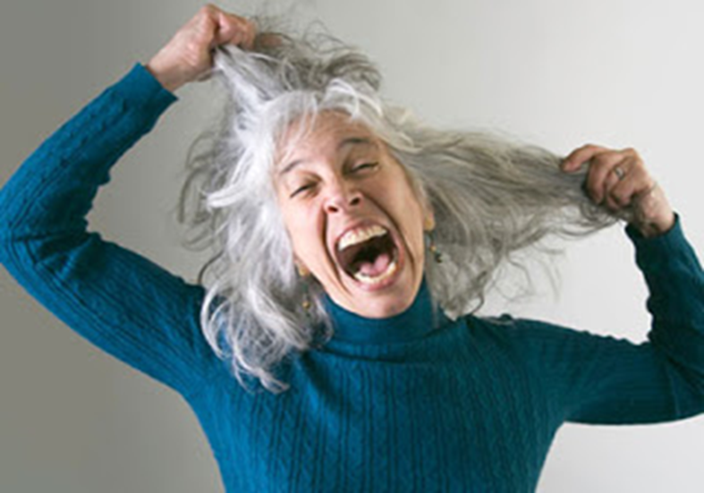
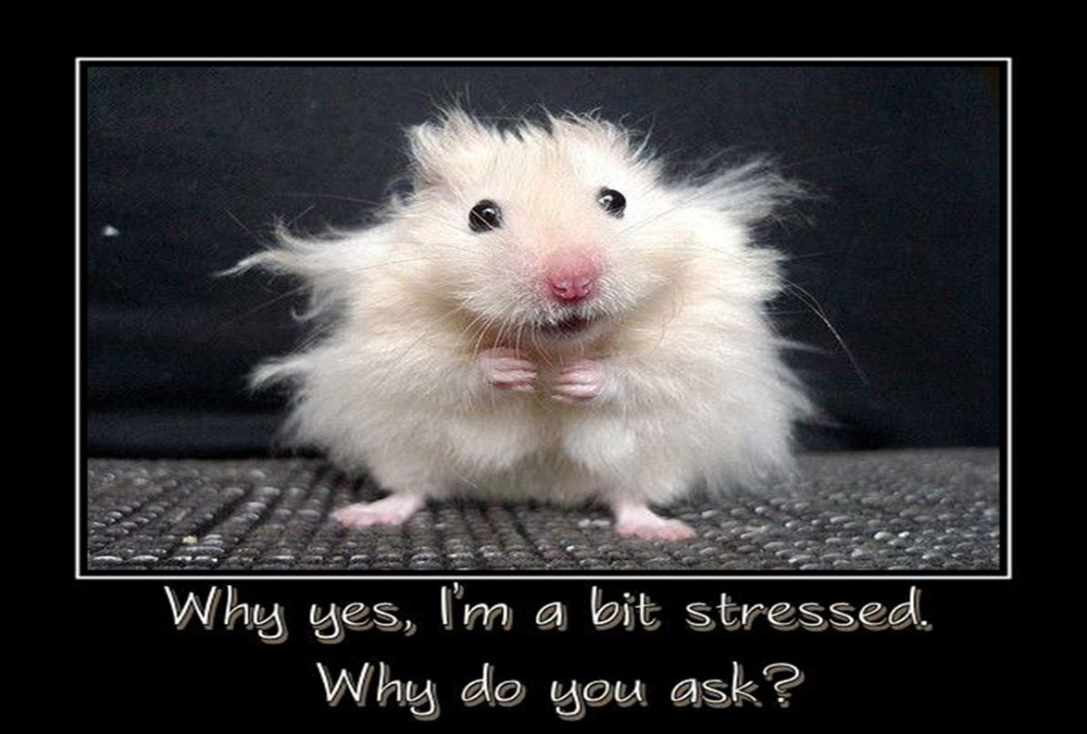
Stress is…
That nervous, uptight, uneasy, feeling that we all experience from time to time.
Notes:
Incase you don’t know, stress is “that nervous, uptight, uneasy, feeling that we all experience from time to time.
Some example someone your age my feel stressed about are….
Learning how to read and write. That can be very stressful, but you must remember there are lots of people who are around to help you. You teachers, your family, other people in the school. If you are feeling stressed about school and education find someone to help you.
You might feel stressed if your pet goes missing. That is super scary and something that would make anyone feel uneasy. When we are going through something like that we are feeling stressed because we don’t know what is going to happen. Now, when we lose our pet do we call 911? Remember we went over this earlier…..
No, we don’t call 911, but we find a trusted adult to help us look. That trusted adult can also help you manage the stressed out feelings you are experiencing.

Slide 24
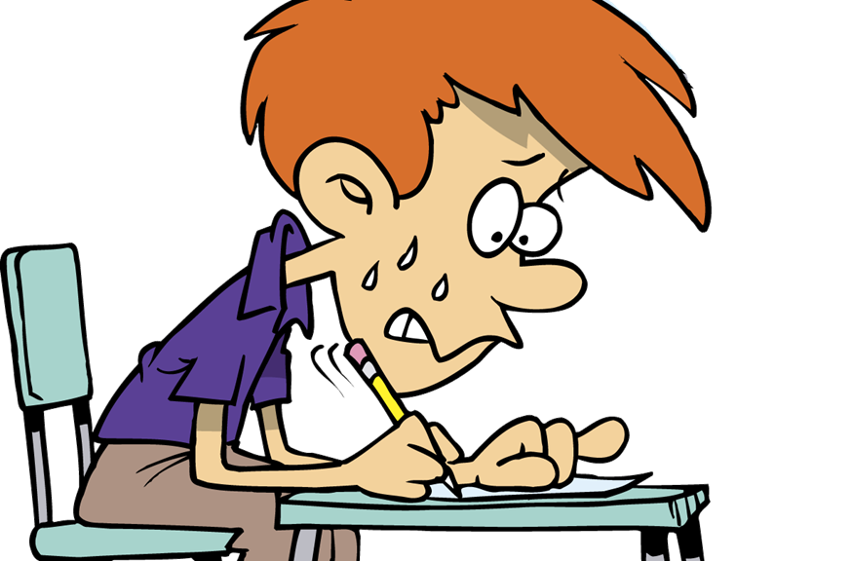
Physical Signs of Stress (Signs that your body gives you to alert you to Stress)
Racing Heart
Shaking Hands
Shaky Legs
Clenched Fists
Red Face
Headaches
Tense
Tight Mussels

Slide 25
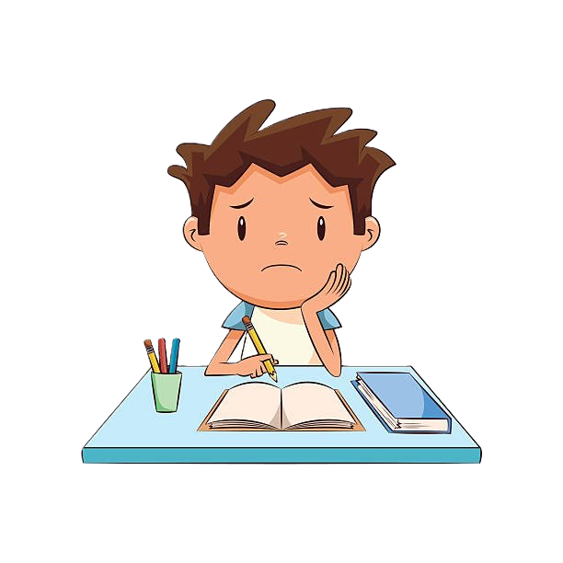
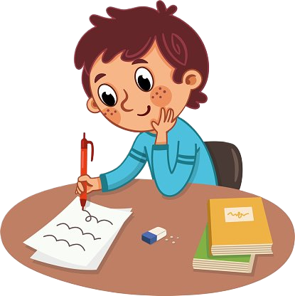
Some amount of stress can be good for you
Notes:
I want to point out that Stress is not always bad;
Stress may motivate you to study for a test, or practice before a “try-out”
We all have to try and learn new things, which can cause stress, because sometimes change is scary and stressful, but if we never try these new things because we are worried about stress, we will never learn anything new or get to have new experiences.
So some stress is good, but we need to learn to how handle any stress that we may face….

Slide 26
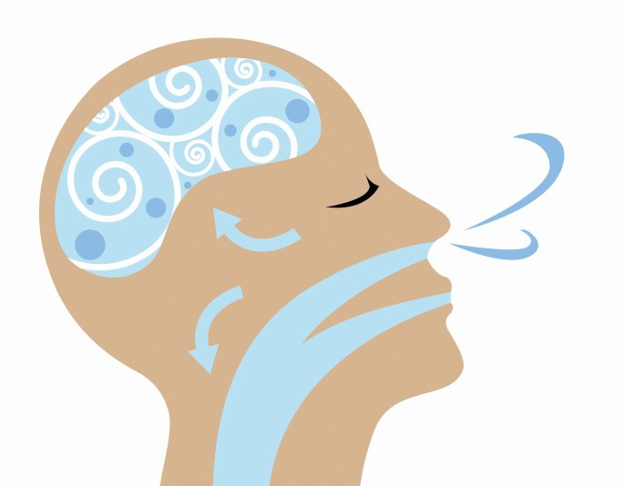
1… 2… 3… 4…
Breathing
Notes:
One great way to handle stress is to take some deep breaths in and out
*Click*
Counting in you head or having someone count for you while taking deep breaths is very helpful

Slide 27
Belly Breathing

Slide 28
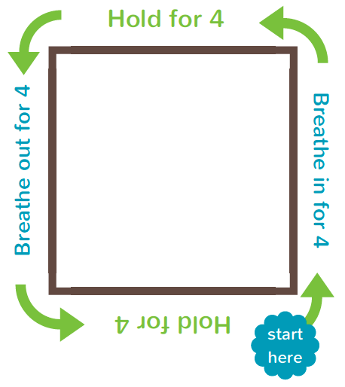
Breathing Square
Notes:
We are going to take some deep breaths, following the path of this breath square!
We are going to start where the arrow is pointing, and I will count out loud for you.
Take a deep breath in for 1… 2… 3… 4… hold it for 1… 2… 3… 4… and breath out for 1… 2… 3… 4… hold it for 1… 2… 3… 4…

Slide 29
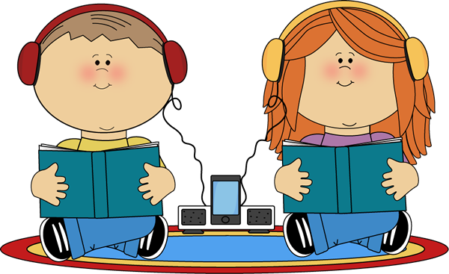
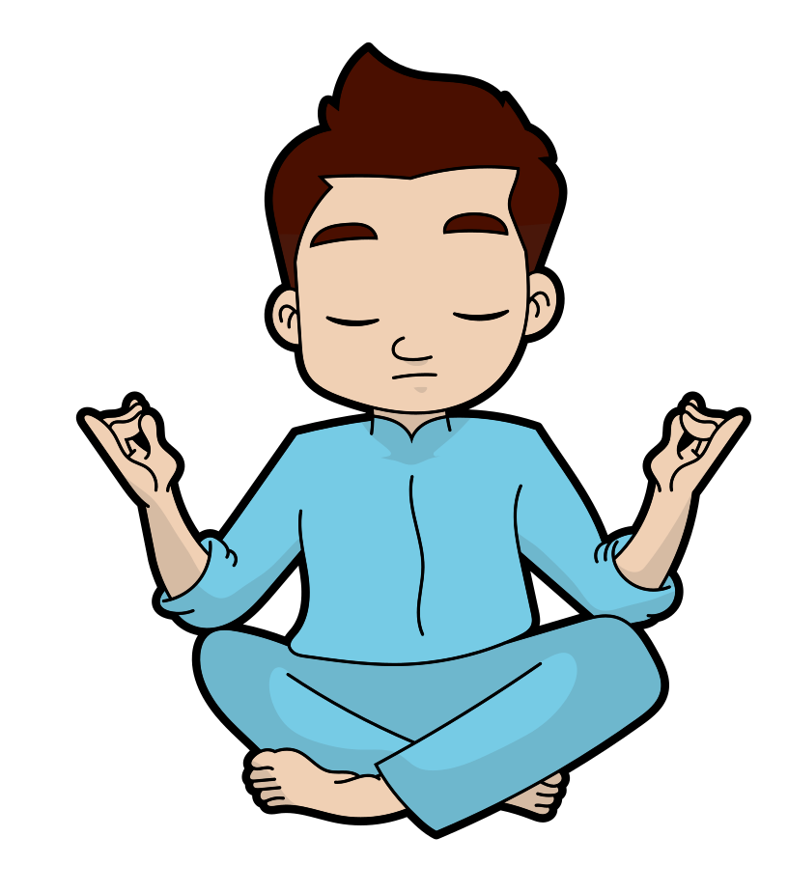
RELAX!
This Photo by Unknown Author is licensed under CC BY-SA
Notes:
Along with breathing, when we are stressed, being able to relax, meditate, daydream, and sleep are all great ways to stay healthy.

Slide 30
10 hours
REST
Notes:
Getting enough sleep is super important for children your age to stay healthy.
*Click* It is recommended for you all to sleep at least 10 hour each night!
When we get enough sleep, we are prepared and energized for the day ahead.

Slide 31
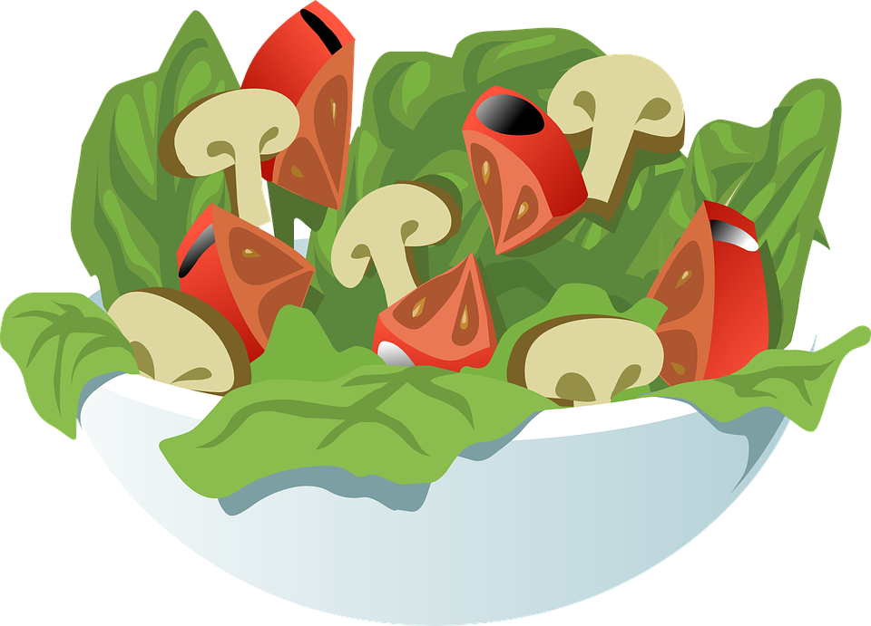
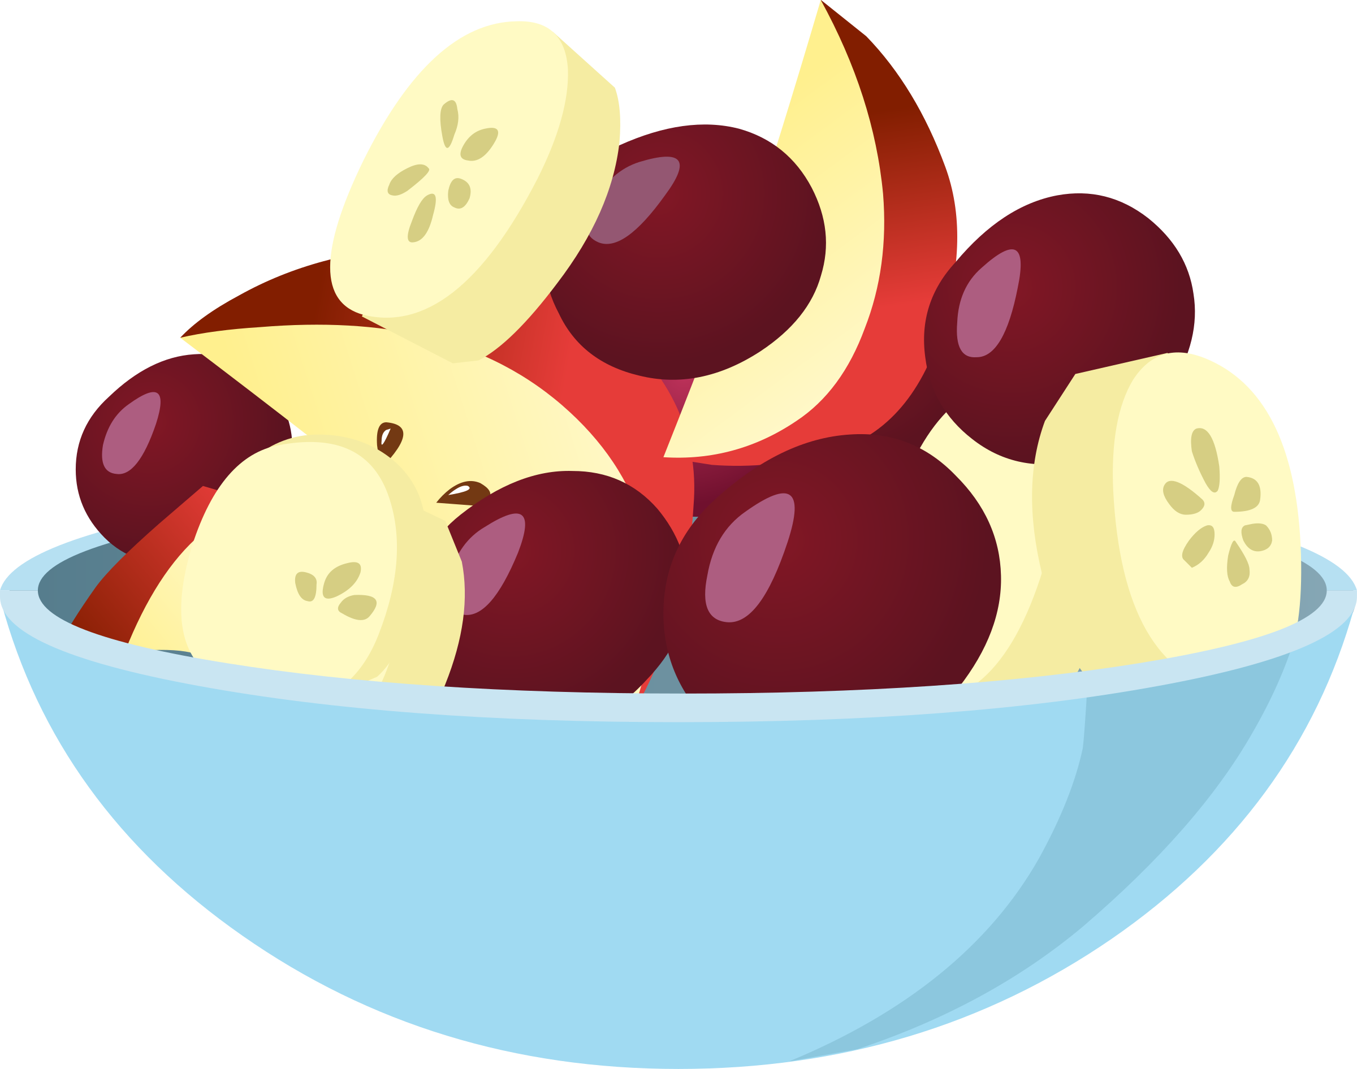
HEALTHY FOODS!
Notes:
Having a balanced diet is a great way to stay healthy!

Slide 32
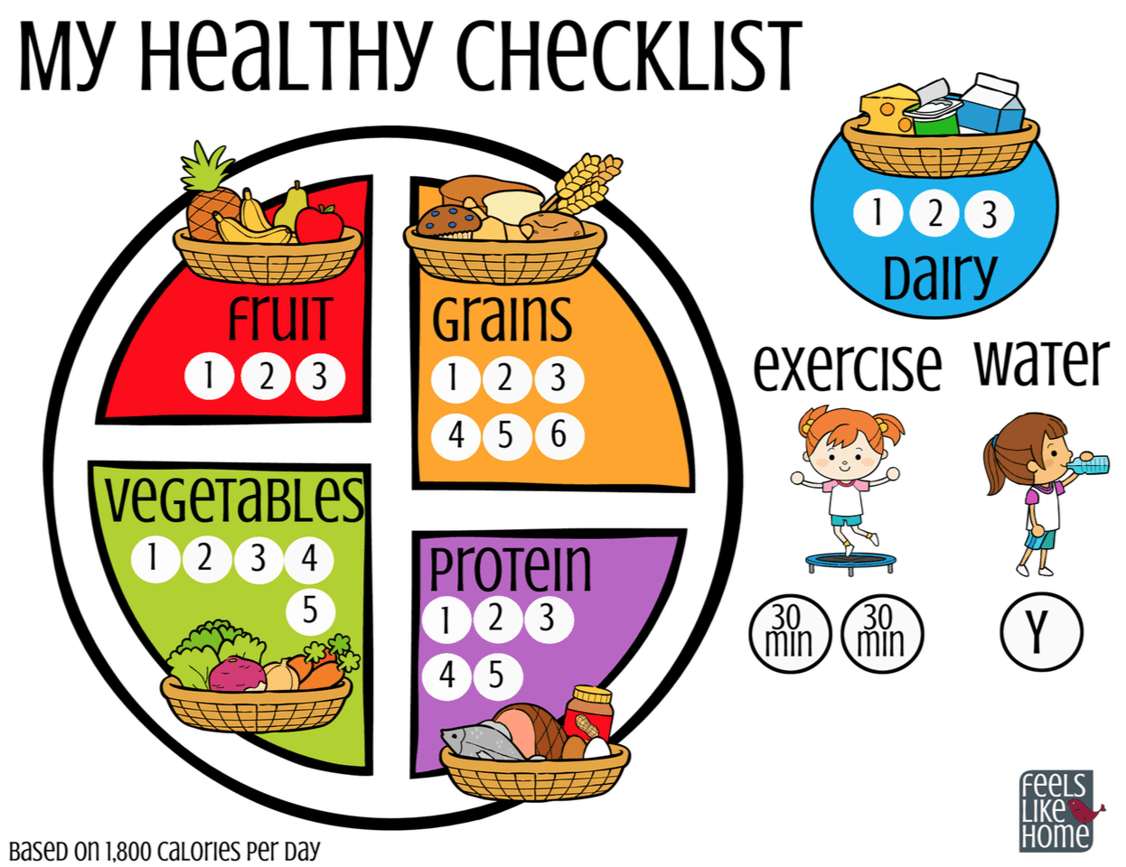
What is a balanced diet?
Notes:
A balanced diet is being sure to eat a variety of healthy foods and making sure you are getting your fruits & vegetable, grains, like bread and protein which is found in meat. You should try to avoid lots of sweets and processed foods.
Raise your hand if you think you know what a processed food is. It’s ok if you don’t know cause it’s a tricky word.
A processed food is anything that has been changed from its original form and has other stuff added to it, like more sugar and salt. An example would be an apple versus an apple breakfast bar. Although the apple breakfast bar has apple in it, they added other stuff to make it into a bar and sometimes that stuff can be unhealthy for you, like adding too much sugar. Most of the time it is better to just have an apple.
You also want to be sure to drink lots of water.

Slide 33
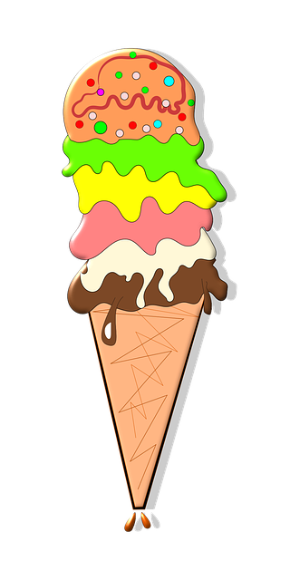
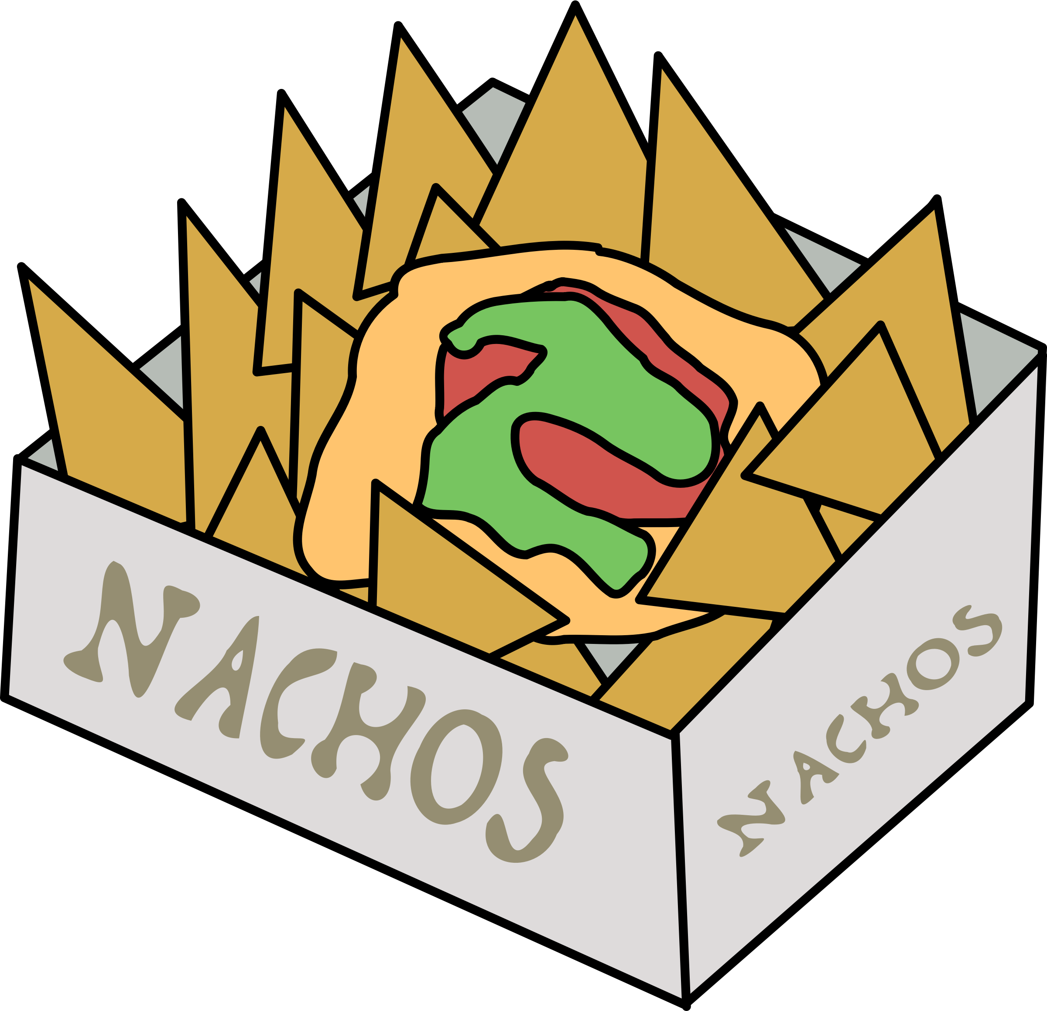
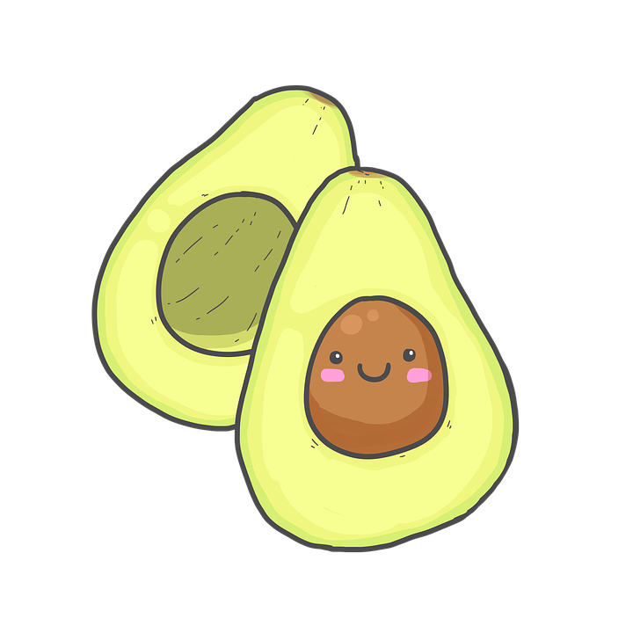
Healthy or UnHealthy?
Notes:
Let’s look at some food items.
Some of these are healthy for you and some are not. Take a minute to think what up here is healthy and what is unhealthy.
** Start from top left and go to the right, then go to the bottom line and go left from right… the clips move based on if they are Healthy or Unhealthy.

Slide 34
Unhealthy
Notes:
So just because these things are unhealthy does that mean we can never have them?
Every now and then they are ok, but we should be sure to balance them with other healthy foods!

Slide 35
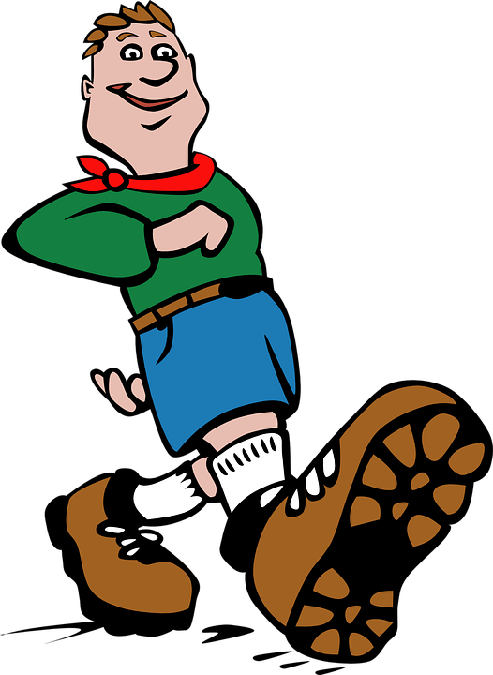
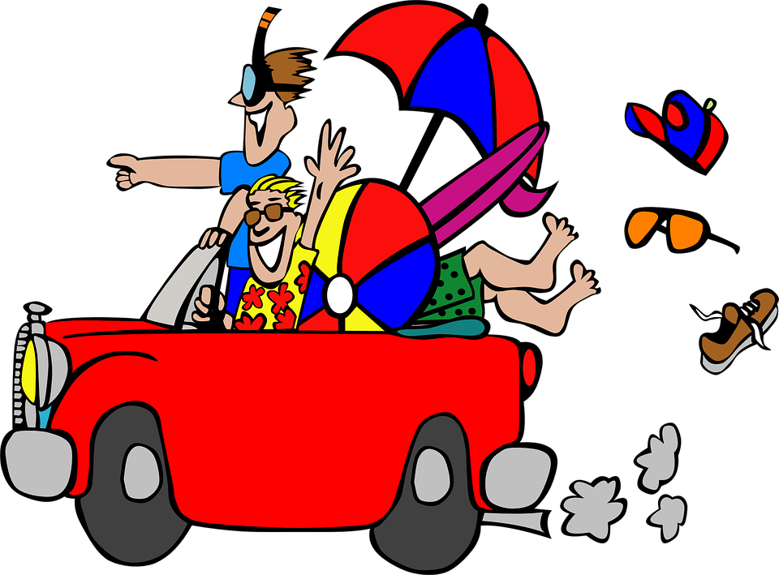
GET OUTSIDE!
Notes:
It is important to get outside everyday. Our bodies soak up vitamins like vitamin D from the sun. It is important to breath in fresh air and when we are outside, we can run around and do things we might not be able to do inside.
But whenever you go outside you always need to be sure to tell a trusted adult! This helps you stay safe by making someone always knows where you are!

Slide 36
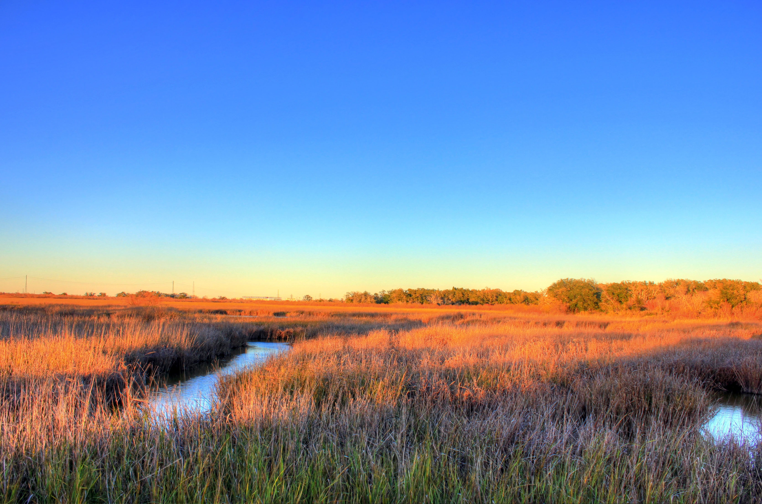
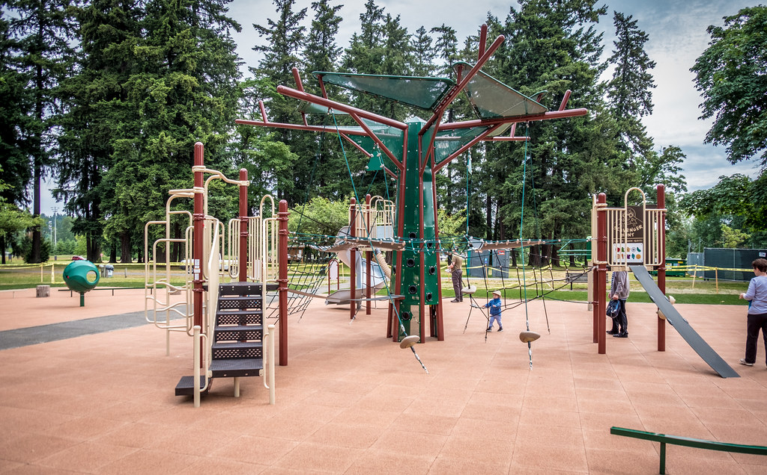
What do you like
to do outside?
Notes:
What do you like to do when you are outside?
I like to walk my dog, go walk around, and I love sitting outside and taking some deep breaths!
If you are going to be in the sun what should you always remember?
Sunscreen, a hat, sunglasses, etc.

Slide 37
ALWAYS BE SAFE!
Notes:
Being safe is very important to living a healthy life!
*Click* You should always remember to wash your hands to help prevent you getting sick or passing germs to someone else.
When washing your hands, try to count to 20 or sing the happy birthday song twice
*Click* Look both ways before you cross the street, and if there is a crossing guard be sure to wait until they say you can cross.
*Click* Always follow safety signs and follow the safety rules your parents, teachers, and other trusted adults have given you.
*Click* & *Click* Be sure you wear a helmet and always wear your seatbelt while you are in a moving vehicle.

Slide 38
BUT LAST BUT NOT LEAST…

Slide 39
HAVE LOTS OF FUN!!
This Photo by Unknown Author is licensed under CC BY-NC
Notes:
Have lots of fun!!
Living a healthy life is fun, you should laugh, sing, play and do all sorts of things that make you happy!
You should always be trying to make new friends to do these fun things with!
And Remember: A good friend will help others make healthy choices!

Slide 40
MAKE HEALTHY CHOICES
Notes:
Don’t let anything get in the way of you achieving your goals.
>Say “YES” to being healthy. There are many healthy choices out there, and so many more than we talked about today, the list is endless!
We are all empowered with shaping our communities through positivity, bravery and strength.
And don’t forget to Celebrate Life, Live Drug Free because*Click* you are all worth it!
Thank you!

Slide 41
South Texas Centre – Dave Coy Building
7500 U.S. Highway 90 West, Suite 201
San Antonio, Texas 78227
Phone: (210) 225-4741  Fax: (210) 225-4768
www.sacada.org
prevention@sacada.org

